Slide 1
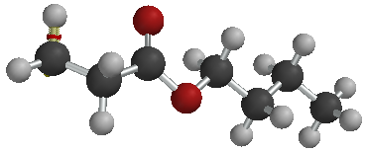
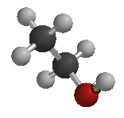
Functional Groups
Double bonded Oxygen
And
Organic Reactions
Kenneth E. Schnobrich

Slide 2
What is a Functional Group
Functional groups are combinations of atoms that generally give the compound –
Characteristic properties
Place the compound in a “specific category”
Alcohols
Primary
Secondary
Tertiary
Ethers
Aldehydes
Ketones
Acids
Esters
Amines
Primary
Secondary
Tertiary
Amides
Dihydroxy & Trihydroxy alcohols
Note the similarity

Slide 3
Alcohols
All alcohols are identified by the presence of the “-OH” or hydroxyl group.
Primary alcohols are indentified by the presence of the “-OH” group on a terminal (or end) carbon atom. In the simple primary alcohols the compound name always ends in “ol”.
CH₃CH₂OH or this is Ethanol it takes it’s name from the two-carbon base

Slide 4
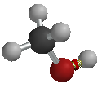
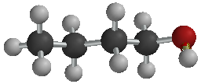
Alcohols
CH₃OH or this is Methanol. It’s name comes from the one carbon base Methane. We just drop the “e” and add “ol”.
CH₃CH₂CH₂CH₂OH or this would be n-Butanol.
Notice that in each case the –OH group was on an end carbon making it a primary alcohol.

Slide 5
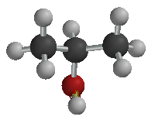
Secondary Alcohols
Secondary alcohols all have the –OH group but it will appear on a carbon other than an end or terminal carbon atom.
In the name of the secondary alcohol we have to locate the position of the –OH group. The name will still end with the “ol” suffix.
CH₃CH(OH)CH₃ or this is 2-Propanol or Propanol-2.
Notice that the –OH group is on carbon #2.

Slide 6
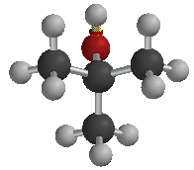
Tertiary Alcohols
The –OH group in this case will be located on a carbon to which there are three other carbon groups attached.
The naming is a little trickier because you must also name other attached groups.
CH₃C(CH₃)(OH)CH₃ or this is a simple tertiary alcohol.
It is named 2-Methyl Propanol-2. Notice that both the –OH and the –CH₃ are attached to the #2 carbon.

Slide 7
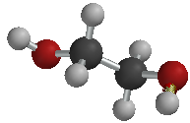
Dihydroxy Alcohols
In dihydroxy alcohols there will be two –OH groups. The –OH groups will never be located on the same carbon atom.
In naming you must locate the –OH groups by the number of the carbon which they are attached.
CH₂(OH)CH₂(OH) or this is commonly called Ethylene glycol (common antifreeze agent) or more correctly Ethandiol.

Slide 8
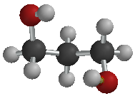
Dihydroxy Alcohol
Just one more example to show you the naming –
CH₂(OH)CH₂CH₂(OH) or this would be called, 1,3 Propandiol or it could be Propandiol-1,3. If one of the –OH groups had been moved to the #2 carbon what would it be named?

Slide 9
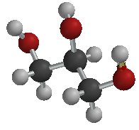
Trihydroxy Alcohols
As the name implies there are now 3 –OH groups located on the carbon base compound.
The most commonly referred to trihydroxy alcohol is commonly called Glycerol or Glycerine. It is a great hydrating agent and is used in beauty soaps as a moisturizer.
CH₂(OH)CH(OH)CH₂(OH) or this would be called Propantriol
It could also be Propantriol-1,2,3

Slide 10
Ethers
Ethers are sometimes referred to as organic oxides. They can be formed as a result of dehydration synthesis of an alcohol using a dehydrating agent like concentrated H₂SO₄.
They are characterized as follows –
R-O-R (R= some hydrocarbon grouping)
The name comes from the attached hydrocarbon groups.
R
R

Slide 11
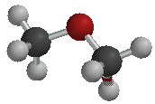
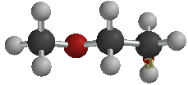
Ethers
If there are two of the same hydrocarbon group you must use the prefix “di”.
CH₃OCH₃ or would be called Dimethyl ether.
In the above case there are two methyl (-CH₃) groups attached to the oxygen.
CH₃OCH₂CH₃ or would be called methyl ethyl ether.

Slide 12
Ethers
In this case you have a methyl group (-CH₃) and you have an ethyl group (-CH₂CH₃ or –C₂H₅) attached to the oxygen.
Always name the smaller hydrocarbon group first.

Slide 13
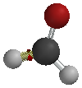
Aldehydes
Aldehydes can be produced from primary alcohols.
They are characterized by the carboxy group on a terminal carbon.
-CHO or C=O is the carbonyl group
The name always has the “al” suffix for aldehyde. This compound is Methanal.
The common name is Formaldehyde.
Double bonded Oxygen

Slide 14
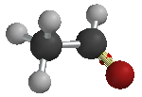
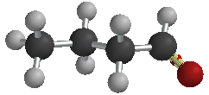
Aldehydes
The first part of the name (prefix) comes from the # of C’s in the chain followed by the “al” suffix.
CH₃CHO or this would be called Ethanal. We don’t use the common name but it is Acetaldehyde.
CH₃CH₂CH₂CHO or
This would be called Butanal.
Double bonded Oxygen
Double bonded Oxygen

Slide 15
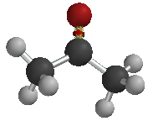
Ketones
Ketones can be derivatives of secondary alcohols. The (C=O) carbonyl group will appear on something other than a terminal (end) carbon atom.
The prefix comes from the # of C’s and the suffix of the name is “one” (from ketone).
CH₃COCH₃ or
This is Propanone
Double bonded Oxygen

Slide 16
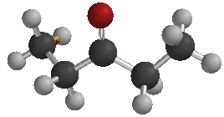
Ketones
Since the (C=O) carbonyl group is on something other than the terminal carbon you must identify its location in the structure in the name.
CH₃CH₂COCH₂CH₃ or
The name is either –
3-Pentanone
Pentanone-3
Double bonded Oxygen
Note the 5 carbon chain

Slide 17
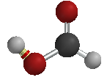
Acids
Organic acids are characterized by the presence of a (-COOH) carboxyl group.
The name typically ends in the suffix “oic” and the prefix comes from the carbon chain.
Acids are oxidation products of aldehydes and the –COOH group will always be on a terminal carbon atom.
HCOOH or this is Methanoic acid.
Commonly it is called Formic acid (insect stings – like ants and bees)
Double bonded Oxygen

Slide 18
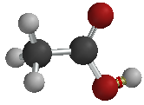
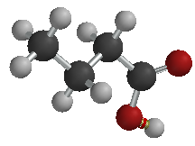
Acids
Ethanoic acid is a common lab acid commonly known as Acetic acid.
CH₃COOH or
CH₃CH₂CH₂COOH Butanoic acid
In Butanoic acid we dropped the “e” from Butane and added “oic”.
Double bonded Oxygen
Notice 4 C atoms
Double bonded Oxygen

Slide 19
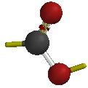
Esters
Esters are formed by a reaction called esterification, in this reaction an alcohol is reacted with an acid to produce the ester and water as products.
Esters are characterized by the presence of a -COO- group (where you have one double bonded oxygen and one single bonded oxygen)
R
Double bonded Oxygen
R
R = some hydrocarbon grouping

Slide 20
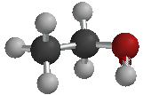
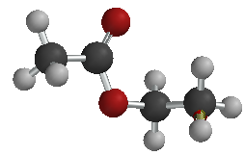
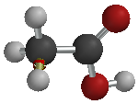
Esters
Esters typical have pleasant smells and are found in synthetic and natural fragrances (raspberry, apple, pineapple, banana, etc).
Esterification Rx.
Double bonded Oxygen
+
+
Double bonded Oxygen
-OH + -H -> HOH

Slide 21
Esters
To name the ester the first name comes from the carbon grouping in the alcohol and the second name comes from the acid (“oic” ending is changed to “oate”)
Double bonded Oxygen
+
+
Double bonded Oxygen
-OH + -H -> HOH
Ethyl Ethanoate
CH₃COOCH₂CH₃

Slide 22
Esters
Name the following ester – CH₃CH₂COOCH₂CH₂CH₂CH₃
Double bonded Oxygen

Slide 23
Your Ester Answer
The ester was made from Propanoic acid and Butanol
Butyl Propanoate would be the name of the ester.
For your info – Methyl Butanoate(apple); Ethyl butanoate(pineapple); Octylethanoate(orange); Pentyl propanoate(apricot) – you might try drawing them

Slide 24
Amines
The Amines are similar to the alcohols, but instead of an –OH group we have a –NH₂ group (the amine group).
The amines are characterized by R-NH₂ (R = a hydrocarbon grouping).
CH₃NH₂ or would be called methylamine. It is a primary amine. That means the –NH₂ group is on an end C atom.

Slide 25
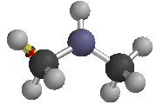
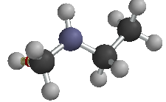
Amines
Secondary amines have two hydrocarbon groups attached to the –NH₂ group.
(CH₃)₂NH₂ or would be called dimethylamine.
When you name the secondary amine always use a prefix (“di”) or start with the smallest hydrocarbon fragment.
this would be methylethylamine

Slide 26
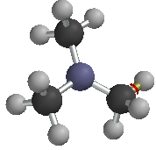
Amines
Tertiary amines have three hydrocarbon groups attached to the –N.
(CH₃)₃N or is called trimethylamine.

Slide 27
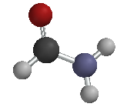
Amides
Amides are similar in structure to organic acids except the –OH portion of the –COOH group is replaced by the –NH₂ group.
R-CONH₂ or (R = H or some hydrocarbon group).
The amide group –CONH₂ will always appear on a terminal carbon atom.
To name the amides identify the carbon fragment, drop the “e” and add amide.
R

Slide 28
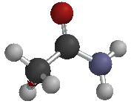
Amides
CH₃CONH₂ or would be called Ethanamide.
Note that it is a two carbon compound (ethane), drop the “e” and add “amide”.

Slide 29
Organic Reactions
There are, of course, millions of organic reactions - the following reactions are some of the more common reactions studied.
We will show each of the reactions and give some commentary about the significant factors in each reaction.
The reactions referred to are –
Combustion (complete & incomplete)

Slide 30
Organic Reactions (cont.)
Substitution Reactions
Addition Reactions
Esterification
Saponification
Fermentation
Polymerization (addition & condensation)

Slide 31
Combustion Rx
Most of the combustion reactions involve the burning of a hydrocarbon in oxygen.
Complete Combustion (products will be CO₂ and H₂O)
C₃H_{8(g)} + 5O_{2(g)} -> 3CO_{2(g)} + 4H₂O_{(g)}
Incomplete Combustion (products will be CO and H₂O)
2C₃H_{8(g)} + 7O_{2(g)} -> 6CO_{(g)} + 8H₂O_{(g)}

Slide 32
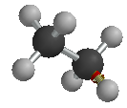
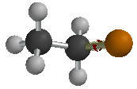
Substitution Rx
A saturated hydrocarbon (Alkane) is reacted with something like a halogen and the halogen replaces hydrogen on the saturated hydrocarbon.
C₂H₆ + Cl₂ -> C₂H₅Cl + HCl
Note – 2 reactants and 2 products
+
+

Slide 33
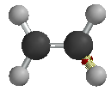
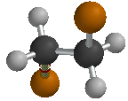
Addition Rx
In an addition reaction you are adding atoms at the location of the double or triple bond of an unsaturated hydrocarbon.
C₂H₄ + Cl₂ -> C₂H₄Cl₂
Note – there are 2 reactants and only 1 product because you are adding to the double bond. You could have added H₂, Br₂, I_{2.}
+
Double bond
Single bond

Slide 34
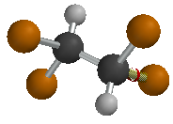
Addition Rx (cont.)
In this addition reaction you are starting with an Alkyne (triple bond) hydrocarbon.
C₂H₂ + 2Cl₂ -> C₂H₂Cl₄
Note – 1:2 ratio for reactants, still 1 products because you added to the triple bond.
+ 2
Triple bond
Single bond

Slide 35
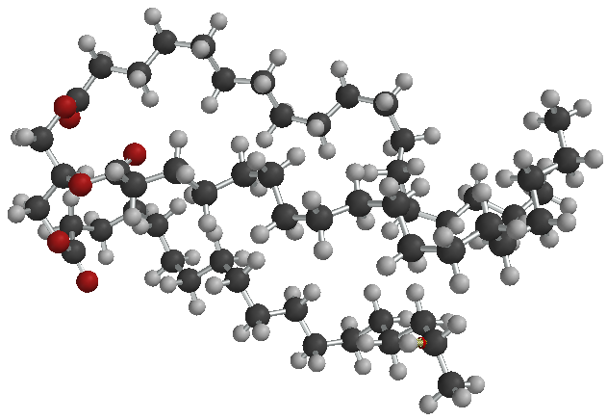
Saponification Rx
In this reaction you are starting with an ester (like glycerol stearate) and you react it with a strong base like NaOH.
C₃H₅(OOCC₁₇H₃₅)₃ + 3NaOH -> C₃H₅(OH)₃ + 3C₁₇H₃₅COONa
Glycerol stearate base Glycerol Soap
That is glycerol stearate, it is hard to visualize
without being able to rotate the molecule

Slide 36
Fermentation Rx
In the fermentation reaction we convert a carbohydrate into ethanol and carbon dioxide. This is an important reaction in baking with yeast or the preparation of alcoholic beverages. Yeast secrets zymase which helps to breakdown the carbohydrate.
C₆H₁₂O₆ -> 2C₂H₅OH + 2CO₂
It is the CO₂that makes bread rise, the alcohol is vaporized during baking.

Slide 37
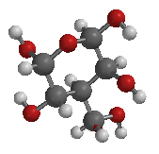
Fermentation Rx
Zymase
+
2
2
Glucose
Ethanol
Carbon dioxide

Slide 38
Polymerization Rx
Polymers are actually complex molecules made up of smaller units called monomers.
Polymers generally fall into two categories
Addition Polymers – these are generally formed by joining smaller units of unsaturated compounds (adding at the site of the double or triple bond).
Condensation Polymers – these are formed by bonding smaller units (monomers) with the elimination of water.

Slide 39
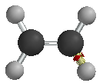
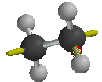
Addition Polymers
nC₂H₄ -> (C₂H₄)_{n} this is a generalized reaction showing the formation of polyethylene. Note the “n” indicating multiple units of that type.
Site for additional monomers
Site for additional monomers
n
n
Double bond
Single bond

Slide 40
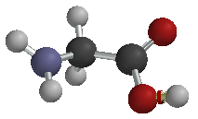
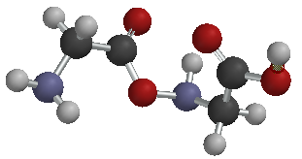
Condensation Polymers
A simple example of condensation polymerization is the bonding together of two amino acids with the resulting polymer and water.
Double bonded oxygen
Double bonded oxygen
+
+
Water splits off
monomers
monomers
polymer

