Slide 1
SOLUTIONS
Homogeneous Mixtures
Kenneth E. Schnobrich

Slide 2
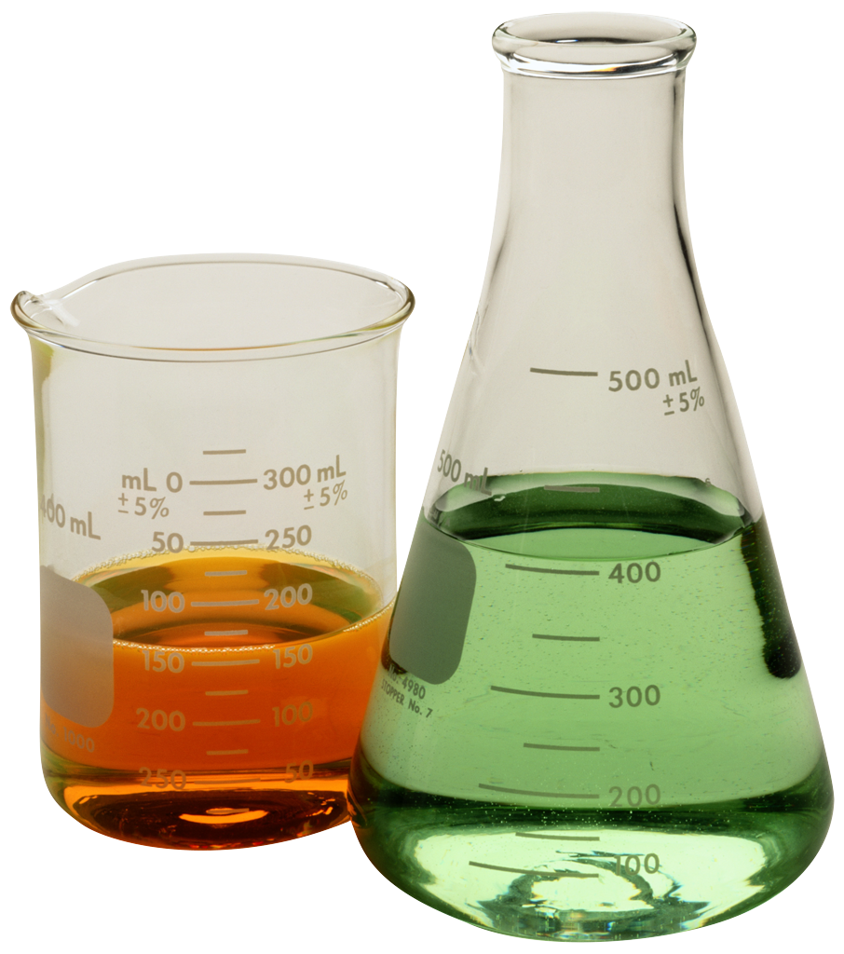
Solution - Definition
A solution is a homogeneous mixture of two or more substances (elements or compounds) in no definite ratio by mass.
All homogeneous mixtures are solutions.
Solutions can exist in any phase (see the next slide).
Liquid solutions must be clear and can be colored.

Slide 3
Terminology
Solute - substance that is being dissolved (lesser amount)
Solvent - substance that is doing the dissolving (greater amount)
Aqueous solutions - water solutions (water is the solvent)
KCl_{(s)} -> K⁺_{(aq)} + Cl⁻_{(aq)}
Tyndall Effect
When a light beam passes through a true solution the particle sizes are very small, so light is not dispersed.
Note the (aq) to indicate a water
solution

Slide 4
Terminology (cont.)
Electrolyte - aqueous solution that will conduct an electric current (ions must be present)
Nonelectrolyte – no ions are present (water by itself is a nonelectrolyte/ a solution of alcohol and water).
Solubility - the amount of solute that will dissolve in a given amount of solvent at a certain temperature.
Dissociation - breaking apart into its ions
KCl_{(s)} -> K⁺_{(aq)} + Cl⁻_{(aq)}
Miscible - mixable (water & alcohol)
Immiscible - will not mix (oil & water)

Slide 5
Solution Types
Solvent/ Solute | Solid | Liquid | Gas
Solid | Alloys Brass(Zn/Cu) | Salt water
Liquid | Amalgams | Alcohol & water
Gas | H₂ in Pt | Soda | Air

Slide 6
Solubility Factors
It is important to distinguish between factors that speed up solubility and those that change the solubility. The following have an effect on how much will go into solution -
Nature of the solute and solvent
Temperature
Pressure (gases)

Slide 7
Solubility Factors
The following will effect how fast something goes into solution -
Surface Area
Stirring

Slide 8
Nature of the Substances
Solute Type | Non Polar Solvent | Polar Solvent
Nonpolar | Soluble | Insoluble
Polar | Insoluble | Soluble
Ionic | Insoluble | Soluble

Slide 9
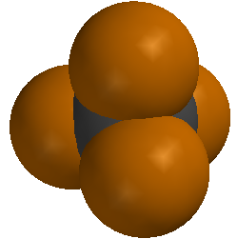
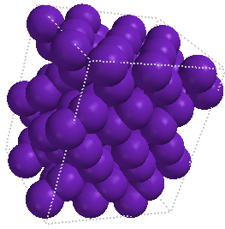
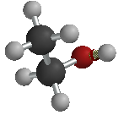
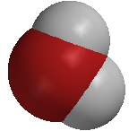
“Like Dissolves Like”
In chemistry the phrase is used to describe how solutes and solvents will interact with each other.
In Both cases the substances are soluble
water
CCl₄ liquid
ethanol
I₂ solid
Both polar
Both nonpolar
*Visual from Odyssey by WaveFunction

Slide 10
Polar vs Nonpolar
Yellow dashed line shows hydrogen bonding between water molecules
Polar water molecules
Both of these substances exist in the liquid state at normal room temperatures. The hydrogen bonding in water is relatively strong and does not allow the mixing of the two substances. A visible boundary can be observed between the two substances. They are said to be immiscible and are an excellent example of “like dissolves like.”
*Visual from Odyssey by WaveFunction
Nonpolar carbon tetrachloride molecules

Slide 11
“Like Dissolves Like”
Substance | Formula | Solubility (g/L H₂O)
Methanol | CH₃OH | Completely soluble
Ethanol | CH₃CH₂OH | Completely soluble
Propanol | CH₃CH₂CH₂OH | Completely soluble
Butanol | CH₃CH₂CH₂CH₂OH | 74
Pentanol | CH₃CH₂CH₂CH₂CH₂OH | 27
Hexanol | CH₃CH₂CH₂CH₂CH₂CH₂OH | 6.0
Heptanol | CH₃CH₂CH₂CH₂CH₂CH₂CH₂OH | 1.7
*Data taken from - Chemistry: Principles & Reactions, Masterton/Hurley, 1989, Holt, Rinehart and Winston, Inc.
As the length of the hydrocarbon chain increases the molecule becomes less polar and its solubility in water decreases because it is becoming less like the “polar” water molecule

Slide 12
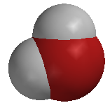
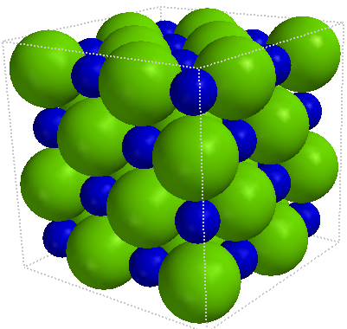
THE SOLUTION PROCESS
FOR
Sodium Chloride (NaCl)
Note - the (+) hydrogen end of the water
Molecule is attracted to the (–) chloride ion
-
+
+
+
-
+
+
+
-
-
-
+
+
The water molecules hydrate the ions
And hold them in solution
Chloride ion (Cl⁻)
+
Sodium ion (Na⁺)
Note - the (-) oxygen end of the water
Molecule is attracted to the (+) sodium ion
Polar Water Molecule
*Visual from Odyssey by WaveFunction

Slide 13
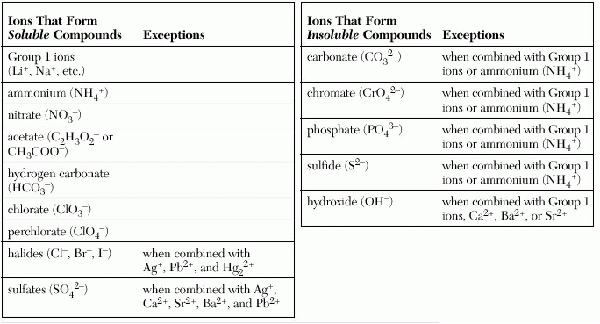
Nature of the Substances (cont.)
Refer to Table F of your Reference Tables for Chemistry
Note that they are talking about the solubility in aqueous solutions
AgCl - insoluble
PbSO₄ - insoluble
(NH₄)₂CrO₄ - soluble
Ag₂S - insoluble
*NYS Reference Tables for Chemistry

Slide 14
TEMPERATURE
Refer to Table G of your Reference Tables for Chemistry
The solubility of most solids increases with an increase in temperature
The solubility of gases decreases with an increase in temperature
You must be able to interpret questions related to Table G (see next slide)

Slide 15
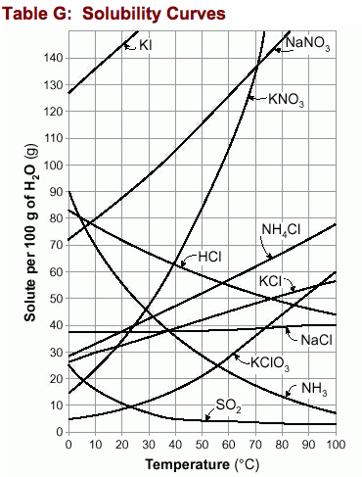
Temperature & Solubility
These substances are gases
Notice that the solubility of the gases increases with an increase in temperature
The solubility of most solids (those on the table) increases with an increase in temperature
The solubility is given in grams of solute per 100 grams of water
*NYS Reference Tables for Chemistry

Slide 16
PRESSURE
Henry’s Law describes how pressure changes the solubility of a gas
as the partial pressure of the gas above a liquid increases its solubility increases
Pressure increasing
Solubility increasing

Slide 17
Solution Conditions
Supersaturated
Grams solute/100 g H₂O
Unsaturated
Saturated
Temperature(°C)

Slide 18
Solution Conditions
Unsaturated - the solution can dissolve more solute in the solvent at the specified temperature.
Saturated - the solution is holding as much solute as it can hold at the given temperature ( the rate of solution equals the rate of dissolution).
Supersaturated - the solution is holding more solute than it normally can hold at the specified temperature. These solutions are unstable and will seek to reach saturation when disturbed and the excess solute will precipitate out.

Slide 19
Units of Concentration
When talking about solutions there are several ways to express the amount of solute in solution (concentration)
Mass percent of solute
Parts per million (ppm) or parts per billion (ppb)
Molarity
Molality
Table T of your Reference tables should be used

Slide 20
Mass Percent of Solute
On Table T you will see the following relationship –
Mass % solute = (mass solute/total solution mass) x (100)
Example – In a solution prepared by dissolving 24 g of NaCl in 152 g of water, what is the % by mass of NaCl in solution?
Solution –
Mass % NaCl = (24 g/176 g) x 100 = 14

Slide 21
ppm & ppb
On Table T you will see the following relationships
ppm solute = (mass solute/total solution mass) x 10⁶
ppb solute = (mass solute/total solution mass) x 10⁹
There is a relationship between mass percent and ppm and ppb
ppm = mass percent x 10⁴
ppb = mass percent x 10⁷

Slide 22
ppm Example
Example – In the United States and Canada, drinking water cannot contain more than 5 x 10⁻⁴ mg of mercury per gram of sample. In parts per million what would that be?
Solution –
Ppm Hg = (5 x 10⁻⁴ mg Hg/1 x 10³ mg) x 10⁶ = 0.5
Remember there are 1000 mg = 1 gram)

Slide 23
Molarity
Molarity (M) is a very common concentration unit used in preparing lab solutions.
Remember – mols (n) = #g/mw
Formula from Table G
M = #mols/#L of solution
Example – if 40 g of NaOH is dissolved in water to prepare 500 mL of solution, what is the molarity?
M = 1 mol/0.5 L = 2M (or a 2 molar solution)
MW of NaOH = 40 g/ mol

Slide 24
Molarity Problems
Fill-in the following blanks
Substance | # grams used | L of solution | Molarity (M)
KOH | 100 | 2.0
CaCl₂ |  | 0.5 | 2.0
NH₄NO₃ | 160 | 1.0
Ca(OH)₂ | 80 |  | 1.5

Slide 25
Molarity Dilution Problems
The number of mols of solute in a sample remains constant when we add water to dilute the sample, the concentration changes.
M₁V₁ = M₂V₂ - 1 & 2 represent the original solution and the diluted solution molarity and volume.
If a 200 mL of a 3.0 M HCl solution is diluted to 400 mL what is the new molarity?
M₂ = (200 mL)(3.0 M)/(400 mL) = 1.5 M

Slide 26
Molality (m)
Molality is another unit of concentration and should not be confused with molarity. In this case, we know the amount of solute and solvent.
Formula – m = #mols solute/#kg solvent
Example – A solution contains 12.0 g of glucose, C₆H₁₂O₆, in 95grams of water. Calculate the molarity.
m = 0.0667 mols/0.095 kg = 0.702 m
MW of glucose = 180 g/mol

Slide 27
Colligative Properties
Colligative properties refers to properties of a solution that depend on the concentration of particles.
Generally these properties are measured for dilute solutions (at high concentrations there are other interactions that take place).
Vapor pressure, boiling point, and freezing point are changed by particle concentration.

Slide 28
Vapor Pressure
Vapor pressure can be described as the pressure exerted by the vapor above a liquid against the opposing atmospheric pressure. When a nonvolatile substance like sugar or salt are added to water they lower the vapor pressure.
How do they lower the vapor pressure?
Some of the nonvolatile particles are at the surface and they interfere with the escape of the volatile water molecules
Since the volatile water molecules need a certain amount of kinetic energy to escape, the number gaining enough energy to escape is less because the nonvolatile particles have absorbed some of that energy

Slide 29
Vapor Pressure Lowering
Notice the decrease in gaseous water molecules as a result the introduction of the nonvolatile sodium ions and chloride ions from NaCl. The vapor pressure is lowered.
Chloride ion
Sodium ion
NaCl _{(aq)}
*Visuals done using Spartan Model by WaveFunction

Slide 30
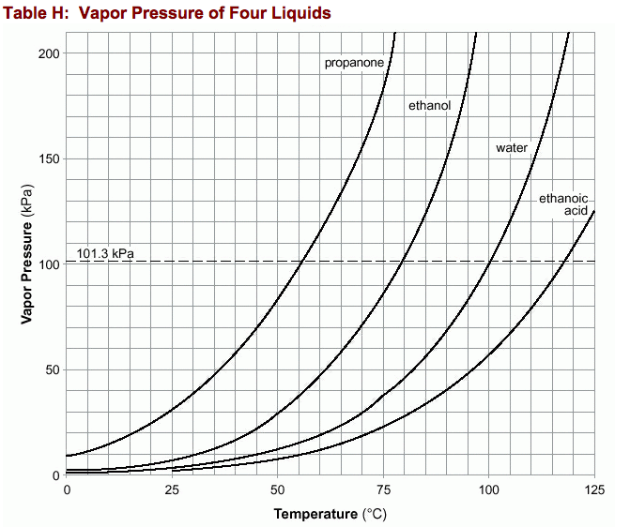
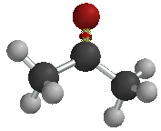
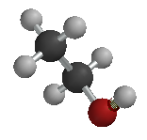
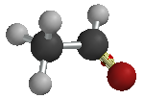
Vapor Pressure
As you look at table H for the
four liquids you can make the
general statement – “as temperature increases the vapor pressure increases.” The differences in vapor pressure are a function of the attractive forces between the molecules in each of the liquids. The lower the attractive forces the higher the vapor pressure at a given temperature.
The hydrogen bonding in water gives it a reasonably lower vapor pressure than ethanol and propanone.

Slide 31
Boiling Point
Boiling Point is defined as the temperature at which the vapor pressure equals the opposing standard atmospheric pressure.
When a nonvolatile particles are added to water to make a solution, the boiling point of that solution is raised.
Chloride ion
Sodium ion
Water boils at 100°C at 1 atm
NaCl solution at > 100°C at 1 atm
*Visuals done using Spartan Model by WaveFunction

Slide 32
Boiling Point (cont.)
The elevation of the boiling point depends on the number of mols of particles present. For each mol of particles in a kg of water the boiling point of the aqueous solution is elevated by 0.52°C. That is called the boiling point elevation constant for water (0.52°C/m).
Molecular compounds such as C₆H₁₂O₆ do not break up into ions, so one mol of C₆H₁₂O₆ would raise the boiling point 0.52°C.
Ionic Compounds such as NaCl and CaCl₂ break up into ions in aqueous solution. One mol of NaCl actually yields two mols of ions, one mol of CaCl₂ yields three mols of ions. They would elevate the boiling point more than one mol of C₆H₁₂O₆.

Slide 33
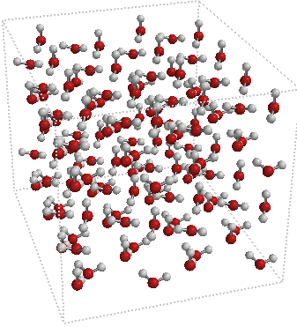
Freezing Point
When water freezes the hydrogen bonds give water a rigid structure (water expands as it freezes).
Adding NaCl or C₆H₁₂O₆ (any solute) to the water interferes with the formation of the hydrogen bonds. The freezing point of an aqueous solution is lowered 1.86°C for each mol of particles per kg of water (1.86°C/m).
The solid water has a definite crystalline structure as a result of the hydrogen bonding
*Visual from Odyssey by WaveFunction

