Slide 1
CHEMICAL BONDING and
MOLECULAR STRUCTURES
Kenneth E. Schnobrich

Slide 2
What is a Bond?
It is the force of attraction that exists between two atoms (or ions) as a result of:
The loss and gain of electrons to form oppositely charged ions
The equal sharing of one or more pairs of electrons between two atomic nuclei
The unequal sharing of one or more pairs of electrons between two atomic nuclei

Slide 3
TYPES OF BONDS
IONIC BONDS
COVALENT BONDS
METALLIC BONDS
SUMMARY OF PROPERTIES
INTERMOLECULAR FORCES

Slide 4
IONIC BONDING
Atoms normally are trying to achieve stability from an electronic arrangement standpoint. Look at the electron arrangement and ask yourself the question - “how can this element best achieve an INERT GAS arrangement when it bonds with another element?”
• these tend to be combinations of metals & nonmetals
Ne
Na 2-8-1
Na⁺¹ 2-8
Cl 2-8-7
Cl⁻¹ 2-8-8
Ar

Slide 5
IONIC BONDS (cont.)
2-8-8-2
Ca
Br
⁻¹
Ca⁺²
Br
⁻¹
Br
Br
2-8-18-7

Slide 6
IONIC BONDS (cont.)
2-8-3
O
⁻²
Al
Al
Al⁺³
O
⁻²
Al⁺³
O
O
O
O
⁻²
2-8-6
Al₂O₃

Slide 7
Ionic Bonding Practice
Draw Lewis Dot Structures for:
LiCl
K₃N
BaS
CaF₂
Draw Lewis Dot Structures for:
MgO
BeF₂
Al₂S₃
Na₂O

Slide 8
PROPERTIES OF IONIC COMPOUNDS
They generally have high melting and boiling points
They are nonconductors in the solid state (ions are not free to move)
They are conductors in the liquid state (ions are now free to move)
Most are soluble in water
In water they form a conducting solution called an electrolyte (ions can move)

Slide 9
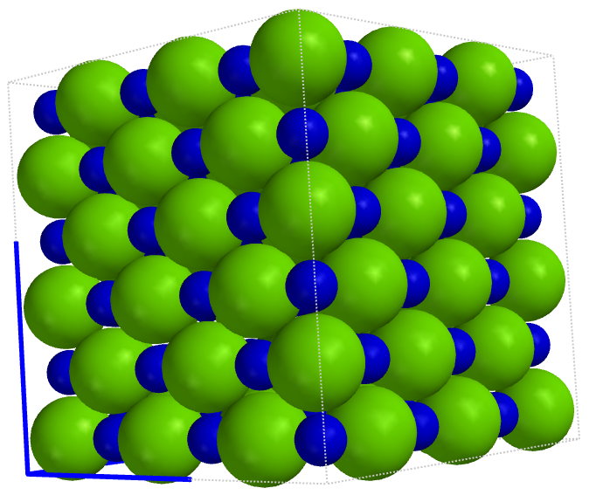
Properties of Ionic Compounds (cont.)
Crystals of Ionic Compounds tend to be brittle
Bonding forces are relatively strong between the ions
Compound/Formula | Lattice Energy kJ/mol
Sodium Chloride (NaCl) | -788 kJ/mol
Lithium Fluoride (LiF) | -1030 kJ/mol
Magnesium Oxide (MgO) | -3795 kJ/mol
Chloride ion
NaCl
Sodium ion
Diagram from Odyssey
Wavefunction, Inc.
The larger the lattice energy the stronger the attractive forces between the ions

Slide 10
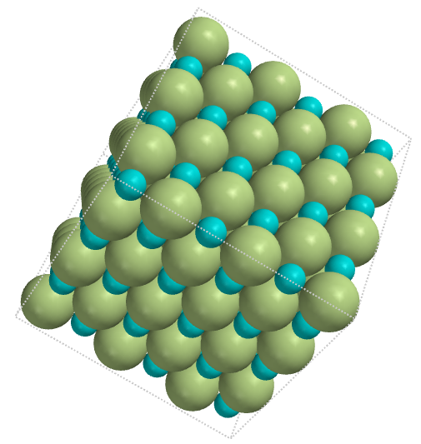
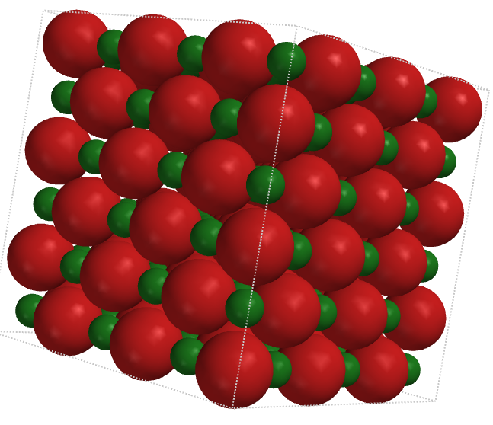
Properties of Ionic Compounds (cont.)
Lattice Energies*
Lithium Fluoride (LiF)
∆H = -1030 kJ/mol
Magnesium Oxide (MgO)
∆H = -3795kJ/mol
*Lattice Energy – the energy needed to separate the ions in a crystal to an infinite distance

Slide 11
COVALENT BONDING
Covalent bonds are generally formed between two nonmetal atoms
Covalent bonds tend to be one of four types:
Nonpolar Covalent Bonds
Polar Covalent Bonds
Coordinate Covalent Bonds
Network Covalent Bonds
In covalent bonds an electron pair or pairs are shared between two nuclei

Slide 12
Nonpolar Covalent Bonds
Nonpolar covalent bonds generally exist between two identical nonmetal atoms or two atoms with similar electronegativities
The diatomic gases are excellent examples of nonpolar covalent bonding
In the diatomic gases we see one, two, and three pairs of electrons being shared between two nonmetals
There is equal or almost equal sharing of electrons

Slide 13
Nonpolar Bonding Examples
H₂
H
H
∆EN = 0
Equal sharing of electrons
O₂
O
O
∆EN = 0
N₂
N
N
∆EN = 0
If the ∆EN is something < 0.5 the bond is nonpolar

Slide 14
One More Example
Cl
Cl
N
Cl
N
Cl
Cl
Cl
Since the ∆E = 0 the bond is nonpolar

Slide 15
Nonpolar Covalent Bonding (Practice)
For each of the following
Write the electron arrangement for each atom before bonding
Draw the Lewis Dot structure to show how they bond chemically
Draw the electron arrangement after bonding and indicate what inert gas arrangement it has achieved
What is the ∆EN between the two atoms
CH₄
Cl₂
Br₂
NBr₃

Slide 16
POLAR COVALENT BONDING
Polar covalent bonds are formed between two nonmetal atoms where the sharing of the electron pair(s) is not equal
The difference in electronegativity (∆EN) is generally 0.5 or greater but less than 1.7.
This unequal sharing can result in a molecule that is polar or nonpolar depending on its symmetry
If it is symmetrical it is nonpolar
If it is asymmetrical it is polar

Slide 17
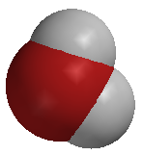
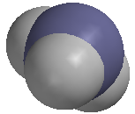
Polar Covalent Bonding
Water
Ammonia

Slide 18
The Water Molecule
In the case of the water molecule the two atoms, hydrogen and oxygen, have a large difference in electronegativity (∆EN = 1.4).
O
H
H
The two circled pairs of electrons are called lone-pairs (because they are not bonded to anything). The lone-pairs prevent the molecule from being symmetrical. The molecule is described as bent, V-shaped, or angular.

Slide 19
The Water Molecule
The asymmetry of the water molecule causes the charges to be distributed so that it is a polar molecule with polar covalent bonding.
+
O
H
-
H
+
Since the molecule is polar (has a positive and negative end) these molecules show attraction for one another.

Slide 20
The Ammonia Molecule
In the case of the ammonia molecule (NH₃) the nitrogen and hydrogen have an electronegativity difference of 0.9. The difference is still great enough to produce a polar covalent bond.
H
N
H
H

Slide 21
The Ammonia Molecule
-
H
N
H
+
+
H
+
Notice that the lone-pair of electrons again prevents the molecule from being symmetrical. This molecule is polar with polar covalent bonds and is described as pyramidal (like a tripod).

Slide 22
The Hydrogen Chloride Molecule
In the case of of HCl the ∆EN = 0.9. The difference is large enough to produce a polar covalent bond. The lone-pairs of electrons produce a molecule that is asymmetrical and thus it is polar molecule. It is described as a linear.
H
Cl
-
+

Slide 23
The Big Question Can the Bonding be Polar and the Molecule Nonpolar?
The answer lies in the symmetry. If there are no lone-pairs of electrons around the central atom the molecule can be symmetrical and have polar covalent bonds.
CO₂
CF₄

Slide 24
The Big Question Can the Bonding be Polar and the Molecule Nonpolar?
-
-
-
-
-
-
CO₂
CF₄
F
O
C
O
F
C
F
F

Slide 25
These are nonpolar because they have an equal charge distribution and are symmetrical - one being linear and the other being tetrahedral. But they do have polar covalent bonds.
-
-
-
-
-
-
CO₂
CF₄
F
O
C
O
F
C
F
F

Slide 26
Bonding & Symmetry
Bonds | Symmetry Central Atom | Molecule
Polar | Asymmetrical (Lone-pairs) | Polar
Polar | Symmetrical (No Lone-pairs) | Nonpolar

Slide 27
Summary Molecular Shapes
#Lone-pr around Central atom | #Bonded-pr around Central atom | Molecular Shape
0 | 2 | Linear
0 | 4 | Tetrahedral
1 | 3 | Pyramidal
2 | 2 | Angular
3 | 1 | Linear
0 | 6 | Octahedral
2 | 4 | Square planar
2 | 3 | T-shaped
1 | 4 | Seesaw
1 | 5 | Sq.based Pyramidal
http://intro.chem.okstate.edu/APnew/Default.html (provides some valuable simulations)

Slide 28
COORDINATE COVALENT BONDING
Coordinate covalent bonding occurs when one atom contributes both of the electrons being shared between the two atoms. Many times they are found in polyatomic ions
Hydronium ion
Ammonium ion
H
+1
+1
H
O
H
H
N
H
H
H

Slide 29
Coordinate Bonds in Compounds
There are compounds that show coordinate covalent bonding also. Remember we are trying to achieve a noble gas configuration of 8 electrons.
Sulfur (IV) Oxide
Sulfur (VI) Oxide
O
O
S
O
O
S
O
Anglular (bent)
Trigonal Planar

Slide 30
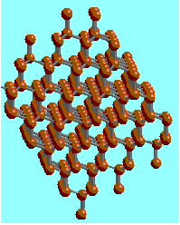
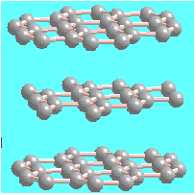
NETWORK COVALENT BONDING
In network covalent bonding the covalent bonds are arranged to form a network. Network covalent bonds are found in network covalent solids and frequently involve either Si or C in their structure. They tend to be very stable and form macromolecules. Common network solids are -
Diamond (C)
Graphite (C)
Silicon dioxide (SiO₂)
Silicon carbide (SiC)

Slide 31
METALLIC BONDING
Metallic bonds are extremely strong bonds and are generally found in metals. They are unique bonding forces because of the “sea of mobile electrons” surrounding the positively charged metallic kernels. The mobile electrons give metals some of their unique properties such as:
Electrical and heat conductivity
Metallic lustre
Malleability and Ductility
High Melting and Boiling Points

Slide 32
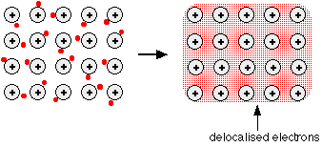
Metallic Bonding Model
Remember the Kernel is the nucleus and all except the valence electrons
The valence electrons are those in the outermost energy level.

Slide 33
PROPERTY SUMMARY
 | MP/BP | CONDUCTIVITY | SOLUBILITY IN WATER | ELECTROLYTE IN WATER
IONIC BONDING | HIGH | SOLID - NO LIQUID - YES | MOST ARE SOLUBLE | YES - MOBILE IONS
NONPOLAR COVALENT | LOW | NONE | MOST ARE NOT | NO
POLAR COVALENT | LOW | VERY WEAK NONE | MOST ARE TO SOME EXTENT | VERY WEAK NO
NETWORK COVALENT | GENERALLY HIGH | ONLY GRAPHITE | NO | NO GRAPHITE
METALLIC | HIGH | SOLID - YES LIQUID - YES | NO | -----

Slide 34
Bonding Type Summary
For the Regents Exam in chemistry there are some artificial cutoff points that may aid you in deciding the type of bonding that is taking place
Understand that in the “real world” of chemistry we speak in terms of “degree” of ionic character or covalent character.
Nonpolar Covalent
Polar Covalent
Ionic
<0.5
>0.5 but <1.7
1.7 or >

Slide 35
Bonding Character
Electronegativity Difference
In the Bonding Atoms
Bond
Type
Zero
Covalent
Covalent character decreases
Ionic Character Increases
Intermediate
PolarCovalent
Large
Ionic
Chemistry - Zumdahl (5th ed)

Slide 36
Ionic Character
100
LiF
KCl
75
CsI
KBr
KF
KI
NaCl
LiBr
LiCl
CsCl
CsF
% Ionic Character
LiI
50
HF
25
HCl
HI
ICl
HBr
IBr
0
0
1
2
3
Electronegativity Difference
Chemistry – Zumdahl & Zumdahl

Slide 37
INTERMOLECULAR FORCES
HYDROGEN BONDING
LONDON DISPERSION FORCES
DIPOLE-DIPOLE FORCES
MOLECULE-ION FORCES
SUMMARY OF BONDING FORCES

Slide 38
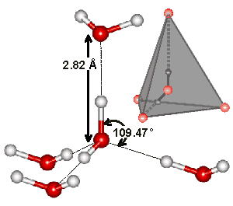
Hydrogen Bonding
Hydrogen bonding occurs when elements with high electronegativities and small atomic radii bond with the element hydrogen.
Nitrogen, Oxygen, and Fluorine are ususally the elements connected with hydrogen bonding.
Water

Slide 39
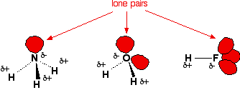
Hydrogen Bonding
The highly electronegative end of the molecule is attracted to the hydrogen end of another molecule
Lone-pairs

Slide 40
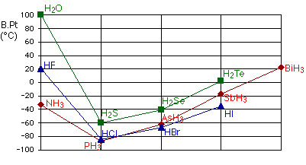
Hydrogen Bonding

Slide 41
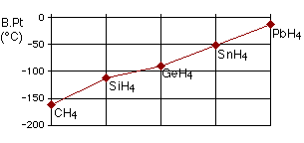
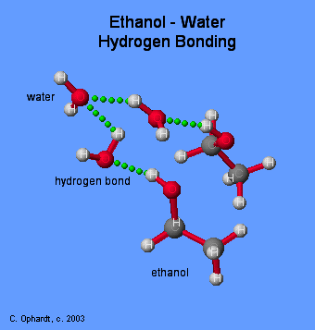
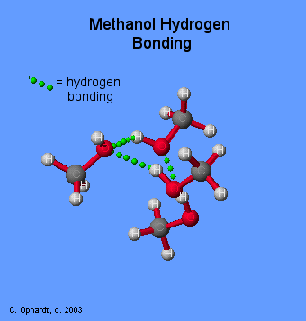
Hydrogen Bonding

Slide 42
London Dispersion Forces
London Dispersion Forces are also sometimes called van der Waals forces. They are very weak forces of attraction and depend on -
The size of the molecule (#electrons)
Distance of separation
Temperature & Pressure
They are the result of temporary dipoles produced by the shifting electrons.

Slide 43
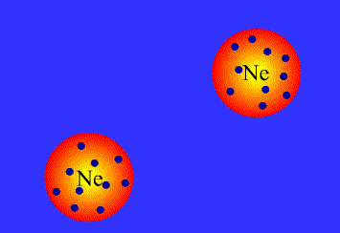
London Dispersion Forces

Slide 44
London Dispersion Forces
16
32
77
123
211
Molecular weights

Slide 45
London Dispersion Forces

Slide 46
Dipole-Dipole Forces
Some molecules are naturally polar because of the differences in electronegativity of the atoms and the asymmetry of the molecule.
+
-
-
-
O
-
S
O
+
-
-
+
+
-
-

Slide 47
Molecule-Ion Attractions
As the name suggests these are attractions between polar molecules (like water) and ions (like those in LiCl).
Solution Animation

Slide 48
Types & Properties of Solids
Type of Solid | Atomic |  |  | Molecular | Ionic
 | Network | Metallic | Group 17
Structural Unit | Atom | Atom | Atom | Molecule | Ion
Bonding Type | Directional Covalent | (+)Kernel & Mobile electrons | London Dispersion | Polar Molecules Nonpolar Molecules | Ionic Electrovalent
Properties | Hard, High MP, Insulator | Conductor High MP/BP | V.Low MP/BP | Soft Low MP/BP | Hard High MP/BP
Examples | Diamond Graphite | Silver Brass | Argon Neon | Ice Dry Ice | NaCl CaF₂

