Slide 1
Regents Chemistry
REVIEW
*Diagrams and some questions from NYS Chemistry Regents exams
Kenneth E. Schnobrich

Slide 2
The diagram above represents the bright-line spectra of four elements and a bright-line spectrum produced by a mixture of two of these elements.
Which two elements are in this mixture?
(1) Barium and hydrogen | (2) Barium and lithium
(3) Helium and hydrogen | (4) Helium and lithium

Slide 3
The diagram above represents the bright-line spectra of four elements and a bright-line spectrum produced by a mixture of two of these elements.
Which two elements are in this mixture?
(1) Barium and hydrogen | (2) Barium and lithium
(3) Helium and hydrogen | (4) Helium and lithium
correct

Slide 4
The table gives information about the nucleus of each of four atoms.
How many different elements are represented by the nuclei in the table?
(1) 1 | (2) 2
(3) 3 | (4) 4

Slide 5
The table gives information about the nucleus of each of four atoms.
How many different elements are represented by the nuclei in the table?
(1) 1 | (2) 2
(3) 3 | (4) 4
correct

Slide 6
Which particle diagram represents a mixture of an element and a compound?
(1) 1 | (2) 2
(3) 3 | (4) 4

Slide 7
Which particle diagram represents a mixture of an element and a compound?
(1) 1 | (2) 2
(3) 3 | (4) 4
correct

Slide 8
Starting as a solid, a sample of a substance is heated at a constant rate. The graph above shows the changes in temperature of this sample.
What is the melting point of the sample and the total time required to completely melt the sample after it has reached its melting point?
(1) 50°C and 3 min | (2) 50 °C and 4 min
(3) 110°C and 5 min | (4) 110°C and 14 min

Slide 9
Starting as a solid, a sample of a substance is heated at a constant rate. The graph above shows the changes in temperature of this sample.
What is the melting point of the sample and the total time required to completely melt the sample after it has reached its melting point?
(1) 50°C and 3 min | (2) 50 °C and 4 min
(3) 110°C and 5 min | (4) 110°C and 14 min
correct

Slide 10
The table above indicates the stability of six nuclides.
All atoms of the unstable nuclides listed in this table have
(1) An odd number of neutrons | (2) An odd number of protons
(3) More neutrons than protons | (4) More protons than neutrons

Slide 11
The table above indicates the stability of six nuclides.
All atoms of the unstable nuclides listed in this table have
(1) An odd number of neutrons | (2) An odd number of protons
(3) More neutrons than protons | (4) More protons than neutrons
correct

Slide 12
.
At standard pressure and 298 K which alkane is a liquid?
(1) ethane | (2) propane
(3) pentane | (4) butane

Slide 13
.
At standard pressure and 298 K which alkane is a liquid?
(1) ethane | (2) propane
(3) pentane | (4) butane
correct

Slide 14
.
What is the boiling point of propane at 1 atmosphere in kelvins?
(1) 231 K | (2) 256 K
(3) 315 K | (4) 340 K

Slide 15
.
What is the boiling point of propane at 1 atmosphere in Kelvins?
(1) 231 K | (2) 256 K
(3) 315 K | (4) 340 K
correct

Slide 16
.The table above shows data for the temperature, pressure, and volume of four gases.
Which two gas samples have the same total number of molecules?
(1) A and B | (2) A and C
(3) B and C | (4) B and D

Slide 17
.The table above shows data for the temperature, pressure, and volume of four gases.
Which two gas samples have the same total number of molecules?
(1) A and B | (2) A and C
(3) B and C | (4) B and D
correct

Slide 18
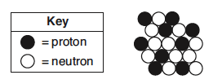
.The diagram above represents an atom of an element.
What are the atomic number and mass number of this atom
(1) The atomic number is 9 and the mass number is 19 | (2) The atomic number is 9 and the mass number is 20
(3) The atomic number is 11 and the mass number is 19 | (4) The atomic number is 11 and the mass number is 20

Slide 19
.The diagram above represents an atom of an element.
What are the atomic number and mass number of this atom
(1) The atomic number is 9 and the mass number is 19 | (2) The atomic number is 9 and the mass number is 20
(3) The atomic number is 11 and the mass number is 19 | (4) The atomic number is 11 and the mass number is 20
correct

Slide 20
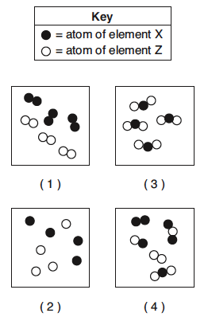
.
Which particle model diagram represents only one compound composed of elements X and Z?
(1) 1 | (2) 2
(3) 3 | (4) 4

Slide 21
.
Which particle model diagram represents only one compound composed of elements X and Z?
(1) 1 | (2) 2
(3) 3 | (4) 4
correct

Slide 22
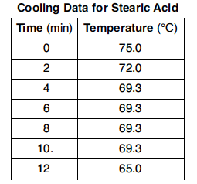
.
Identify the physical change occurring during the time interval 4 minutes to 10 minutes.
(1) boiling | (2) freezing
(3) melting | (4) vaporization

Slide 23
.
Identify the physical change occurring during the time interval 4 minutes to 10 minutes.
(1) boiling | (2) freezing
(3) melting | (4) vaporization
correct

Slide 24
Given the above structure for oxygen
.
What is the total number of electrons shared between the atoms represented in the formula?
(1) 1 | (2) 2
(3) 8 | (4) 4

Slide 25
Given the above structure for oxygen
.
What is the total number of electrons shared between the atoms represented in the formula?
(1) 1 | (2) 2
(3) 8 | (4) 4
correct

Slide 26
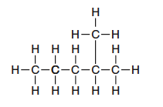
Given the above structure
.
What is the IUPAC name for the organic compound that has the formula shown above?
(1) 1,1-dimethylbutane | (2) 2-methylpentane
(3) hexane | (4) 4-methypentane

Slide 27
Given the above structure
.
What is the IUPAC name for the organic compound that has the formula shown above?
(1) 1,1-dimethylbutane | (2) 2-methylpentane
(3) hexane | (4) 4-methypentane
correct

Slide 28
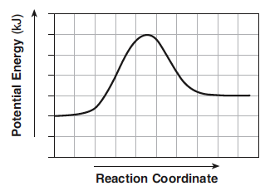
.
The potential energy diagram for a chemical reaction is shown above:
Each interval on the axis labeled “Potential Energy (kJ)” represents 40 kilojoules. What is the heat of reaction?
(1) -120 kJ | (2) -40 kJ
(3) +40 kJ | (4) +160 kJ

Slide 29
.
The potential energy diagram for a chemical reaction is shown above:
Each interval on the axis labeled “Potential Energy (kJ)” represents 40 kilojoules. What is the heat of reaction?
(1) -120 kJ | (2) -40 kJ
(3) +40 kJ | (4) +160 kJ
correct

Slide 30
.
Base your answer on the table above for two isotopes of Cu:
How many neutrons are in an atom of Cu-65?
(1) 36 | (2) 29
(3) 63 | (4) 34

Slide 31
.
Base your answer on the table above for two isotopes of Cu:
How many neutrons are in an atom of Cu-65?
(1) 36 | (2) 29
(3) 63 | (4) 34
correct

Slide 32
.
Base your answer on the table above for two isotopes of Cu:
What is the total number of electrons in an atom of Cu-63?
(1) 36 | (2) 29
(3) 63 | (4) 34

Slide 33
.
Base your answer on the table above for two isotopes of Cu:
What is the total number of electrons in an atom of Cu-63?
(1) 36 | (2) 29
(3) 63 | (4) 34
correct

Slide 34
.
Base your answer on the table above for two isotopes of Cu:
The atomic mass of Cu-63 is expressed to what number of significant figures?
(1) 4 | (2) 3
(3) 5 | (4) 2

Slide 35
.
Base your answer on the table above for two isotopes of Cu:
The atomic mass of Cu-63 is expressed to what number of significant figures?
(1) 4 | (2) 3
(3) 5 | (4) 2
correct

Slide 36
.
Base your answer on the table above for two isotopes of Cu:
Which of the following is the correct numerical setup for calculating the atomic mass of Cu?
(1) (62.930 + 64.928)/2 | (2) .6917(62.930) + .3083(64.928)
(3) 63 + 65/2 | (4) (.6917 x 62.930 + .3083 x 64.928)/2

Slide 37
.
Base your answer on the table above for two isotopes of Cu:
Which of the following is the correct numerical setup for calculating the atomic mass of Cu?
(1) (62.930 + 64.928)/2 | (2) .6917(62.930) + .3083(64.928)
(3) 63 + 65/2 | (4) (.6917 x 62.930 + .3083 x 64.928)/2
correct

Slide 38
.
The equation above represents the reaction between butanoic acid and an unidentified reactant, X.
What type of reaction is taking place in this equation?
(1) saponification | (2) esterification
(3) oxidation | (4) hydrogenation

Slide 39
.
The equation above represents the reaction between butanoic acid and an unidentified reactant, X.
What type of reaction is taking place in this equation?
(1) saponification | (2) esterification
(3) oxidation | (4) hydrogenation
correct

Slide 40
.
The equation above represents the reaction between butanoic acid and an unidentified reactant, X.
Which of the following represents the molecular formula of reactant X?
(1) C₂H₅COOH | (2) C₂H₆
(3) C₂H₄OH | (4) C₂H₅OH

Slide 41
.
The equation above represents the reaction between butanoic acid and an unidentified reactant, X.
Which of the following represents the molecular formula of reactant X?
(1) C₂H₅COOH | (2) C₂H₆
(3) C₂H₄OH | (4) C₂H₅OH
correct

Slide 42
.
The equation above represents the reaction between butanoic acid and an unidentified reactant, X.
Which of the following represents the molecular formula of the organic product in the equation?
(1) C₄H₇COOC₂H₅ | (2) C₃H₇COOC₂H₅
(3) C₆H₁₂COO | (4) C₃H₇C₂H₅COOH

Slide 43
.
The equation above represents the reaction between butanoic acid and an unidentified reactant, X.
Which of the following represents the molecular formula of the organic product in the equation?
(1) C₄H₇COOC₂H₅ | (2) C₃H₇COOC₂H₅
(3) C₆H₁₂COO | (4) C₃H₇C₂H₅COOH
correct

Slide 44
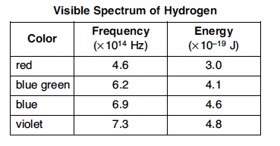
In the laboratory, a glass tube is filled with hydrogen gas at a very low pressure. When a scientist applies a high voltage between metal electrodes in the tube, light is emitted. When the light is analyzed with a spectroscope four distinct spectral lines are noted. Information on their frequency and energy are given in the table above (Hz = hertz a unit for frequency).
.
Which of the following electron transitions might result in the emission of light in the violet region of the spectrum?
(1) 2 -> 4 | (2) 1 -> 4
(3) 3 -> 1 | (4) 1 ->3

Slide 45
In the laboratory, a glass tube is filled with hydrogen gas at a very low pressure. When a scientist applies a high voltage between metal electrodes in the tube, light is emitted. When the light is analyzed with a spectroscope four distinct spectral lines are noted. Information on their frequency and energy are given in the table above (Hz = hertz a unit for frequency).
.
Which of the following electron transitions might result in the emission of light in the violet region of the spectrum?
(1) 2 -> 4 | (2) 1 -> 4
(3) 3 -> 1 | (4) 1 ->3
correct

Slide 46
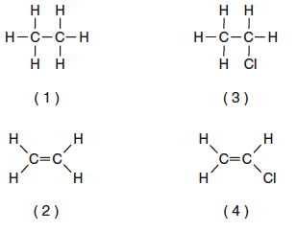
.
Which of the above formulas represents an unsaturated hydrocarbon?
(1) 1 | (2) 3
(3) 2 | (4) 4

Slide 47
.
Which of the above formulas represents an unsaturated hydrocarbon?
(1) 1 | (2) 3
(3) 2 | (4) 4
correct

Slide 48
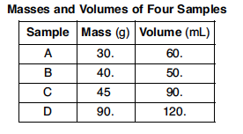
The table above shows mass and volume data for four samples of a substance at 298 K and 1 atmosphere.
Which two samples could consist of the same substance?
(1) A and B | (2) A and C
(3) B and C | (4) C and D

Slide 49
The table above shows mass and volume data for four samples of a substance at 298 K and 1 atmosphere.
Which two samples could consist of the same substance?
(1) A and B | (2) A and C
(3) B and C | (4) C and D
correct

Slide 50
Given the above formula for an organic substance:
What is the total number of shared electrons in a molecule of this substance
(1) 22 | (2) 11
(3) 9 | (4) 6

Slide 51
Given the above formula for an organic substance:
What is the total number of shared electrons in a molecule of this substance
(1) 22 | (2) 11
(3) 9 | (4) 6
correct

Slide 52
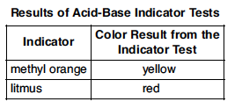
The table above shows the color of the indicator methyl orange and litmus in two samples of the same solution.
Which pH value is consistent with the indicator results?
(1) 1 | (2) 5
(3) 3 | (4) 10

Slide 53
The table above shows the color of the indicator methyl orange and litmus in two samples of the same solution.
Which pH value is consistent with the indicator results?
(1) 1 | (2) 5
(3) 3 | (4) 10
correct

Slide 54
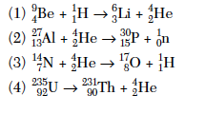
This question refers to the four nuclear equations above.
Which nuclear equation represents a natural transmutation?
(1) 1 | (2) 2
(3) 3 | (4) 4

Slide 55
This question refers to the four nuclear equations above.
Which nuclear equation represents a natural transmutation?
(1) 1 | (2) 2
(3) 3 | (4) 4
correct

Slide 56
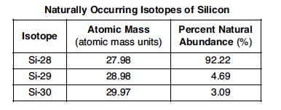
The accepted values for the atomic mass and percent abundance of each naturally occurring isotope of silicon are given in the table above.
Determine the total number of neutrons in an atom of Si-29
(1) 15 | (2) 12
(3) 14 | (4) 29

Slide 57
The accepted values for the atomic mass and percent abundance of each naturally occurring isotope of silicon are given in the table above.
Determine the total number of neutrons in an atom of Si-29
(1) 15 | (2) 12
(3) 14 | (4) 29
correct

Slide 58
The accepted values for the atomic mass and percent abundance of each naturally occurring isotope of silicon are given in the table above.
A scientist calculated the percent natural abundance of Si-30 in a sample to be 3.29%. What is the percent error for this value?
(1) 4.2% | (2) 1.5%
(3) 8.5% | (4) 6.5%

Slide 59
The accepted values for the atomic mass and percent abundance of each naturally occurring isotope of silicon are given in the table above.
A scientist calculated the percent natural abundance of Si-30 in a sample to be 3.29%. What is the percent error for this value?
(1) 4.2% | (2) 1.5%
(3) 8.5% | (4) 6.5%
correct

Slide 60
The accepted values for the atomic mass and percent abundance of each naturally occurring isotope of silicon are given in the table above.
Which of the following numerical setups can be used to calculate the atomic mass of Si?
(1) (27.98 + 28.98 + 29.97)/3 x 100 | (2) (27.98 + 28.98 + 29.97)/3
(3) (92.22 + 4.69 + 3.09)/3 | (4) .9222(27.98) + .0469(28.98) + .0309(29.97)

Slide 61
The accepted values for the atomic mass and percent abundance of each naturally occurring isotope of silicon are given in the table above.
Which of the following numerical setups can be used to calculate the atomic mass of Si?
(1) (27.98 + 28.98 + 29.97)/3 x 100 | (2) (27.98 + 28.98 + 29.97)/3
(3) (92.22 + 4.69 + 3.09)/3 | (4) .9222(27.98) + .0469(28.98) + .0309(29.97)
correct

Slide 62
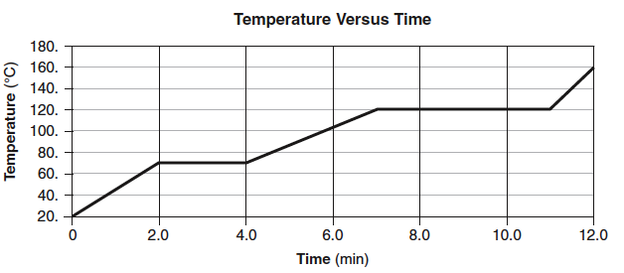
The temperature of a sample of a substance is increased from 20°C to 160°C as the sample absorbs heat at a constant rate of 15 kJ per minute at standard pressure. The graph above represents the relationship between temperature and time.
What is the boiling point of this sample?
(1) 65°C | (2) 120°C
(3) 273 K | (4) 293 K

Slide 63
The temperature of a sample of a substance is increased from 20°C to 160°C as the sample absorbs heat at a constant rate of 15 kJ per minute at standard pressure. The graph above represents the relationship between temperature and time.
What is the boiling point of this sample?
(1) 65°C | (2) 120°C
(3) 303K | (4) 293 K
correct

Slide 64
The temperature of a sample of a substance is increased from 20°C to 160°C as the sample absorbs heat at a constant rate of 15 kJ per minute at standard pressure. The graph above represents the relationship between temperature and time.
What is the closest value for the amount of time this substance is in the liquid phase?
(1) 5 min | (2) 7.0 min
(3) 3.0 min | (4) 8.0 min

Slide 65
The temperature of a sample of a substance is increased from 20°C to 160°C as the sample absorbs heat at a constant rate of 15 kJ per minute at standard pressure. The graph above represents the relationship between temperature and time.
What is the closest value for the amount of time this substance is in the liquid phase?
(1) 5 min | (2) 7.0 min
(3) 3.0 min | (4) 8.0 min
correct

Slide 66
The temperature of a sample of a substance is increased from 20°C to 160°C as the sample absorbs heat at a constant rate of 15 kJ per minute at standard pressure. The graph above represents the relationship between temperature and time.
What is the total amount of heat required to completely melt this sample at its melting point?
(1) 60 kJ | (2) 97.5 kJ
(3) 30 kJ | (4) 180 kJ

Slide 67
The temperature of a sample of a substance is increased from 20°C to 160°C as the sample absorbs heat at a constant rate of 15 kJ per minute at standard pressure. The graph above represents the relationship between temperature and time.
What is the total amount of heat required to completely melt this sample at its melting point?
(1) 60 kJ | (2) 97.5 kJ
(3) 30 kJ | (4) 180 kJ
correct

Slide 68
The incomplete equation above represents an esterification reaction. The alcohol reactant is represented by X.
Which of the following represents the acid functional group?
(1) R-COOH | (2) R-CHO
(3) R-OH | (4) R-O-R

Slide 69
The incomplete equation above represents an esterification reaction. The alcohol reactant is represented by X.
Which of the following represents the acid functional group?
(1) R-COOH | (2) R-CHO
(3) R-OH | (4) R-O-R
correct

Slide 70
The incomplete equation above represents an esterification reaction. The alcohol reactant is represented by X.
Which of the following is the correct IUPAC name for the known reactant?
(1) Ethanal | (2) Propanoic acid
(3) Ethanoic acid | (4) Propyl ethanoate

Slide 71
The incomplete equation above represents an esterification reaction. The alcohol reactant is represented by X.
Which of the following is the correct IUPAC name for the known reactant?
(1) Ethanal | (2) Propanoic acid
(3) Ethanoic acid | (4) Propyl ethanoate
correct

Slide 72
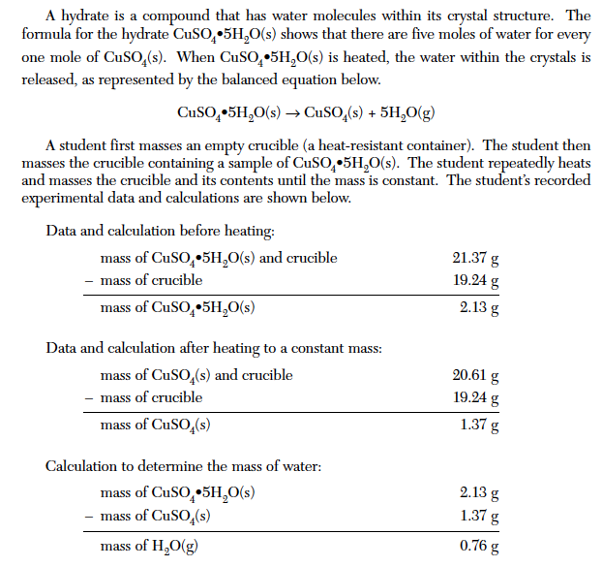
How many significant figures are recorded in the calculated mass of CuSO₄•5H₂O(s)?
(1) 4 | (2) 3
(3) 2 | (4) 5

Slide 73
How many significant figures are recorded in the calculated mass of CuSO₄•5H₂O(s)?
(1) 4 | (2) 3
(3) 2 | (4) 5
correct

Slide 74
Which of the following is the correct numerical setup for calculating the % composition of water in the hydrate?
(1) (1.37 – 0.76)/2.13 x 100 | (2) (0.76) x 21.3
(3) (0.76)/2.13 x 100 | (4) (1.37)/2.13 x 100

Slide 75
Which of the following is the correct numerical setup for calculating the % composition of water in the hydrate?
(1) (1.37 – 0.76)/2.13 x 100 | (2) (0.76) x 21.3
(3) (0.76)/2.13 x 100 | (4) (1.37)/2.13 x 100
correct

Slide 76
Why must the crucible be heated until a constant mass is reached?
(1) To make certain that sample is hot enough | (2) To make certain that all of the SO₂ has been driven off
(3) To make certain that all of the copper(II) sulfate has been hydrated | (4) To make certain that all of the water has been driven off

Slide 77
Why must the crucible be heated until a constant mass is reached?
(1) To make certain that sample is hot enough | (2) To make certain that all of the SO₂ has been driven off
(3) To make certain that all of the copper(II) sulfate has been hydrated | (4) To make certain that all of the water has been driven off
correct

Slide 78
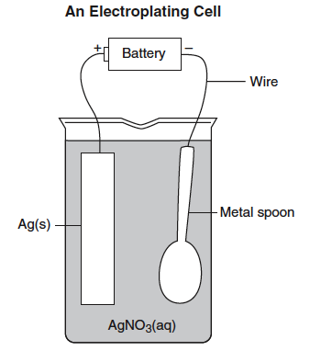
Electroplating is an electrolytic process used to coat metal objects with a more expensive and less reactive metal. The diagram above shows an electroplating cell that includes a battery connected to a silver bar and a metal spoon. The bar and spoon are submerged in AgNO₃(aq).
Why is AgNO_{3(aq)} a better choice than AgCl_{(aq)} in this process?
(1) Silver nitrate is less soluble than AgCl | (2) Silver nitrate is more soluble than silver chloride
(3) Silver nitrate does not take part in the electroplating | (4) Silver nitrate will not release Ag⁺ ions in solution

Slide 79
Electroplating is an electrolytic process used to coat metal objects with a more expensive and less reactive metal. The diagram above shows an electroplating cell that includes a battery connected to a silver bar and a metal spoon. The bar and spoon are submerged in AgNO₃(aq).
Why is AgNO_{3(aq)} a better choice than AgCl_{(aq)} in this process?
(1) Silver nitrate is less soluble than AgCl | (2) Silver nitrate is more soluble than silver chloride
(3) Silver nitrate does not take part in the electroplating | (4) Silver nitrate will not release Ag⁺ ions in solution
correct

Slide 80
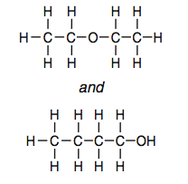
Given the formulas of two organic compounds:
These compounds differ in
(1) gram-formula mass | (2) molecular formula
(3) Percent composition by mass | (4) Physical properties at STP

Slide 81
Given the formulas of two organic compounds:
These compounds differ in
(1) gram-formula mass | (2) molecular formula
(3) Percent composition by mass | (4) Physical properties at STP
correct

Slide 82
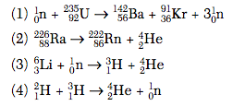
Given the nuclear reactions above:
Which balanced equation represents nuclear fusion?
(1) 1 | (2) 2
(3) 3 | (4) 4

Slide 83
Given the nuclear reactions above:
Which balanced equation represents nuclear fusion?
(1) 1 | (2) 2
(3) 3 | (4) 4
correct

Slide 84
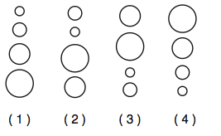
Which grouping of circles, when considered in order from the top to the bottom, best represents the relative size of atoms of Li, Na, K, and Rb, respectively?
(1) 1 | (2) 2
(3) 3 | (4) 4

Slide 85
Which grouping of circles, when considered in order from the top to the bottom, best represents the relative size of atoms of Li, Na, K, and Rb, respectively?
(1) 1 | (2) 2
(3) 3 | (4) 4
correct

Slide 86
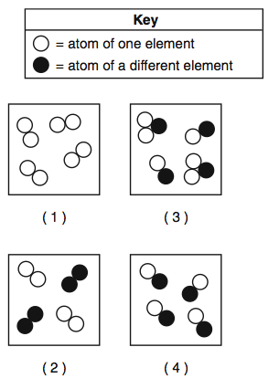
Which particle diagram represents a sample of one compound, only?
(1) 1 | (2) 2
(3) 3 | (4) 4

Slide 87
Which particle diagram represents a sample of one compound, only?
(1) 1 | (2) 2
(3) 3 | (4) 4
correct

Slide 88
An atom in the ground state contains a total of 5 electrons, 5 protons, and 5 neutrons. Which Lewis electron-dot diagram represents this atom?
(1) 1 | (2) 2
(3) 3 | (4) 4

Slide 89
An atom in the ground state contains a total of 5 electrons, 5 protons, and 5 neutrons. Which Lewis electron-dot diagram represents this atom?
(1) 1 | (2) 2
(3) 3 | (4) 4
correct

Slide 90
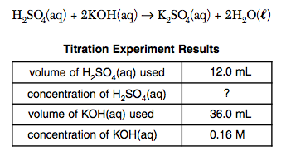
Information related to a titration is given in the balanced equation and table above.
Based on the equation and titration results, what is the concentration of the H₂SO₄(aq)?
(1) 0.12 M | (2) 0.16 M
(3) 0.24 M | (4) 0.96 M

Slide 91
Information related to a titration is given in the balanced equation and table above.
Based on the equation and titration results, what is the concentration of the H₂SO₄(aq)?
(1) 0.12 M | (2) 0.16 M
(3) 0.24 M | (4) 0.96 M
correct

Slide 92
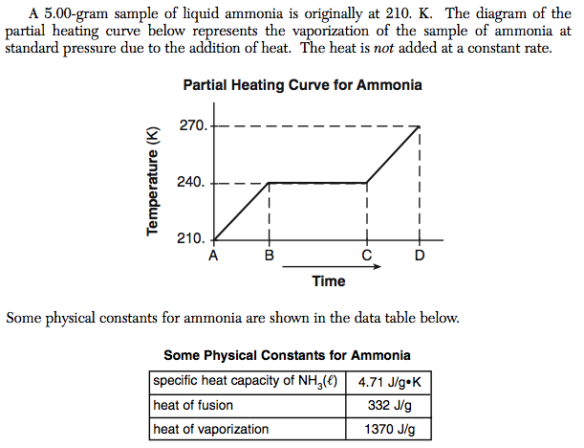
A 5.00-gram sample of liquid ammonia is originally at 210 K. The diagram of the partial heating curve represents the vaporization of the sample at standard pressure due to the addition of heat. The heat is not added a a constant rate
What is the total heat absorbed by the 5.00-gram sample during interval AB?
(1) 710 J | (2) 1,660 J
(3) 6,850 J | (4) 1,370 J

Slide 93
What is the total heat absorbed by the 5.00-gram sample of ammonia during interval AB?
(1) 710 J | (2) 1,660 J
(3) 6,850 J | (4) 1,370 J
correct

Slide 94
What is happening to the potential energy and the average kinetic energy of the ammonia molecules during interval BC?
(1) The potential energy is decreasing and the kinetic energy is increasing | (2) The potential energy is decreasing and the kinetic energy is decreasing
(3) The potential energy is increasing and the kinetic energy remains the same | (4) The potential energy remains the same and the kinetic energy is increasing

Slide 95
What is happening to the potential energy and the average kinetic energy of the ammonia molecules during interval BC?
(1) The potential energy is decreasing and the kinetic energy is increasing | (2) The potential energy is decreasing and the kinetic energy is decreasing
(3) The potential energy is increasing and the kinetic energy remains the same | (4) The potential energy remains the same and the kinetic energy is increasing
correct

Slide 96
What is the total amount of heat required to vaporize this 5.00-gram sample of ammonia at its boiling point?
(1) 1660 J | (2) 6850 J
(3) 710 J | (4) 6,453 J

Slide 97
What is the total amount of heat required to vaporize this 5.00-gram sample of ammonia at its boiling point?
(1) 1660 J | (2) 6850 J
(3) 710 J | (4) 6,453 J
correct

Slide 98
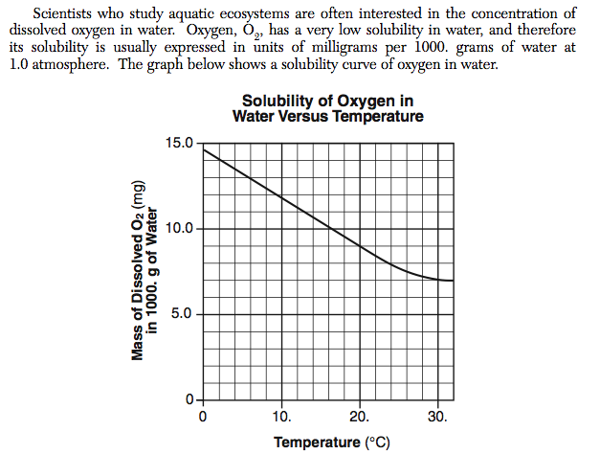
A student determines that 8.2 milligrams of O₂ is dissolved in a 1000.-gram sample of water at 15°C and 1.0 atmosphere. What type of solution is this sample?
(1) saturated | (2) supersaturated
(3) unsaturated | (4) solid solution

Slide 99
A student determines that 8.2 milligrams of O₂ is dissolved in a 1000.-gram sample of water at 15°C and 1.0 atmosphere. What type of solution is this sample?
(1) saturated | (2) supersaturated
(3) unsaturated | (4) solid solution
correct

Slide 100
Which of the following answers explains why oxygen gas has a low solubility in water?
(1) Both water molecules and oxygen molecules are polar | (2) Both water molecules and oxygen molecules are nonpolar
(3) Water is a polar molecule while oxygen is a nonpolar molecule | (4) Water is a nonpolar molecule while water is a polar molecule

Slide 101
Which of the following answers explains why oxygen gas has a low solubility in water?
(1) Both water molecules and oxygen molecules are polar | (2) Both water molecules and oxygen molecules are nonpolar
(3) Water is a polar molecule while oxygen is a nonpolar molecule | (4) Water is a nonpolar molecule while water is a polar molecule
correct

Slide 102
An aqueous solution has 0.0070 gram of O₂ dissolved in 1000.-gram sample of water. Which of the following shows the correct numerical setup to calculate the concentration of the solution in ppm?
(1) (0.0070/1000.0070) x 1,000,000 | (2) (0.0070/1000.0070)/1,000,000
(3) (1000.0070/0.0070) x 1,000,000 | (4) (1000.0070/0.0070)/1,000,000

Slide 103
An aqueous solution has 0.0070 gram of O₂ dissolved in 1000.-gram sample of water. Which of the following shows the correct numerical setup to calculate the concentration of the solution in ppm?
(1) (0.0070/1000.0070) x 1,000,000 | (2) (0.0070/1000.0070)/1,000,000
(3) (1000.0070/0.0070) x 1,000,000 | (4) (1000.0070/0.0070)/1,000,000
correct

Slide 104
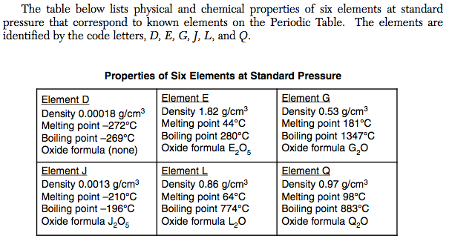
What is the total number of elelemts in the “Properties of Six Elements at Standard Pressure” table that are solids at STP?
(1) 1 | (2) 3
(3) 5 | (4) 4

Slide 105
What is the total number of elelemts in the “Properties of Six Elements at Standard Pressure” table that are solids at STP?
(1) 1 | (2) 3
(3) 5 | (4) 4
correct

Slide 106
An atom of element G is in the ground state. What is the total number of valence electrons in this atom?
(1) 5 | (2) 1
(3) 2 | (4) 4

Slide 107
An atom of element G is in the ground state. What is the total number of valence electrons in this atom?
(1) 5 | (2) 1
(3) 2 | (4) 4
correct

Slide 108
Based on the trend in melting points for G,Q, and L, what is a good estimate for the melting point of Z in °C?
(1) 190°C | (2) 100°C
(3) 54°C | (4) 120°C

Slide 109
Based on the trend in melting points for G,Q, and L, what is a good estimate for the melting point of Z in °C?
(1) 190°C | (2) 100°C
(3) 54°C | (4) 120°C
correct

Slide 110
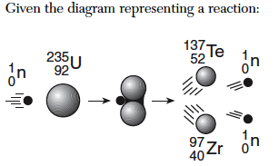
Which phrase best describes this type of reaction and the overall energy change that occurs?
(1) nuclear, and energy is released | (2) nuclear, and energy is absorbed
(3) chemical, and energy is released | (4) Chemical, and energy is absorbed

Slide 111
Which phrase best describes this type of reaction and the overall energy change that occurs?
(1) nuclear, and energy is released | (2) nuclear, and energy is absorbed
(3) chemical, and energy is released | (4) Chemical, and energy is absorbed
correct

Slide 112
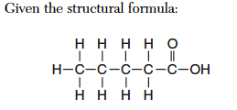
What is the IUPOAC name of this compound?
(1) pentanal | (2) pentanol
(3) Methyl pentanoate | (4) Pentanoic acid

Slide 113
What is the IUPOAC name of this compound?
(1) pentanal | (2) pentanol
(3) Methyl pentanoate | (4) Pentanoic acid
correct

Slide 114
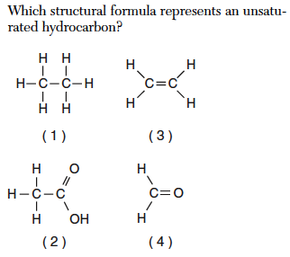
Which structural formula represents an unsaturated hydrocarbon?
(1) 1 | (2) 2
(3) 3 | (4) 4

Slide 115
Which structural formula represents an unsaturated hydrocarbon?
(1) 1 | (2) 2
(3) 3 | (4) 4
correct

Slide 116
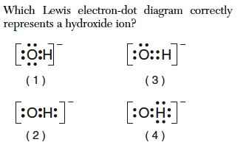
(1) 1 | (2) 2
(3) 3 | (4) 4

Slide 117
(1) 1 | (2) 2
(3) 3 | (4) 4
correct

Slide 118
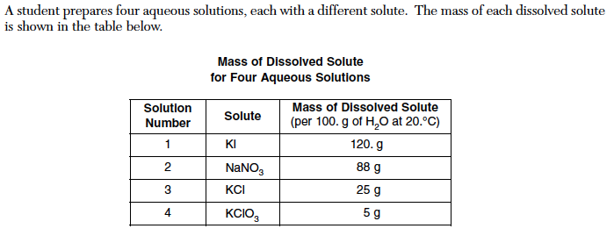
Which solution is saturated?
(1) 1 | (2) 2
(3) 3 | (4) 4

Slide 119
Which solution is saturated?
(1) 1 | (2) 2
(3) 3 | (4) 4
correct

Slide 120
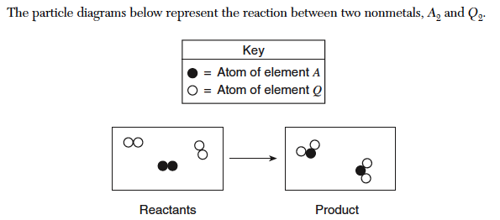
Using the symbols A and Q, write the chemical formula of the product.
(1) AQ | (2) A₂Q
(3) AQ₂ | (4) A₂Q₂

Slide 121
Using the symbols A and Q, write the chemical formula of the product.
(1) AQ | (2) A₂Q
(3) AQ₂ | (4) A₂Q₂
correct

Slide 122
Identify the type of bond between an atom of element A and an atom of element Q.
(1) ionic | (2) Metallic
(3) nonmetallic | (4) covalent

Slide 123
Identify the type of bond between an atom of element A and an atom of element Q.
(1) ionic | (2) Metallic
(3) nonmetallic | (4) covalent
correct

Slide 124
Comparing the total mass of the reactants to the total mass of the products, which statement applies
(1) The two masses are equal | (2) The mass of the reactants is greater than the mass of the product
(3) The masses of the reactants is less than the mass of the product | (4) There is an overall loss of mass

Slide 125
Comparing the total mass of the reactants to the total mass of the products, which statement applies
(1) The two masses are equal | (2) The mass of the reactants is greater than the mass of the product
(3) The masses of the reactants is less than the mass of the product | (4) There is an overall loss of mass
correct

Slide 126
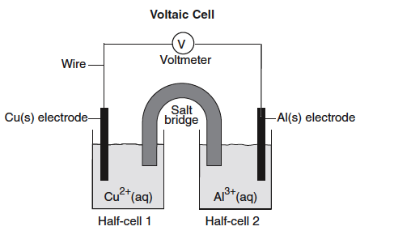
Which of the following is the oxidation reaction occurring in the Voltaic Cell above?
(1) Cu⁺² -> Cu⁰ + 2e⁻ | (2) Cu⁰ + 2e⁻ -> Cu⁺²
(3) Al⁰ -> Al⁺³ + 3e⁻ | (4) Al⁺³ + 3e⁻ -> Al⁰

Slide 127
Which of the following is the oxidation reaction occurring in the Voltaic Cell above?
(1) Cu⁺² -> Cu⁰ + 2e⁻ | (2) Cu⁰ + 2e⁻ -> Cu⁺²
(3) Al⁰ -> Al⁺³ + 3e⁻ | (4) Al⁺³ + 3e⁻ -> Al⁰
correct

Slide 128
Which of the following is a correctly balanced redox reaction for this Voltaic Cell?
(1) 2Al⁰ + 3Cu⁺² -> 2Al⁺³ + 2Cu⁰ | (2) 2Al⁰ + 3Cu⁺² -> 2Al⁺³ + 3Cu⁰
(3) Al⁰ + 3Cu⁺² -> Al⁺³ + 2Cu⁰ | (4) Al⁰ + Cu⁺² -> Al⁺³ + Cu⁰

Slide 129
Which of the following is a correctly balanced redox reaction for this Voltaic Cell?
(1) 2Al⁰ + 3Cu⁺² -> 2Al⁺³ + 2Cu⁰ | (2) 2Al⁰ + 3Cu⁺² -> 2Al⁺³ + 3Cu⁰
(3) Al⁰ + 3Cu⁺² -> Al⁺³ + 2Cu⁰ | (4) Al⁰ + Cu⁺² -> Al⁺³ + Cu⁰
correct

Slide 130
Looking at the Voltaic Cell above, which of the following substances will act as a reducing agent in the redox reaction?
(1) Cu⁰ | (2) Cu⁺²
(3) Al⁺³ | (4) Al⁰

Slide 131
Looking at the Voltaic Cell above, which of the following substances will act as a reducing agent in the redox reaction?
(1) Cu⁰ | (2) Cu⁺²
(3) Al⁺³ | (4) Al⁰
correct

Slide 132
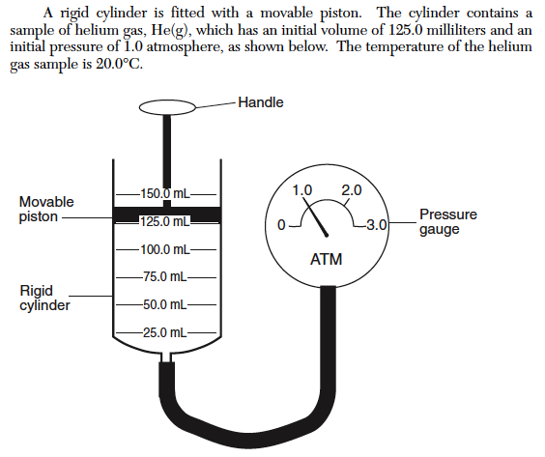
What is the initial volume of the helium gas sample, in liters?
(1) 0.125 L | (2) 1.25 x 10⁻³ L
(3) 1.25 L | (4) 1.25 x 10³ L

Slide 133
What is the initial volume of the helium gas sample, in liters?
(1) 0.125 L | (2) 1.25 x 10⁻³ L
(3) 1.25 L | (4) 1.25 x 10³ L
correct

Slide 134
The piston is pushed further into the cylinder. What is the volume of the helium gas if the new pressure reading is 1.5 atmospheres?
(1) 0.012 mL | (2) 187.5 mL
(3) 83.3 mL | (4) 153.3 mL

Slide 135
The piston is pushed further into the cylinder. What is the volume of the helium gas if the new pressure reading is 1.5 atmospheres?
(1) 0.012 mL | (2) 187.5 mL
(3) 83.3 mL | (4) 153.3 mL
correct

Slide 136
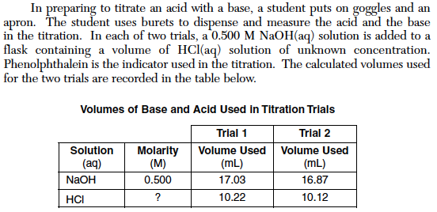
What is the name of the acid used in the titration?
(1) Perchloric acid | (2) Chloric acid
(3) Hypochlorous acid | (4) Hydrochloric acid

Slide 137
What is the name of the acid used in the titration?
(1) Perchloric acid | (2) Chloric acid
(3) Hypochlorous acid | (4) Hydrochloric acid
correct

Slide 138
Using the volumes from trial 1, determine the molarity of the HCl(aq) solution.
(1) 0.833 M | (2) 1.20 M
(3) 2.40 M | (4) 0.414 M

Slide 139
Using the volumes from trial 1, determine the molarity of the HCl(aq) solution.
(1) 0.833 M | (2) 1.20 M
(3) 2.40 M | (4) 0.414 M
correct

Slide 140
Using the volumes from trial 2 in the table, how many significant figures should be shown in the calculated molarity of the HCl(aq) solution?
(1) 4 | (2) 3
(3) 2 | (4) 1

Slide 141
Using the volumes from trial 2 in the table, how many significant figures should be shown in the calculated molarity of the HCl(aq) solution?
(1) 4 | (2) 3
(3) 2 | (4) 1
correct

Slide 142
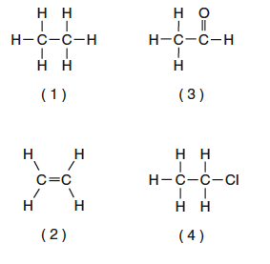
Which formula represents an unsaturated hydrocarbon?
(1) 1 | (2) 2
(3) 3 | (4) 4

Slide 143
Which formula represents an unsaturated hydrocarbon?
(1) 1 | (2) 2
(3) 3 | (4) 4
correct

Slide 144
Given the formula above, what is the IUPAC name of this compound?
(1) 2-pentene | (2) 2-pentyne
(3) 2-butene | (4) 2-butyne

Slide 145
Given the formula above, what is the IUPAC name of this compound?
(1) 2-pentene | (2) 2-pentyne
(3) 2-butene | (4) 2-butyne
correct

Slide 146
In each of the four beakers shown above, a 2.0 centimeter strip of magnesium ribbon reacts with 100 milliliters of HCl(aq) under the conditions shown. In which beaker will the reaction occur at the fastest rate?
(1) A | (2) B
(3) C | (4) D

Slide 147
In each of the four beakers shown above, a 2.0 centimeter strip of magnesium ribbon reacts with 100 milliliters of HCl(aq) under the conditions shown. In which beaker will the reaction occur at the fastest rate?
(1) A | (2) B
(3) C | (4) D
correct

Slide 148
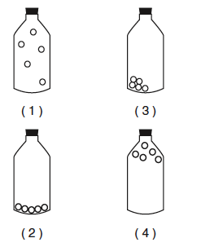
Which diagram above best represents a gas in a closed container?
(1) 1 | (2) 2
(3) 3 | (4) 4

Slide 149
Which diagram above best represents a gas in a closed container?
(1) 1 | (2) 2
(3) 3 | (4) 4
correct

Slide 150
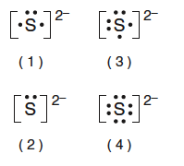
Which Lewis electron-dot diagram is correct for a S⁻² ion?
(1) 1 | (2) 2
(3) 3 | (4) 4

Slide 151
Which Lewis electron-dot diagram is correct for a S⁻² ion?
(1) 1 | (2) 2
(3) 3 | (4) 4
correct

Slide 152
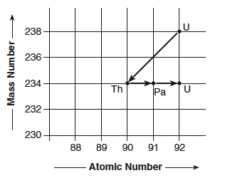
The chart above shows the spontaneous nuclear decay of U-238 to Th-234 to Pa-234 to U-234. What is the correct order of the nuclear decay modes for the change from U-238 to U-234?
(1) Beta decay, gamma decay, beta decay | (2) Beta decay, beta decay, alpha decay
(3) Alpha decay, alpha decay, beta decay | (4) Alpha decay, beta decay, beta decay

Slide 153
The chart above shows the spontaneous nuclear decay of U-238 to Th-234 to Pa-234 to U-234. What is the correct order of the nuclear decay modes for the change from U-238 to U-234?
(1) Beta decay, gamma decay, beta decay | (2) Beta decay, beta decay, alpha decay
(3) Alpha decay, alpha decay, beta decay | (4) Alpha decay, beta decay, beta decay
correct

Slide 154
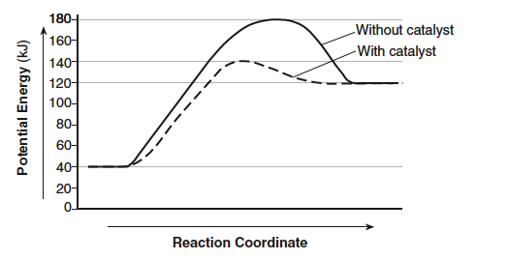
What is the heat of reaction for the forward reaction?
(1) +140 kJ | (2) +180 kJ
(3) +80 kJ | (4) +100 kJ

Slide 155
What is the heat of reaction for the forward reaction?
(1) +140 kJ | (2) +180 kJ
(3) +80 kJ | (4) +100 kJ
correct

Slide 156
What is the activation energy for the forward reaction with a catalyst?
(1) +140 kJ | (2) +180 kJ
(3) +80 kJ | (4) +100 kJ

Slide 157
What is the activation energy for the forward reaction with a catalyst?
(1) +140 kJ | (2) +180 kJ
(3) +80 kJ | (4) +100 kJ
correct

Slide 158
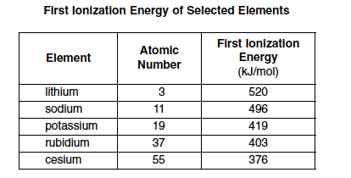
State the trend in first ionization energies for the elements in the table as the atomic number increases?
(1) As the atomic number increases the first ionization energy increases | (2) As the atomic number increases the first ionization energy decreases
(3) As the atomic number increases the first ionization energy increases then decreases | (4) As the atomic number increases the first ionization energy decreases then increases

Slide 159
State the trend in first ionization energies for the elements in the table as the atomic number increases?
(1) As the atomic number increases the first ionization energy increases | (2) As the atomic number increases the first ionization energy decreases
(3) As the atomic number increases the first ionization energy increases then decreases | (4) As the atomic number increases the first ionization energy decreases then increases
correct

Slide 160
Why does cesium have a lower first ionization energy than rubidium?
(1) The number of neutrons in rubidium is greater than in cesium | (2) The number of protons in rubidium is greater than in cesium
(3) The atomic radius of cesium is greater than that of rubidium | (4) The atomic radius of cesium is smaller than that of rubidium

Slide 161
Why does cesium have a lower first ionization energy than rubidium?
(1) The number of neutrons in rubidium is greater than in cesium | (2) The number of protons in rubidium is greater than in cesium
(3) The atomic radius of cesium is greater than that of rubidium | (4) The atomic radius of cesium is smaller than that of rubidium
correct

Slide 162
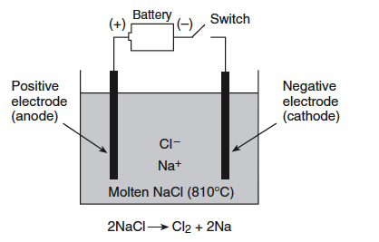
When the switch is closed, which particle with be oxidized?
(1) Na⁰ | (2) Na⁺
(3) Cl⁰ | (4) Cl⁻

Slide 163
When the switch is closed, which particle with be oxidized?
(1) Na⁰ | (2) Na⁺
(3) Cl⁰ | (4) Cl⁻
correct

Slide 164
which of the following reactions represents the balanced half-reaction for the reduction taking place in this electrolytic cell?
(1) 2Na⁺ + 2e⁻ -> 2Na⁰ | (2) 2Na⁺ -> 2Na⁰ + 2e⁻
(3) Cl₂ + 2e⁻ -> 2Cl⁻ | (4) 2Cl⁻ + 2e⁻ -> Cl₂

Slide 165
which of the following reactions represents the balanced half-reaction for the reduction taking place in this electrolytic cell?
(1) 2Na⁺ + 2e⁻ -> 2Na⁰ | (2) 2Na⁺ -> 2Na⁰ + 2e⁻
(3) Cl₂ + 2e⁻ -> 2Cl⁻ | (4) 2Cl⁻ + 2e⁻ -> Cl₂
correct

Slide 166
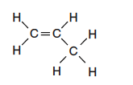
Given the structural formula above, what is the IUPAC name of this compound?
(1) propane | (2) propene
(3) propanone | (4) propanal

Slide 167
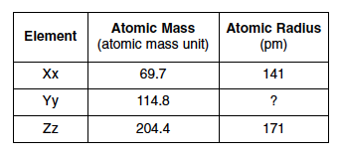
The data table above shows elements Xx, Yy, and Zz from the same group on the Periodic Table. What is the most likely atomic radius of element Yy?
(1) 103 pm | (2) 127 pm
(3) 166 pm | (4) 185 pm

Slide 168
The data table above shows elements Xx, Yy, and Zz from the same group on the Periodic Table. What is the most likely atomic radius of element Yy?
(1) 103 pm | (2) 127 pm
(3) 166 pm | (4) 185 pm
correct

Slide 169
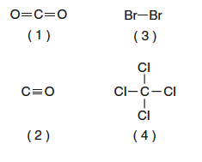
Which molecule contains a nonpolar covalent bond?
(1) 1 | (2) 2
(3) 3 | (4) 4
correct

Slide 170
Which molecule contains a nonpolar covalent bond?
(1) 1 | (2) 2
(3) 3 | (4) 4
correct

Slide 171
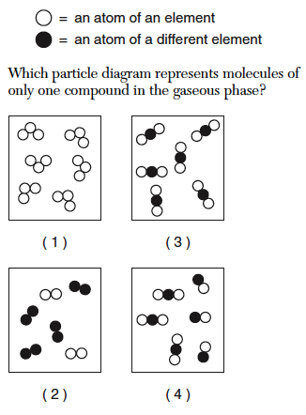
Which particle diagram represents molecules of only one compound in the gaseous phase?
(1) 1 | (2) 2
(3) 3 | (4) 4

Slide 172
Which particle diagram represents molecules of only one compound in the gaseous phase?
(1) 1 | (2) 2
(3) 3 | (4) 4
correct

Slide 173
Given the structural formula above, the compound represented by this formula can be classified as an
(1) Organic acid | (2) Ester
(3) ether | (4) aldehyde

Slide 174
Given the structural formula above, the compound represented by this formula can be classified as an
(1) Organic acid | (2) Ester
(3) ether | (4) aldehyde
correct

Slide 175
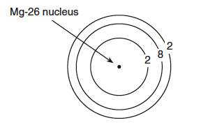
What is the total number neutrons in the nucleus of this isotope of magnesium
(1) 12 | (2) 26
(3) 24 | (4) 14

Slide 176
What is the total number neutrons in the nucleus of this isotope of magnesium
(1) 12 | (2) 26
(3) 24 | (4) 14
correct

Slide 177
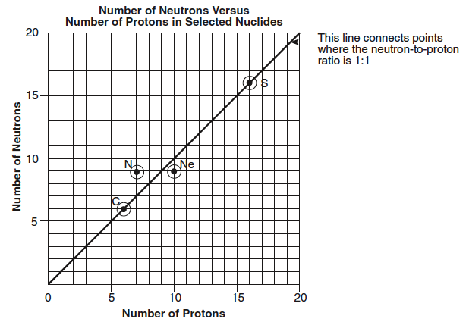
Using the point plotted on the graph above, what is the neutron-to-proton ratio of this nuclide?
(1) 6:7 | (2) 7:6
(3) 7:7 | (4) 9:7

Slide 178
Using the point plotted on the graph above, what is the neutron-to-proton ratio of this nuclide?
(1) 6:7 | (2) 7:6
(3) 7:7 | (4) 9:7
correct

Slide 179
The heat of fusion for this substance is 122 joules per gram. How many joules of heat are needed to melt 7.50 grams of this substance at its melting point?
(1) 16.27 joules | (2) 915 joules
(3) 397.5 joules | (4) 53.0 joules

Slide 180
The heat of fusion for this substance is 122 joules per gram. How many joules of heat are needed to melt 7.50 grams of this substance at its melting point?
(1) 16.27 joules | (2) 915 joules
(3) 397.5 joules | (4) 53.0 joules
correct

Slide 181
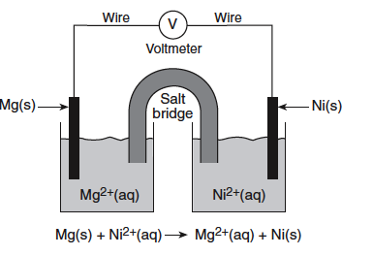
What is the total number of moles of electrons needed to completely reduce 6.0 moles of Ni⁺²(aq) ions?
(1) 12 moles | (2) 6 moles
(3) 2 moles | (4) 18 moles

Slide 182
What is the total number of moles of electrons needed to completely reduce 6.0 moles of Ni⁺²(aq) ions?
(1) 12 moles | (2) 6 moles
(3) 2 moles | (4) 18 moles
correct

Slide 183
Identify a metal from Reference Table J that is more easily oxidized than Mg(s).
(1) Al | (2) Sr
(3) Mn | (4) Fe

Slide 184
Identify a metal from Reference Table J that is more easily oxidized than Mg(s).
(1) Al | (2) Sr
(3) Mn | (4) Fe
correct

Slide 185
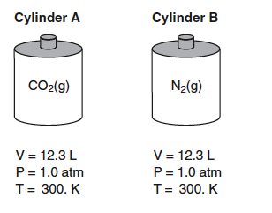
Cylinder A contains 22.0 grams of CO₂(g) and cylinder B contains N₂(g). The volumes, pressures, and temperatures of the two gases are indicated in the diagram. What is the total number of moles of CO₂ in cylinder A?
(1) 6.02 moles | (2) 2.00 moles
(3) 1.00 mole | (4) 0.500 moles

Slide 186
Cylinder A contains 22.0 grams of CO₂(g) and cylinder B contains N₂(g). The volumes, pressures, and temperatures of the two gases are indicated in the diagram. What is the total number of moles of CO₂ in cylinder A?
(1) 6.02 moles | (2) 2.00 moles
(3) 1.00 mole | (4) 0.500 moles
correct

Slide 187
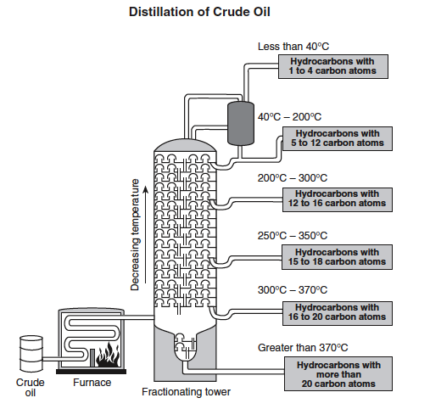
In which section of the fractionating tower do the molecules have the weakest intermolecular forces?
(1) Less than 40°C | (2) 200°C – 300°C
(3) 300°C – 370°C | (4) Greater than 370°C

Slide 188
In which section of the fractionating tower do the molecules have the weakest intermolecular forces?
(1) Less than 40°C | (2) 200°C – 300°C
(3) 300°C – 370°C | (4) Greater than 370°C
correct

Slide 189
What is the IUPAC name of one saturated hydrocarbon that leaves the fractionating tower at less that 40°C?
Octane | (2) decane
(3) hexane | (4) propane

Slide 190
What is the IUPAC name of one saturated hydrocarbon that leaves the fractionating tower at less that 40°C?
Octane | (2) decane
(3) hexane | (4) propane
correct

Slide 191
Which Lewis electron-dot diagram represents a boron atom in the ground state?
1 | (2) 2
(3) 3 | (4) 4

Slide 192
Which Lewis electron-dot diagram represents a boron atom in the ground state?
1 | (2) 2
(3) 3 | (4) 4
correct

Slide 193
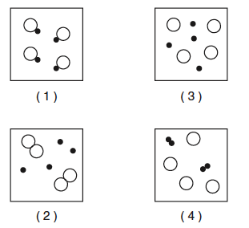
Which particle diagram represents one pure substance, only?
1 | (2) 2
(3) 3 | (4) 4

Slide 194
Which particle diagram represents one pure substance, only?
1 | (2) 2
(3) 3 | (4) 4
correct

Slide 195
Given the particle diagram above, at 101.3 kPa and 298 K, which element could this diagram represent?
Rn | (2) Xe
(3) Ag | (4) Kr

Slide 196
Given the particle diagram above, at 101.3 kPa and 298 K, which element could this diagram represent?
Rn | (2) Xe
(3) Ag | (4) Kr
correct

Slide 197
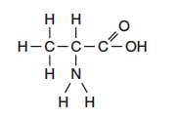
Given the structural formula, it could represent
An aldehyde | (2) A ketone
(3) An ester | (4) An amino acid

Slide 198
Given the structural formula, it could represent
An aldehyde | (2) A ketone
(3) An ester | (4) An amino acid
correct

Slide 199
Given the structures above, which molecule could be described as nonpolar with polar covalent bonds?
(1) H₂S | (2) CO₂
(3) F₂ | (4) None of these

Slide 200
Given the structures above, which molecule could be described as nonpolar with polar covalent bonds?
(1) H₂S | (2) CO₂
(3) F₂ | (4) None of these
correct

Slide 201
Which atom, when bonded as shown, has the same electron configuration as an atom of argon?
(1) S | (2) O
(3) H | (4) C

Slide 202
Which atom, when bonded as shown, has the same electron configuration as an atom of argon?
(1) S | (2) O
(3) H | (4) C
correct

Slide 203
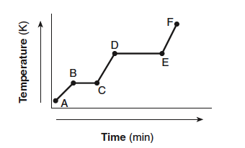
In which segments of this heating curve is the potential energy remaining constant?
(1) AB and BC | (2) BC and CD
(3) BC and DE | (4) DE and EF

Slide 204
In which segments of this heating curve is the potential energy remaining constant?
(1) AB and BC | (2) BC and CD
(3) BC and DE | (4) DE and EF
correct

Slide 205
In which segments of this heating curve is the kinetic energy increasing?
(1) AB and BC | (2) AB and DE
(3) CD and DE | (4) CD and AB

Slide 206
In which segments of this heating curve is the kinetic energy increasing?
(1) AB and BC | (2) AB and DE
(3) CD and DE | (4) CD and AB
correct

Slide 207
Which segment in the potential energy diagram above represents the heat of reaction?
(1) 1 | (2) 2
(3) 3 | (4) 4

Slide 208
Which segment in the potential energy diagram above represents the heat of reaction?
(1) 1 | (2) 2
(3) 3 | (4) 4
correct

Slide 209
What is the IUPAC name of the structure above?
(1) chlorobutane | (2) 3-chlorobutane
(3) 3-chlorobutene | (4) 2-chlorobutane

Slide 210
What is the IUPAC name of the structure above?
(1) chlorobutane | (2) 3-chlorobutane
(3) 3-chlorobutene | (4) 2-chlorobutane
correct

Slide 211
which of the following represents the correct numerical setup for calculating the molarity of the KOH?
(1) (1.4 M)(15.40 mL) = M_{b}(22.10 mL) | (2) 1.4 M/15.40 mL = M_{b}/22.10 mL
(3) (1.4 M)(22.10 mL) = M_{b}(15.40 mL) | (4) 15.40 mL/1.4M = M_{b}/22.10 mL

Slide 212
which of the following represents the correct numerical setup for calculating the molarity of the KOH?
(1) (1.4 M)(15.40 mL) = M_{b}(22.10 mL) | (2) 1.4 M/15.40 mL = M_{b}/22.10 mL
(3) (1.4 M)(22.10 mL) = M_{b}(15.40 mL) | (4) 15.40 mL/1.4M = M_{b}/22.10 mL
correct

Slide 213
What is the calculated heat lost to the water based on the data and procedure followed in the diagrams and table above?
(1) 310 J | (2) 418 J
(3) 1296 J | (4) 3100 J

Slide 214
What is the calculated heat lost to the water based on the data and procedure followed in the diagrams and table above?
(1) 310 J | (2) 418 J
(3) 1296 J | (4) 3100 J
correct

Slide 215
The data in the table above gives the temperature and pressure of four different gas samples, each in a 2-Liter container. Which two gas samples contain the same total number of particles?
(1) CH₄ and CO₂ | (2) CH₄ and Ne
(3) He and CO₂ | (4) He and Ne

Slide 216
The data in the table above gives the temperature and pressure of four different gas samples, each in a 2-Liter container. Which two gas samples contain the same total number of particles?
(1) CH₄ and CO₂ | (2) CH₄ and Ne
(3) He and CO₂ | (4) He and Ne
correct

Slide 217
Which two formulas represent compounds that are isomers of each other?
(1) A and B | (2) A and C
(3) B and D | (4) C and D

Slide 218
Which two formulas represent compounds that are isomers of each other?
(1) A and B | (2) A and C
(3) B and D | (4) C and D
correct

Slide 219
Which diagram represents the nucleus of an atom of ₁₃Al²⁷?
(1) 1 | (2) 2
(3) 3 | (4) 4

Slide 220
Which diagram represents the nucleus of an atom of ₁₃Al²⁷?
(1) 1 | (2) 2
(3) 3 | (4) 4
correct

Slide 221
Which particle diagram represents a mixture of element X and element Z only?
(1) 1 | (2) 2
(3) 3 | (4) 4

Slide 222
Which particle diagram represents a mixture of element X and element Z only?
(1) 1 | (2) 2
(3) 3 | (4) 4
correct

Slide 223
Given the potential energy diagram above, which interval represents the difference between the potential energy of the products and the potential energy of the reactants?
(1) 1 | (2) 2
(3) 3 | (4) 4

Slide 224
Given the potential energy diagram above, which interval represents the difference between the potential energy of the products and the potential energy of the reactants?
(1) 1 | (2) 2
(3) 3 | (4) 4
correct

Slide 225
What type of mixture is represented by X?
(1) aqueous | (2) Compound mixture
(3) heterogeneous | (4) solution

Slide 226
What type of mixture is represented by X?
(1) aqueous | (2) Compound mixture
(3) heterogeneous | (4) solution
correct

Slide 227
What type of substance is represented by Z?
(1) metallic | (2) Compound
(3) heterogeneous | (4) nonmetallic

Slide 228
What type of substance is represented by Z?
(1) metallic | (2) Compound
(3) heterogeneous | (4) nonmetallic
correct

Slide 229
Based on the data table above, what is the effect of the reactant on the rate of the chemical reaction?
(1) As concentration increases the rate decreases | (2) As the concentration increases the rate increases
(3) As concentration decreases the rate increases | (4) As concentration increases the rate remains unaffected

Slide 230
Based on the data table above, what is the effect of the reactant on the rate of the chemical reaction?
(1) As concentration increases the rate decreases | (2) As the concentration increases the rate increases
(3) As concentration decreases the rate increases | (4) As concentration increases the rate remains unaffected
correct

Slide 231
What type of organic reaction is represented by the equation above?
(1) addition | (2) substitution
(3) hydrogenation | (4) decomposition

Slide 232
What type of organic reaction is represented by the equation above?
(1) addition | (2) substitution
(3) hydrogenation | (4) decomposition
correct

Slide 233
What is the IUPAC name for the organic compound that reacts with Br₂?
(1) 1-propene | (2) 2-propene
(3) propane | (4) propene

Slide 234
What is the IUPAC name for the organic compound that reacts with Br₂?
(1) 1-propene | (2) 2-propene
(3) propane | (4) propene
correct

Slide 235
Based on this graph, what particle is emitted during the nuclear decay of a Po-218 atom?
(1) A beta particle | (2) An alpha particle
(3) A positron | (4) A neutron

Slide 236
Based on this graph, what particle is emitted during the nuclear decay of a Po-218 atom?
(1) A beta particle | (2) An alpha particle
(3) A positron | (4) A neutron
correct

Slide 237
The table above lists information about three radioisotopes and the body part each radioisotope is used to study. It could take up to 60. hours for a radioisotope to be delivered to the hospital from a laboratory where it is produced. What fraction of an original sample of Na-24 remains unchanged after 60. hours?
(1) 1/8 | (2) 1/4
(3) 1/16 | (4) 1/32

Slide 238
The table above lists information about three radioisotopes and the body part each radioisotope is used to study. It could take up to 60. hours for a radioisotope to be delivered to the hospital from a laboratory where it is produced. What fraction of an original sample of Na-24 remains unchanged after 60. hours?
(1) 1/8 | (2) 1/4
(3) 1/16 | (4) 1/32
correct

Slide 239
The graph above shows a compound being cooled at a constant rate starting at the liquid phase at 75°C and ending at 15°C. What is the freezing point of the compound, in degrees Celsius?
(1) 12°C | (2) 50°C
(3) 75°C | (4) 30°C

Slide 240
The graph above shows a compound being cooled at a constant rate starting at the liquid phase at 75°C and ending at 15°C. What is the freezing point of the compound, in degrees Celsius?
(1) 12°C | (2) 50°C
(3) 75°C | (4) 30°C
correct

Slide 241
Using burets, a student titrated a sodium hydroxide solution of unknown concentration with a standard solution of 0.10 M hydrochloric acid. Which of the following is the correct numerical setup for calculating the molarity of the sodium hydroxide solution?
(1) (0.10 M)(9.50 mL) = M_{b}(3.80 mL) | (2) 0.10 M)(15.50 mL) = M_{b}(5.00 mL)
(3) (0.10 M)(25.00 mL) = M_{b}(8.80 mL) | (4) (0.10 M)/9.50 mL = M_{b}/8.80 mL

Slide 242
Using burets, a student titrated a sodium hydroxide solution of unknown concentration with a standard solution of 0.10 M hydrochloric acid. Which of the following is the correct numerical setup for calculating the molarity of the sodium hydroxide solution?
(1) (0.10 M)(9.50 mL) = M_{b}(3.80 mL) | (2) 0.10 M)(15.50 mL) = M_{b}(5.00 mL)
(3) (0.10 M)(25.00 mL) = M_{b}(8.80 mL) | (4) (0.10 M)/9.50 mL = M_{b}/8.80 mL
correct

Slide 243
Looking at the results in bottle 3, what can the student conclude?
(1) [OH⁻] < [H₃O⁺] | (2) [OH⁻] > [H₃O⁺]
(3) [OH⁻] = [H₃O⁺] | (4) [H₃O⁺] > [OH⁻]

Slide 244
Looking at the results in bottle 3, what can the student conclude?
(1) [OH⁻] < [H₃O⁺] | (2) [OH⁻] > [H₃O⁺]
(3) [OH⁻] = [H₃O⁺] | (4) [H₃O⁺] > [OH⁻]
correct

Slide 245
Identify the type of reaction that takes place when magnesium reacts with the aqueous hydrochloric acid solution.
(1) substitution | (2) decomposition
(3) single replacement | (4) double replacement

Slide 246
Identify the type of reaction that takes place when magnesium reacts with the aqueous hydrochloric acid solution.
(1) substitution | (2) decomposition
(3) single replacement | (4) double replacement
correct

Slide 247
If a student uses a 2.50-gram sample of magnesium metal in the experiment above, how many moles of magnesium has he used?
(1) 0.104 | (2) 9.60
(3) 2.82 | (4) 0.208

Slide 248
If a student uses a 2.50-gram sample of magnesium metal in the experiment above, how many moles of magnesium has he used?
(1) 0.104 | (2) 9.60
(3) 2.82 | (4) 0.208
correct

Slide 249
(1) 1 | (2) 2
(3) 3 | (4) 4

Slide 250
(1) 1 | (2) 2
(3) 3 | (4) 4
correct

Slide 251
Which Lewis electron-dot diagram represents chloroethene?
(1) 1 | (2) 2
(3) 3 | (4) 4

Slide 252
Which Lewis electron-dot diagram represents chloroethene?
(1) 1 | (2) 2
(3) 3 | (4) 4
correct

Slide 253
Given the formula above, this compound is classified as
(1) An aldehyde | (2) An amine
(3) An amide | (4) A ketone

Slide 254
Given the formula above, this compound is classified as
(1) An aldehyde | (2) An amine
(3) An amide | (4) A ketone
correct

Slide 255
Which model correctly describes the locations of protons and electrons in the wave-mechnical model of the atom?
(1) A | (2) B
(3) C | (4) D

Slide 256
Which model correctly describes the locations of protons and electrons in the wave-mechnical model of the atom?
(1) A | (2) B
(3) C | (4) D
correct

Slide 257
The graph shows the relationship between the solubility of a sequence of primary alcohols in water. The temperature and pressure a kept constant.
Determine the total mass of 1-pentanol that will dissolve in 110. grams of water to produce a saturated solution
(1) 2.5 grams | (2) 0.8 grams
(3) 8.0 grams | (4) 0.5 grams

Slide 258
The graph shows the relationship between the solubility of a sequence of primary alcohols in water. The temperature and pressure a kept constant.
Determine the total mass of 1-pentanol that will dissolve in 110. grams of water to produce a saturated solution
(1) 2.5 grams | (2) 0.8 grams
(3) 8.0 grams | (4) 0.5 grams
correct

Slide 259
In terms of electron configuration and nuclear structure, why do oxygen and sulfur atoms form compounds with similar molecular structures?
(1) They have identical nuclear compositions | (2) They are located in the same period of the Periodic Table
(3) They have the same number of electron shells | (4) They have the same valence shell structure

Slide 260
In terms of electron configuration and nuclear structure, why do oxygen and sulfur atoms form compounds with similar molecular structures?
(1) They have identical nuclear compositions | (2) They are located in the same period of the Periodic Table
(3) They have the same number of electron shells | (4) They have the same valence shell structure
correct

Slide 261
What color is Thymol blue when added to milk of magnesia?
(1) Blue | (2) yellow
(3) green | (4) colorless

Slide 262
What color is Thymol blue when added to milk of magnesia?
(1) Blue | (2) yellow
(3) green | (4) colorless
correct

Slide 263
Given the structural formula above, what is the empirical formula of this compound?
(1) CH₃O | (2) C₂H₅O
(3) C₄H₁₀O₂ | (4) C₈H₂₀O₄

Slide 264
Given the structural formula above, what is the empirical formula of this compound?
(1) CH₃O | (2) C₂H₅O
(3) C₄H₁₀O₂ | (4) C₈H₂₀O₄
correct

Slide 265
Which chemical equation is balanced correctly?
(1) 1 | (2) 2
(3) 3 | (4) 4

Slide 266
Which chemical equation is balanced correctly?
(1) 1 | (2) 2
(3) 3 | (4) 4
correct

Slide 267
Which Lewis electron-dot diagram is correct for CO₂?
(1) 1 | (2) 2
(3) 3 | (4) 4

Slide 268
Which Lewis electron-dot diagram is correct for CO₂?
(1) 1 | (2) 2
(3) 3 | (4) 4
correct

Slide 269
Which structural formula is correct for 2-methyl-3-pentanol?
(1) 1 | (2) 2
(3) 3 | (4) 4

Slide 270
Which structural formula is correct for 2-methyl-3-pentanol?
(1) 1 | (2) 2
(3) 3 | (4) 4
correct

Slide 271
(1) 1 | (2) 2
(3) 3 | (4) 4

Slide 272
(1) 1 | (2) 2
(3) 3 | (4) 4
correct

Slide 273
Given the potential energy diagram, which statement correctly describes the energy changes that occur in the forward reaction?
(1) The activation energy is 10. kJ and the reaction is endothermic | (2) The activation energy is 10. kJ and the reaction is exothermic
(3) The activation energy is 50. kJ and the reaction is endothermic | (4) The activation energy is 50. kJ and the reaction is exothermic

Slide 274
Given the potential energy diagram, which statement correctly describes the energy changes that occur in the forward reaction?
(1) The activation energy is 10. kJ and the reaction is endothermic | (2) The activation energy is 10. kJ and the reaction is exothermic
(3) The activation energy is 50. kJ and the reaction is endothermic | (4) The activation energy is 50. kJ and the reaction is exothermic
correct

Slide 275
This compound is classified as an
(1) amide | (2) aldehyde
(3) amine | (4) alcohol

Slide 276
This compound is classified as an
(1) amide | (2) aldehyde
(3) amine | (4) alcohol
correct

Slide 277
The volume of 1.00 mole of hydrogen bromide gas at STP is 22.4 Liters. The gram-formula mass of hydrogen bromide is 80.9 grams/mole. What is the density of HBr at STP?
(1) 0.277 g/L | (2) 3.61 g/L
(3) 0.544 g/L | (4) 0.155 g/L

Slide 278
The volume of 1.00 mole of hydrogen bromide gas at STP is 22.4 Liters. The gram-formula mass of hydrogen bromide is 80.9 grams/mole. What is the density of HBr at STP?
(1) 0.277 g/L | (2) 3.61 g/L
(3) 0.544 g/L | (4) 0.155 g/L
correct

Slide 279
Which of the four molecular substances shows the greatest intermolecular forces of attraction?
(1) H₂ | (2) HCl
(3) HBr | (4) HI

Slide 280
Which of the four molecular substances shows the greatest intermolecular forces of attraction?
(1) H₂ | (2) HCl
(3) HBr | (4) HI
correct

Slide 281
What is the melting point of this substance?
(1) 110°C | (2) 50°C
(3) 165°C | (4) 15°C
correct

Slide 282
Which segment of this graph represents the gas phase only?
(1) EF | (2) CD
(3) DE | (4) AB

Slide 283
Which segment of this graph represents the gas phase only?
(1) EF | (2) CD
(3) DE | (4) AB

Slide 284
Which segment of this graph represents the gas phase only?
(1) EF | (2) CD
(3) DE | (4) AB
correct

Slide 285
What particles allow the electric to flow?
(1) O₂ and H₂ | (2) H₂O and H₃O⁺
(3) H₃O⁺ and SO₄⁻² | (4) O₂ and SO₄⁻²

Slide 286
What particles allow the electric to flow?
(1) O₂ and H₂ | (2) H₂O and H₃O⁺
(3) H₃O⁺ and SO₄⁻² | (4) O₂ and SO₄⁻²
correct

Slide 287
The empirical formula of a compound is CH₂. Which molecular formula is correctly paired with a structural formula for this compound?
(1) 1 | (2) 2
(3) 3 | (4) 4

Slide 288
The empirical formula of a compound is CH₂. Which molecular formula is correctly paired with a structural formula for this compound?
(1) 1 | (2) 2
(3) 3 | (4) 4
correct

Slide 289
Given the equation above, this equation represents the formation of a
(1) Fluoride ion, which is smaller in radius than a fluorine atom | (2) Fluoride ion, which is larger I radius that a fluorine atom
(3) Fluorine atom, which is smaller in radius than a fluoride ion | (4) Fluorine atom, which is larger in radius than a fluoride ion

Slide 290
Given the equation above, this equation represents the formation of a
(1) Fluoride ion, which is smaller in radius than a fluorine atom | (2) Fluoride ion, which is larger in radius that a fluorine atom
(3) Fluorine atom, which is smaller in radius than a fluoride ion | (4) Fluorine atom, which is larger in radius than a fluoride ion
correct

Slide 291
Which compound has an isomer?
(1) 1 | (2) 2
(3) 3 | (4) 4

Slide 292
Which compound has an isomer?
(1) 1 | (2) 2
(3) 3 | (4) 4
Correct

Slide 293
Which of the above equations is an example of artificial transmutation?
(1) 1 | (2) 2
(3) 3 | (4) 4

Slide 294
Which of the above equations is an example of artificial transmutation?
(1) 1 | (2) 2
(3) 3 | (4) 4
Correct

Slide 295
Given the solutions above, which list has the solutions placed in order of increasing H⁺ concentration?
(1) A,B,C | (2) B,A,C
(3) C,A,B | (4) C,B,A

Slide 296
Given the solutions above, which list has the solutions placed in order of increasing H⁺ concentration?
(1) A,B,C | (2) B,A,C
(3) C,A,B | (4) C,B,A
Correct

Slide 297
Given the reaction:
S(s) + O₂(g) -> SO₂(g) + energy
Which diagram best represents the potential energy changes for this reaction?
(1) 1 | (2) 2
(3) 3 | (4) 4

Slide 298
Given the reaction:
S(s) + O₂(g) -> SO₂(g) + energy
Which diagram best represents the potential energy changes for this reaction?
(1) 1 | (2) 2
(3) 3 | (4) 4
Correct

Slide 299
A chemist performs the same test on two homogeneous white crystalline solids, A and B. The results are shown in the table above. The results of these tests suggest that
(1) Both solids contain only ionic bonds | (2) Both solids contain only covalent bonds
(3) Solid A contains only covalent bonds and solid B contains only ionic bonds | (4) Solid A contains only ionic bonds and solid B contains only covalent bonds

Slide 300
A chemist performs the same test on two homogeneous white crystalline solids, A and B. The results are shown in the table above. The results of these tests suggest that
(1) Both solids contain only ionic bonds | (2) Both solids contain only covalent bonds
(3) Solid A contains only covalent bonds and solid B contains only ionic bonds | (4) Solid A contains only ionic bonds and solid B contains only covalent bonds
Correct

Slide 301
Which salt is most soluble at 60 °C?
(1) A | (2) B
(3) C | (4) D

Slide 302
Which salt is most soluble at 60 °C?
(1) A | (2) B
(3) C | (4) D
Correct

Slide 303
A gas occupies a volume of 40.0 milliliters at 20°C. If the volume is increased to 80.0 milliliters at a constant pressure, the resulting temperature will be equal to which of the above
(1) 1 | (2) 2
(3) 3 | (4) 4

Slide 304
A gas occupies a volume of 40.0 milliliters at 20°C. If the volume is increased to 80.0 milliliters at a constant pressure, the resulting temperature will be equal to which of the above
(1) 1 | (2) 2
(3) 3 | (4) 4
Correct

Slide 305
The graph above represents the heating curve of a substance that starts as a solid below its freezing point. What is the melting point of this substance?
(1) 30°C | (2) 55°C
(3) 90°C | (4) 120°C

Slide 306
The graph above represents the heating curve of a substance that starts as a solid below its freezing point. What is the melting point of this substance?
(1) 30°C | (2) 55°C
(3) 90°C | (4) 120°C
Correct

Slide 307
Which type of organic compound is represented by the structural formula shown above?
(1) aldehyde | (2) alcohol
(3) ether | (4) ester

Slide 308
Which type of organic compound is represented by the structural formula shown above?
(1) aldehyde | (2) alcohol
(3) ether | (4) ester
Correct

Slide 309
What type of nuclear reaction is indicated by the equation above?
(1) Fission | (2) Single replacement
(3) Fusion | (4) Nuclear mutation

Slide 310
What type of nuclear reaction is indicated by the equation above?
(1) Fission | (2) Single replacement
(3) Fusion | (4) Nuclear mutation
Correct

Slide 311
Rutherford performed an experiment which appeared to indicate that most of the alpha particles passed directly through the gold foil. A few particles were deflected from their straight-line paths. This would seem to indicate that
(1) The greatest concentration of positive charge is located outside the nucleus | (2) The atom is mostly empty space with a small dense positive nucleus
(3) Alpha particles were deflected by the negatively charged electrons | (4) The nucleus is mostly empty space surrounded by a dense region of electrons

Slide 312
Rutherford performed an experiment which appeared to indicate that most of the alpha particles passed directly through the gold foil. A few particles were deflected from their straight-line paths. This would seem to indicate that
(1) The greatest concentration of positive charge is located outside the nucleus | (2) The atom is mostly empty space with a small dense positive nucleus
(3) Alpha particles were deflected by the negatively charged electrons | (4) The nucleus is mostly empty space surrounded by a dense region of electrons
Correct

Slide 313
What is the vapor pressure of Liquid A at 70°C?
(1) 710 mm Hg | (2) 114 mm Hg
(3) 200 mm Hg | (4) 538 mm Hg

Slide 314
What is the vapor pressure of Liquid A at 70°C?
(1) 710 mm Hg | (2) 114 mm Hg
(3) 200 mm Hg | (4) 538 mm Hg
Correct

Slide 315
A titration setup was used to determine the unknown molar concentration of a solution of NaOH. A 1.2 M HCl solution was used as the titration standard. Calculate the volume of NaOH solution used to neutralize 10.0 mL of the HCl in trial 3.
(1) 14.5 mL | (2) 12.0 mL
(3) 32.0 mL | (4) 10.5 mL

Slide 316
A titration setup was used to determine the unknown molar concentration of a solution of NaOH. A 1.2 M HCl solution was used as the titration standard. Calculate the volume of NaOH solution used to neutralize 10.0 mL of the HCl in trial 3.
(1) 14.5 mL | (2) 12.0 mL
(3) 32.0 mL | (4) 10.5 mL
Correct

Slide 317
What is the total number of moles of NaCl formed when 2 moles of Na₂CrO₄ react completely?
(1) 1 mole | (2) 2 moles
(3) 3 moles | (4) 4 moles

Slide 318
What is the total number of moles of NaCl formed when 2 moles of Na₂CrO₄ react completely?
(1) 1 mole | (2) 2 moles
(3) 3 moles | (4) 4 moles
Correct

Slide 319
Which equation above represents a neutralization?
(1) 1 | (2) 2
(3) 3 | (4) 4

Slide 320
Which equation above represents a neutralization?
(1) 1 | (2) 2
(3) 3 | (4) 4
Correct

Slide 321
Which arrow on the diagram above represents the activation energy of the forward reaction?
(1) A | (2) B
(3) C | (4) D

Slide 322
Which arrow on the diagram above represents the activation energy of the forward reaction?
(1) A | (2) B
(3) C | (4) D
Correct

Slide 323
You are given the formulas of four organic compounds above, which pair contains an alcohol and an acid?
(1) a and b | (2) a and c
(3) b and d | (4) c and d

Slide 324
You are given the formulas of four organic compounds above, which pair contains an alcohol and an acid?
(1) a and b | (2) a and c
(3) b and d | (4) c and d
Correct

Slide 325
You are given the formulas of four organic compounds above, which pair contains an alcohol and an acid?
(1) esterification | (2) fermentation
(3) saponification | (4) polymerization

Slide 326
You are given the formulas of four organic compounds above, which pair contains an alcohol and an acid?
(1) esterification | (2) fermentation
(3) saponification | (4) polymerization
Correct

Slide 327
When the switch is closed, electrons flow from
(1) The Pb(s) to the Cu(s) | (2) The Cu(s) to the Pb(s)
(3) The Pb²⁺(aq) to the Pb(s) | (4) The Cu²⁺(aq) to the Cu(s)

Slide 328
When the switch is closed, electrons flow from
(1) The Pb(s) to the Cu(s) | (2) The Cu(s) to the Pb(s)
(3) The Pb²⁺(aq) to the Pb(s) | (4) The Cu²⁺(aq) to the Cu(s)
Correct

Slide 329
Based on the data table above, which unknown solution could be 0.1 M NaOH?
(1) A | (2) B
(3) C | (4) D

Slide 330
Based on the data table above, which unknown solution could be 0.1 M NaOH?
(1) A | (2) B
(3) C | (4) D
Correct

Slide 331
What is the total number of valence electrons in an atom of electron configuration X?
(1) 3 | (2) 10
(3) 18 | (4) 2

Slide 332
What is the total number of valence electrons in an atom of electron configuration X?
(1) 3 | (2) 10
(3) 18 | (4) 2
Correct

Slide 333
Which Lewis electron-dot structure is drawn correctly for the atom it represents?
(1) 1 | (2) 2
(3) 3 | (4) 4

Slide 334
Which Lewis electron-dot structure is drawn correctly for the atom it represents?
(1) 1 | (2) 2
(3) 3 | (4) 4
Correct

Slide 335
Which structural formula correctly represents a hydrocarbon molecule?
(1) 1 | (2) 2
(3) 3 | (4) 4

Slide 336
Which structural formula correctly represents a hydrocarbon molecule?
(1) 1 | (2) 2
(3) 3 | (4) 4
Correct

Slide 337
The differences in the physical properties and chemical properties of these two organic compounds are primarily due to their different
(1) Number of carbon atoms | (2) Number of hydrogen atoms
(3) Molecular masses | (4) Functional groups

Slide 338
The differences in the physical properties and chemical properties of these two organic compounds are primarily due to their different
(1) Number of carbon atoms | (2) Number of hydrogen atoms
(3) Molecular masses | (4) Functional groups
Correct

Slide 339
Which structural formula to the left represents a molecule that is not an isomer of pentane?
(1) 1 | (2) 2
(3) 3 | (4) 4

Slide 340
Which structural formula to the left represents a molecule that is not an isomer of pentane?
(1) 1 | (2) 2
(3) 3 | (4) 4
Correct

Slide 341
which equation represents a double replacement reaction?
(1) 1 | (2) 2
(3) 3 | (4) 4

Slide 342
which equation represents a double replacement reaction?
(1) 1 | (2) 2
(3) 3 | (4) 4
Correct

Slide 343
Which diagram represents a mixture of elements A and B?
(1) X, only | (2) Z, only
(3) X and Y | (4) X and Z

Slide 344
Which diagram represents a mixture of elements A and B?
(1) X, only | (2) Z, only
(3) X and Y | (4) X and Z
Correct

Slide 345
Which structural formula represents an alcohol?
(1) 1 | (2) 2
(3) 3 | (4) 4

Slide 346
Which structural formula represents an alcohol?
(1) 1 | (2) 2
(3) 3 | (4) 4
Correct

Slide 347
Identify the two elements in the unknown sample based on the spectral information above.
(1) H and Li | (2) Na and Li
(3) H and He | (4) Na and He

Slide 348
Identify the two elements in the unknown sample based on the spectral information above.
(1) H and Li | (2) Na and Li
(3) H and He | (4) Na and He
Correct

Slide 349
What is the calculated average atomic mass of element X (use the correct number of significant figures in your answer)?
(1) 11.02 | (2) 10.8
(3) 10.81 | (4) 11.20

Slide 350
What is the calculated average atomic mass of element X (use the correct number of significant figures in your answer)?
(1) 11.02 | (2) 10.8
(3) 10.81 | (4) 11.20
Correct

Slide 351
What is the IUPAC name of the compound with the structural formula above?
(1) propanone | (2) propanal
(3) butanone | (4) butanal

Slide 352
What is the IUPAC name of the compound with the structural formula above?
(1) propanone | (2) propanal
(3) butanone | (4) butanal
Correct

Slide 353
Which equation represents a spontaneous nuclear decay?
(1) 1 | (2) 2
(3) 3 | (4) 4

Slide 354
Which equation represents a spontaneous nuclear decay?
(1) 1 | (2) 2
(3) 3 | (4) 4
Correct

Slide 355
Which substance is an ionic compound?
(1) A | (2) B
(3) C | (4) D

Slide 356
Which substance is an ionic compound?
(1) A | (2) B
(3) C | (4) D
Correct

Slide 357
What is the correct Lewis electron-dot structure for the compound magnesium fluoride?
(1) 1 | (2) 2
(3) 3 | (4) 4

Slide 358
What is the correct Lewis electron-dot structure for the compound magnesium fluoride?
(1) 1 | (2) 2
(3) 3 | (4) 4
Correct

Slide 359
Which equation shows both conservation of mass and charge?
(1) 1 | (2) 2
(3) 3 | (4) 4

Slide 360
Which equation shows both conservation of mass and charge?
(1) 1 | (2) 2
(3) 3 | (4) 4
Correct

Slide 361
The volume of a gas is 4.00 Liters at 293 K and constant pressure. For the volume of the gas to become 3.00 Liters, the Kelvin temperature must be equal to which of the above setups?
(1) 1 | (2) 2
(3) 3 | (4) 4

Slide 362
The volume of a gas is 4.00 Liters at 293 K and constant pressure. For the volume of the gas to become 3.00 Liters, the Kelvin temperature must be equal to which of the above setups?
(1) 1 | (2) 2
(3) 3 | (4) 4
Correct

Slide 363
Which graph best represents the pressure-volume relationship for an ideal gas at constant temperature?
(1) 1 | (2) 2
(3) 3 | (4) 4

Slide 364
Which graph best represents the pressure-volume relationship for an ideal gas at constant temperature?
(1) 1 | (2) 2
(3) 3 | (4) 4
Correct

Slide 365
The diagram above shows a key being plated with copper in an electrolytic cell. Given the reduction reaction for this cell: Cu²⁺(aq) + 2e⁻ -> Cu(s)
This reduction reaction occurs at
(1) A, which is the anode | (2) A, which is the cathode
(3) B, which is the anode | (4) B, which is the cathode

Slide 366
The diagram above shows a key being plated with copper in an electrolytic cell. Given the reduction reaction for this cell: Cu²⁺(aq) + 2e⁻ -> Cu(s)
This reduction reaction occurs at
(1) A, which is the anode | (2) A, which is the cathode
(3) B, which is the anode | (4) B, which is the cathode
Correct

Slide 367
Which electron configuration represents an atom of chlorine in an excited state?
(1) 1 | (2) 2
(3) 3 | (4) 4

Slide 368
Which electron configuration represents an atom of chlorine in an excited state?
(1) 1 | (2) 2
(3) 3 | (4) 4
Correct

Slide 369
When the switch is closed. What is the direction of flow of the electrons?
(1) Pb²⁺ -> Ag⁺ | (2) Ag⁺ -> Pb²⁺
(3) Pb -> Ag | (4) Ag -> Pb

Slide 370
When the switch is closed. What is the direction of flow of the electrons?
(1) Pb²⁺ -> Ag⁺ | (2) Ag⁺ -> Pb²⁺
(3) Pb -> Ag | (4) Ag -> Pb
Correct

Slide 371
Identify the two gases in the unknown mixture?
(1) A and D | (2) A and C
(3) B and D | (4) B and C

Slide 372
Identify the two gases in the unknown mixture?
(1) A and D | (2) A and C
(3) B and D | (4) B and C
Correct

Slide 373
Which sample(s) represent a pure compound?
(1) Sample 1 | (2) Sample 2
(3) Sample 3 | (4) Sample 1 and sample 2

Slide 374
Which sample(s) represent a pure compound?
(1) Sample 1 | (2) Sample 2
(3) Sample 3 | (4) Sample 1 and sample 2
Correct

Slide 375
What is the name of this type of organic reaction?
(1) addition | (2) substitution
(3) saponification | (4) esterification

Slide 376
What is the name of this type of organic reaction?
(1) addition | (2) substitution
(3) saponification | (4) esterification
Correct

Slide 377
Which lettered interval on the above diagram represents the potential energy of the products?
(1) A | (2) B
(3) C | (4) D

Slide 378
Which lettered interval on the above diagram represents the potential energy of the products?
(1) A | (2) B
(3) C | (4) D
Correct

Slide 379
The reaction above is an example of
(1) fermentation | (2) saponification
(3) hydrogenation | (4) esterification

Slide 380
The reaction above is an example of
(1) fermentation | (2) saponification
(3) hydrogenation | (4) esterification
Correct

Slide 381
Which electron configuration represents the electrons of an atom in the excited state?
(1) 1 | (2) 2
(3) 3 | (4) 4

Slide 382
Which electron configuration represents the electrons of an atom in the excited state?
(1) 1 | (2) 2
(3) 3 | (4) 4
Correct

Slide 383
Which line segment represents an increase in the potential energy and no change in average kinetic energy?
(1) A-B | (2) B-C
(3) C-D | (4) E-F

Slide 384
Which line segment represents an increase in the potential energy and no change in average kinetic energy?
(1) A-B | (2) B-C
(3) C-D | (4) E-F
Correct

Slide 385
Which structural formula represents 2-pentyne?
(1) 1 | (2) 2
(3) 3 | (4) 4

Slide 386
Which structural formula represents 2-pentyne?
(1) 1 | (2) 2
(3) 3 | (4) 4
Correct

Slide 387
Which structural formula represents and aldehyde?
(1) 1 | (2) 2
(3) 3 | (4) 4

Slide 388
Which structural formula represents and aldehyde?
(1) 1 | (2) 2
(3) 3 | (4) 4
Correct

Slide 389
Which structural formula represents and aldehyde?
(1) 1 | (2) 2
(3) 3 | (4) 4

Slide 390
Which structural formula represents and aldehyde?
(1) 1 | (2) 2
(3) 3 | (4) 4
Correct

Slide 391
Which of the following setups could be used to calculate the average atomic mass of Ne based on the information above?
(1) 19.99/3 | (2) (19.99)(.909) + (20.99)(0.003)
(3) 19.99(.909) + (20.99)(0.003) + (21.99)(.088) | (4) (19.99 + 20.99 + 21.99)/3

Slide 392
Which of the following setups could be used to calculate the average atomic mass of Ne based on the information above?
(1) 19.99/3 | (2) (19.99)(.909) + (20.99)(0.003)
(3) 19.99(.909) + (20.99)(0.003) + (21.99)(.088) | (4) (19.99 + 20.99 + 21.99)/3
Correct

Slide 393
Which electrons are represented by all of the dots?
(1) The carbon valence electrons, only | (2) The hydrogen valence electrons, only
(3) The carbon and hydrogen valence electrons | (4) All of the carbon and hydrogen electrons

Slide 394
Which electrons are represented by all of the dots?
(1) The carbon valence electrons, only | (2) The hydrogen valence electrons, only
(3) The carbon and hydrogen valence electrons | (4) All of the carbon and hydrogen electrons
Correct

Slide 395
What is the IUPAC name of the compound with the structural formula shown above?
(1) 2-pentene | (2) 3-pentene
(3) 2-pentyne | (4) 3-pentyne

Slide 396
What is the IUPAC name of the compound with the structural formula shown above?
(1) 2-pentene | (2) 3-pentene
(3) 2-pentyne | (4) 3-pentyne
Correct

Slide 397
(1) 1 | (2) 2
(3) 3 | (4) 4

Slide 398
(1) 1 | (2) 2
(3) 3 | (4) 4
Correct

Slide 399
(1) 1 | (2) 2
(3) 3 | (4) 4

Slide 400
(1) 1 | (2) 2
(3) 3 | (4) 4
Correct

Slide 401
(1) 1 | (2) 2
(3) 3 | (4) 4

Slide 402
(1) 1 | (2) 2
(3) 3 | (4) 4
Correct

Slide 403
(1) 1 | (2) 2
(3) 3 | (4) 4

Slide 404
(1) 1 | (2) 2
(3) 3 | (4) 4
Correct

Slide 405
(1) 1 | (2) 2
(3) 3 | (4) 4

Slide 406
(1) 1 | (2) 2
(3) 3 | (4) 4
Correct

Slide 407
Which line segments represent an increase in average kinetic energy?
(1) AB and BC | (2) AB and CD
(3) BC and DE | (4) DE and EF

Slide 408
Which line segments represent an increase in average kinetic energy?
(1) AB and BC | (2) AB and CD
(3) BC and DE | (4) DE and EF
Correct

Slide 409
Which organic-compound classes are represented by the above structural formulas, as shown from left to right?
(1) ester, organic acid, ketone | (2) ester, aldehyde, organic acid
(3) ketone, aldehyde, alcohol | (4) ketone, organic acid, alcohol

Slide 410
Which organic-compound classes are represented by the above structural formulas, as shown from left to right?
(1) ester, organic acid, ketone | (2) ester, aldehyde, organic acid
(3) ketone, aldehyde, alcohol | (4) ketone, organic acid, alcohol
Correct

Slide 411
(1) 1 | (2) 2
(3) 3 | (4) 4

Slide 412
(1) 1 | (2) 2
(3) 3 | (4) 4
Correct

Slide 413
(1) 1 | (2) 2
(3) 3 | (4) 4

Slide 414
(1) 1 | (2) 2
(3) 3 | (4) 4
Correct

Slide 415
Which of the above diagrams represents a pure substance?
(1) A, only | (2) B, only
(3) C, only | (4) B and C

Slide 416
Which of the above diagrams represents a pure substance?
(1) A, only | (2) B, only
(3) C, only | (4) B and C
Correct

Slide 417
Which of the following could be identified as the reducing agent in the above cell?
(1) Zn | (2) Zn²⁺
(3) Pb | (4) Pb²⁺

Slide 418
Which of the following could be identified as the reducing agent in the above cell?
(1) Zn | (2) Zn²⁺
(3) Pb | (4) Pb²⁺
Correct

Slide 419
Based on Reference Table F, describe the solubility of magnesium hydroxide in water.
(1) very soluble | (2) insoluble
(3) slightly soluble | (4) supersaturated

Slide 420
Based on Reference Table F, describe the solubility of magnesium hydroxide in water.
(1) very soluble | (2) insoluble
(3) slightly soluble | (4) supersaturated
Correct

