Slide 1
The history of the atom
Scientists and their discoveries

Slide 2
The important questions…
Who discovered the atom?
What is an atom?
What is the Periodic Table?
Why is it important to you?

Slide 3
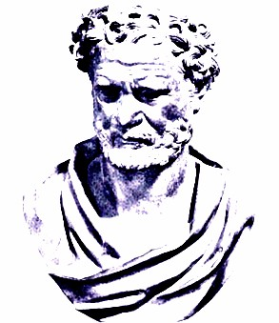
Democritus (460 BC ~ 370 BC)
Proposed an Atomic Theory
which states that all atoms
are small, hard, indivisible and
indestructible particles made
of a single material formed
into different shapes and
sizes.
Aristotle did not support his
atomic theory
http://www.chemteam.info/AtomicStructure/Greeks.html

Slide 4
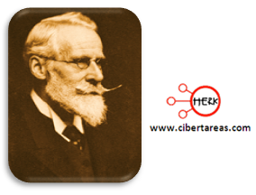
John Dalton (1766 ~1844)
In 1803, proposed an Atomic Theory which states:
All substances are made of atoms; atoms are
small particles that cannot be created, divided, or
destroyed.
Atoms of the same element are exactly alike, and
atoms of different elements are different
Atoms join with other atoms to make new substances
Calculated the atomic weights of various elements
https://prezi.com/yvzpnneczway/john-dalton-atomic-theory-gas-experiments/

Slide 5
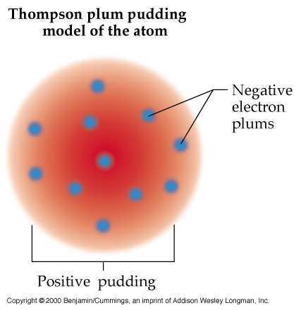
J.J. Thomson (1856 ~ 1940)
Proved that an atom can be divided into smaller parts
Discovered electrons
Stated that the atom is neutral
In 1897, proposed the Plum Pudding Model which states that atoms mostly consist of positively charged material with negatively charged particles (electrons) located throughout the positive material
Won a Nobel Prize
Watch this video about JJ Thomson
http://www.teachertube.com/video/j-j-thomson-81901

Slide 6
Niels Bohr (1885 ~ 1962)
In 1913, proposed the Bohr Model, which suggests that
electrons travel around the nucleus of an atom in orbits or
definite paths. Additionally, the electrons can jump from
a path in one level to a path in another level (depending on their energy)
Won a Nobel Prize
Worked with Ernest Rutherford
Watch the following video
http://video.about.com/inventors/Profile-of-Niels-Bohr.htm

Slide 7
Matter
Anything that has mass and takes up space (volume)
Can you think of anything that would not be considered matter?
Examples:
A brick has mass and takes up space
A desk has mass and takes up space
A pencil has mass and takes up space
Air has mass and takes up space

Slide 8
Atoms
Atoms- smallest possible unit into which matter can be divided, while still maintaining its properties.
Made up of Protons, Neutrons, and Electrons

Slide 9
Atoms are so small that…
A stack of 50,000 aluminum atoms = the thickness of a sheet of aluminum foil from your kitchen.
If you could enlarge a penny until it was as wide as the US, each of its atoms would be only about 3 cm in diameter about the size of a ping-pong ball
Human hair is about 1 million carbon atoms wide.
Typical human cell contains roughly 1 trillion atoms.
A speck of dust might contain 3x1012 (3 trillion) atoms.
It would take you around 500 years to count the number of atoms in a grain of salt.

Slide 10
Let’s Experiment
In order to try to gain an idea of how small an atom really is, you will complete the following activity.
Cut a strip of 11 in. paper in half.
Discard one half.
Cut the remaining piece in half.
Continue cutting the pieces in half and discarding the strips as many times as you
can, counting the number of cuts you make

Slide 11
results
How many cuts were you able to make?
Do you think you could keep cutting the paper forever? Why or why not?
You would have to cut the paper in half around 31 times to get to the size
of any atom.

Slide 12
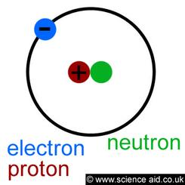
Protons (+) Neutrons Electrons (-)
Protons- positively
charged particles
Make up part of the
nucleus of the atom
Identify the atom
Equal to the atomic
number of the atom
Contribute to the
atomic mass
Equal to the number of
electrons
Neutrons- neutral
particles; have no
electric charge
Help make up the
nucleus of the
atom
Contribute to the
atomic mass
Electrons- negatively charged
particles
Found outside the nucleus of the atom in electron orbits/levels
Each orbit/level can hold a maximum number of electrons
1st = 2, 2nd = 8, 3rd = 8
Equal to the number of
Protons
Valence electrons- the
outermost electrons involved in the formation of chemical bonds

Slide 13
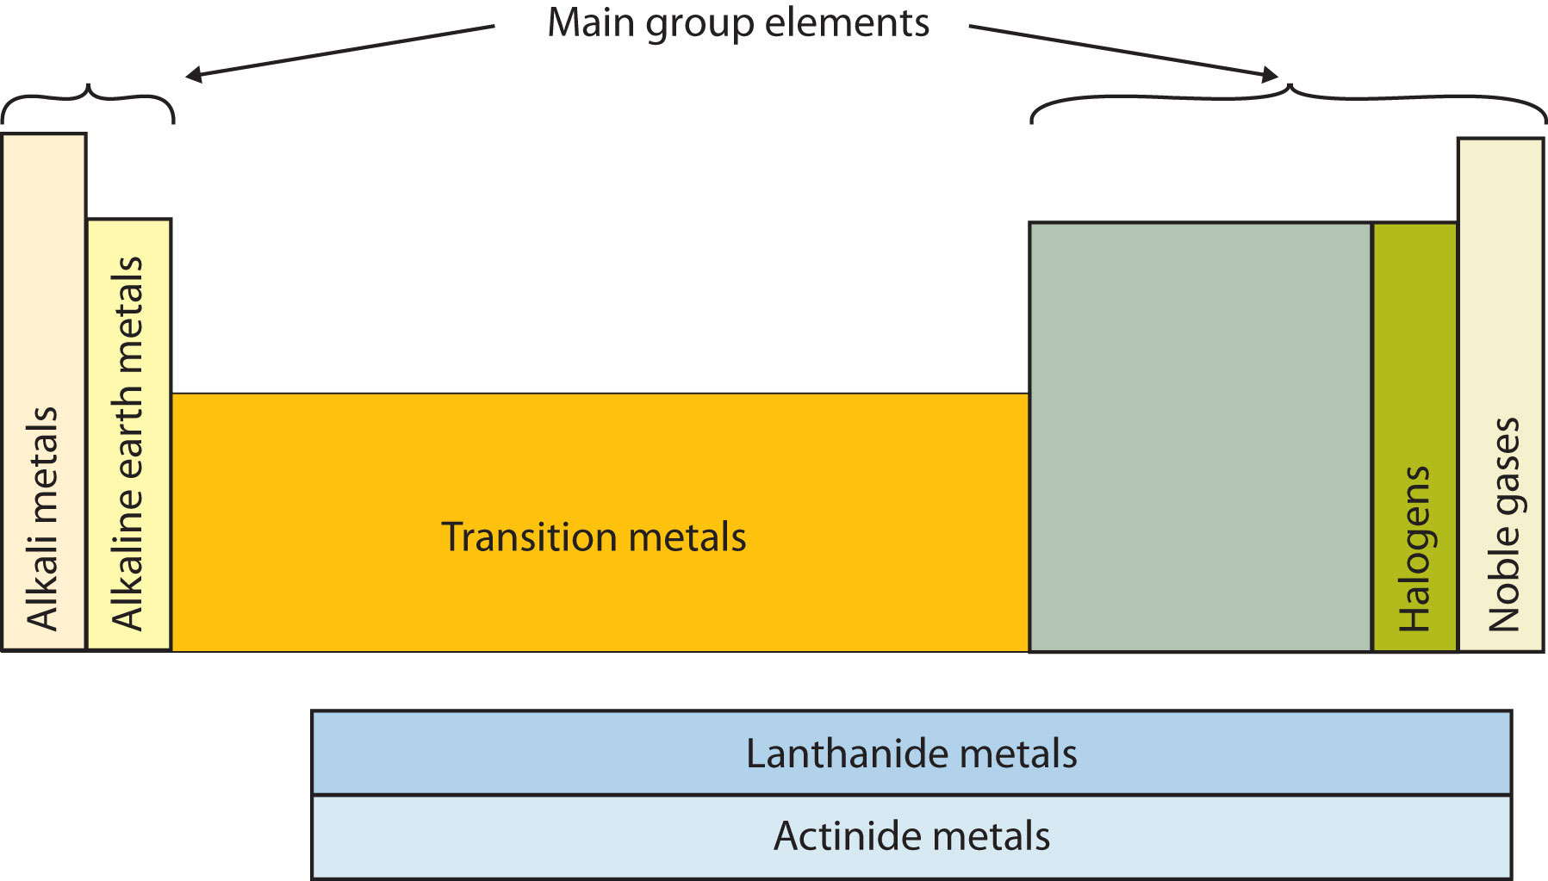
Elements
Element- made up of one
kind of atom that can’t be
broken down into simpler
substances by physical or
chemical means
90 occur naturally on Earth
25 were synthesized (made) by scientists
Listen to the Elements Song

Slide 14
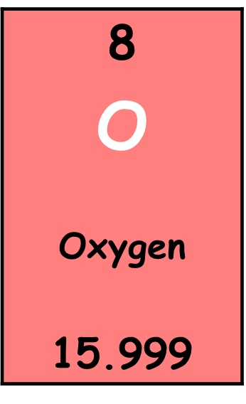
The Periodic Table Elements
Boxes in the periodic table contain a lot of information. To understand this information, it is necessary to refer to the periodic table’s key.
Atomic Number
Element Symbol (a capital letter or a capital followed by a lower case letter)
Element Name
Atomic Mass

Slide 15
Atomic number and atomic mass
Atomic number- the number of protons in the nucleus of an atom equal to the number of electrons to make an atom neutral.
Protons are equal to electrons in a neutral atom. Protons are also the same as the atomic number of an element.
Atomic mass- the total number of protons and neutrons in an atom’s nucleus. Expressed in Atomic Mass Units (amu).
Atomic Mass minus the number of protons will give you the number of neutrons in a neutral atom.

Slide 16
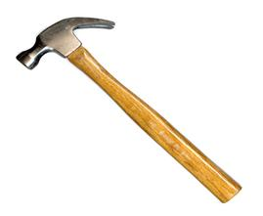
Building atoms

Slide 17
Bohr electron diagrams
Show ALL the electrons in an atom. Notice the 1 electron in the 1st orbital. The rule is 2 in the first orbital, then 8, 8 = full and stable (unreactive)
Oxygen (O) Atom
Notice the two electrons in the first orbital/level and the six in the second
How many
more electrons
can fit in the 2nd
orbital/ level?
=8
=8
=8

Slide 18
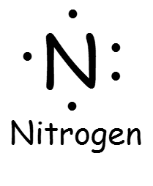
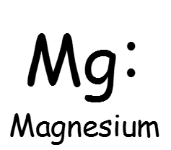
Lewis Structure (Electron Dot Diagram)
Valence electrons- the electrons in the outermost shell that are responsible for how an atom will behave chemically
Lewis Dot Structure- way of drawing ONLY the valence electrons of an atom
Element symbol surrounded by as many dots as there are valence electrons
How many valence electrons
do each of these atoms have?

Slide 19
Making an Electron Dot Diagram
Write down the element’s symbol
and place the first two dots on any
side of the symbol.
If this were an atom of an element
from group 1, you would just place the
one dot on any side of the element.
Place the rest of the dots in either a
clockwise or counter clockwise manner around
the symbol, with no side receiving two dots
until each side gets one.

Slide 20
Check for understanding
How many valence electrons does each element have…
H
Ne
O
Mg

Slide 21
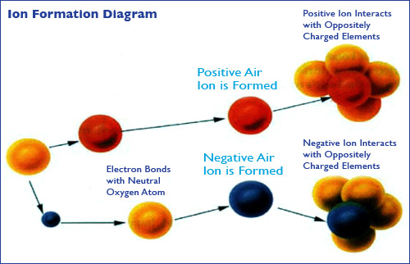
ions
Charged particle that typically results from a loss or gain of electrons
Two types:
Anion = negatively charged particle
Cation = positively charged particle
Be aware that the atomic and atomic mass are not
impacted by the loss or gain of electrons.

Slide 22
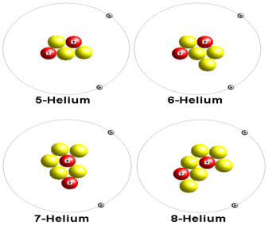
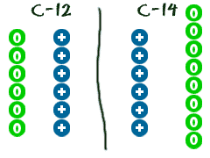
Isotopes
Isotopes- atoms that have the same number of protons, but have different numbers of neutrons. Recall that the atomic mass is the number of neutrons and protons in an atom so the atomic mass will change.
Notice each isotope of helium has the same number of protons but different number of neutrons
Carbon 12 and
Carbon 14 have the same number of protons but a different number of neutrons

Slide 23
The periodic table of elements
Periodic Table of Elements – a table of the elements, arranged by atomic number, that shows
the patterns in their properties; based on the periodic law

Slide 24
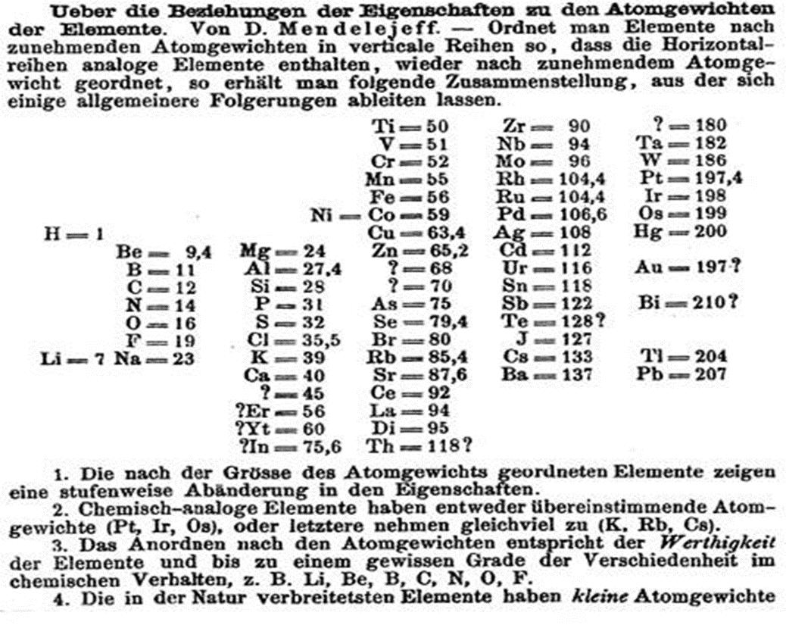
Dmitri Mendeleev
In the 1860’s he devised a
periodic table where the
elements were ordered by
their atomic masses
He did this by grouping
elements together according
to their similarities
Why do you think there are question
marks in his periodic table??

Slide 25
3 Classes of Elements
Metals
Non-Metals
Metalloids
Location
Found on the left of the zigzag line/staircase on the periodic table (exception → Hydrogen)
Chemical Properties
Have few electrons in their outer energy level, thus lose electrons easily
Physical Properties
Ductile, good conductors, malleable, shiny, most are solid at room temperature
Location
Most found to the right of the zigzag line/staircase on the periodic table
Chemical Properties
Most have almost full outer energy levels, thus they tend to gain electrons; some have completely full outer level
Physical Properties
Not ductile or malleable, not shiny, poor conductors, most are solid, but some are gas at room temperature
Location
Border the zigzag line/staircase on the periodic table
Chemical Properties
Most atoms have ½ (≈) complete set of electrons in outer level
Physical Properties
have properties of both metals and non-metals

Slide 26
Important Features of the Periodic Table
Period- each horizontal row of elements on the periodic table
Seven periods on a periodic table (numbered from the top down)
Atomic numbers and atomic masses increase as you move from the left to the right in a period
All atoms of the elements in the same period have the same number of orbitals/levels
All atoms of the elements in a specific period have that respective number of orbitals/levels
Example
Period 1 = 1 orbital
Period 2 = 2 orbitals
Period 3 = 3 orbitals
Etc…

Slide 27
Important Features of the Periodic Table
Group- each column of elements on the periodic table
Eighteen groups on the periodic table (numbered from left to right)
Atomic numbers and atomic masses increase as you move from the top down in a group (family)
Atoms of elements in the same group have the same number of electrons in the outer orbitals of their atoms (known as valence electrons)
Exceptions:
Transition elements (3-12)
Helium (actually has 2 valence electrons)
Elements in groups usually have similar physical and chemical properties

Slide 28
Determining the Number of Valence Electrons by Using the Periodic Table
*Atoms of elements in Groups 1 and 2 have the same number of valence electrons as their group number.
*Atoms of elements in Group 3-12 do not have a general rule relating their valence electrons to their group number. However, they typically have between 1 or 2 valence electrons.
*Atoms of elements in Groups 13-18 have 10 fewer valence electrons than their group number. (Exception - helium atoms have only 2 valence electrons, even though they are in group 18)

