Slide 1
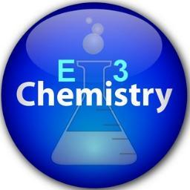
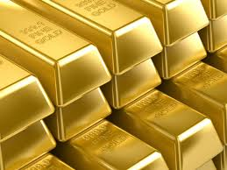
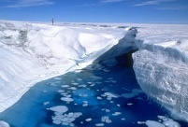
Interactive By
Chemistry E3 Scholastic
Notes Publishing
(NYS: The Physical Setting Curriculum)
Topic 1
Matter and Energy
© 2013 E3 Scholastic Publishing. All Rights Reserved E3hemistry.com SurvivingChem.com
Introduction to chemistry
Practice Problem Sets
PoPuP Quiz
Thanks for previewing my notes.
Please visit my sites for more.
Lesson 1. Classifications of Matter
Lesson 2. Phases and Changes of Matter
For Books of Test Preps and Instructional Materials
Lesson 3: Heat and Heat Calculations
For Digital Downloads of Test Preps and Instructional Materials
SurvivingChem.com
TpT Store
Lesson 4: Characteristics of Gases and Gas Laws
E3Chemistry.com
Teachers Notebook Shop
Lesson 5: Physical and Chemical Properties of Matter
Important info
Click to Topic
Click to Restore

Slide 2
Introduction to Chemistry
© 2013 E3 Scholastic Publishing. All Rights Reserved E3hemistry.com SurvivingChem.com
Chemistry is the study of matter:
● Its composition, structures, properties, changes, and
energy accompanying the changes
Matter Is anything that has mass and occupy space (has volume)
● matter is “stuff”
Previous Concept
Next Concept
1
2
3
4
5
HOME
Lessons

Slide 3
Lesson 1. Classification of Matter
© 2013 E3 Scholastic Publishing. All Rights Reserved E3hemistry.com SurvivingChem.com
Index of Concepts
Introduction
Separation of Mixtures
Pure substances
Decantation
Elements
Filtration
Compounds
Evaporation
Law of definite composition
Distillation
Mixtures
Chromatography
Homogeneous mixtures
Heterogeneous mixtures
PoPuP Quiz
Classification Diagram
Formula Representations of Matter
Diagram Representations of Matter
Previous Concept
Next Concept
1
2
3
4
5
HOME
Lessons

Slide 4
Lesson 1. Classification of Matter
© 2013 E3 Scholastic Publishing. All Rights Reserved E3hemistry.com SurvivingChem.com
Introduction
● All matter are composed of particles
● An atom is the smallest unit of particles found in all matter
● Matter can be grouped into different categories based on the
types of particles they contain
● Pure substances and mixtures are the two major classifications
of matter
Previous Concept
Next Concept
1
2
3
4
5
HOME
Lessons

Slide 5
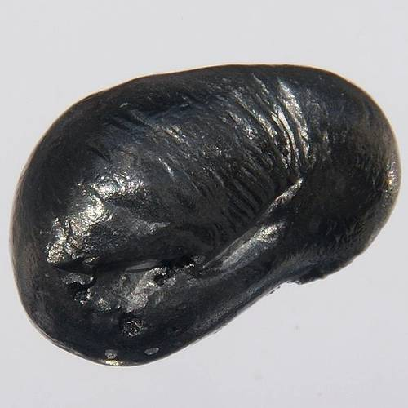
Lesson 1. Classification of Matter
© 2013 E3 Scholastic Publishing. All Rights Reserved E3hemistry.com SurvivingChem.com
Types of Matter
Pure Substances
beryllium water
Pure Substances are types of matter that are:
● composed of particles that are the same in all samples
● elements and compounds
Previous Concept
Next Concept
1
2
3
4
5
HOME
Lessons

Slide 6
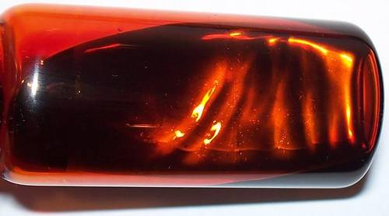
Lesson 1. Classification of Matter
© 2013 E3 Scholastic Publishing. All Rights Reserved E3hemistry.com SurvivingChem.com
Types of Matter
Elements
Elements are pure substances with the following characteristics:
● composed of atoms of identical atoms (same atomic #)
● cannot be broken down by physical nor chemical processes
● can be found on the
Be (beryllium ) Au (gold) Br (bromine)
Periodic Table of the Elements
Previous Concept
PoPuP Quiz #1
Next Concept
1
2
3
4
5
HOME
Lessons

Slide 7
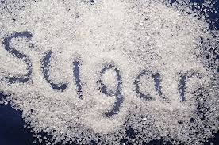
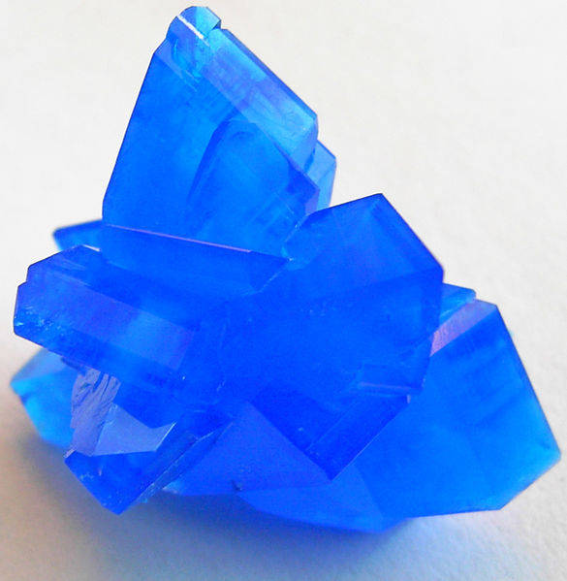
Lesson 1. Classification of Matter
© 2013 E3 Scholastic Publishing. All Rights Reserved E3hemistry.com SurvivingChem.com
Types of Matter
Compounds
Compounds are pure substances with the following characteristics:
● composed of two or more different chemically combined elements
● ratio of elements (composition) of a compound is fixed (unchanging)
● can be broken down by chemical processes (chemical reactions)
● properties are different from those of its elements
H₂O (water) C₆H₁₂O₆ CuSO₄ copper sulfate
Previous Concept
PoPuP Quiz #2
Next Concept
1
2
3
4
5
HOME
Lessons

Slide 8
Lesson 1. Classification of Matter
© 2013 E3 Scholastic Publishing. All Rights Reserved E3hemistry.com SurvivingChem.com
Types of Matter
Law of definite composition states:
Elements in a compound are combined in a fixed and definite proportion (ratio) by mass.
Example:
Mass percentages in every sample of water is 89% O and 11% H.
Therefore, any 10-gram sample of water contains 8.9 g O and 1.1 g H.
Previous Concept
PoPuP Quiz #3
Next Concept
1
2
3
4
5
HOME
Lessons

Slide 9
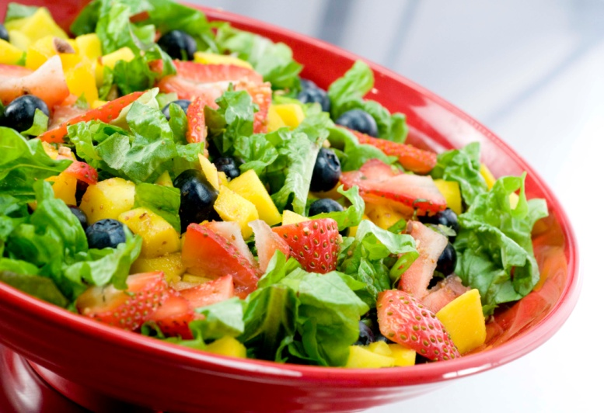
Lesson 1. Classification of Matter
Types of Matter
Mixtures
Mixtures are types of matter with the following characteristics:
● composed of two or more different physically combined substances
● ratio of substances (composition) of a mixture can vary
● can be separated through physical processes
● properties of individual substances are retained in a mixture
● can be homogeneous or heterogeneous
Previous Concept
Next Concept
1
2
3
4
5
HOME
Lessons

Slide 10
Lesson 1. Classification of Matter
© 2013 E3 Scholastic Publishing. All Rights Reserved E3hemistry.com SurvivingChem.com
Types of Matter
Homogeneous mixtures
Homogeneous mixtures have the following characteristics:
● substances are evenly and uniformly mixed throughout
● definite and fixed composition in all samples of the same mixture
● Aqueous solutions are homogeneous mixtures made with water
Aqueous solution is further discussed in
Topic 7
Previous Concept
Next Concept
1
2
3
4
5
HOME
Lessons

Slide 11
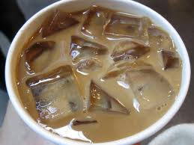
Lesson 1. Classification of Matter
© 2013 E3 Scholastic Publishing. All Rights Reserved E3hemistry.com SurvivingChem.com
Types of Matter
Heterogeneous mixtures
Heterogeneous mixtures have the following characteristics:
● substances are unevenly (not uniformly ) mixed throughout
● samples from the same mixture have compositions than can vary
Previous Concept
PoPuP Quiz #4
Next Concept
1
2
3
4
5
HOME
Lessons

Slide 12
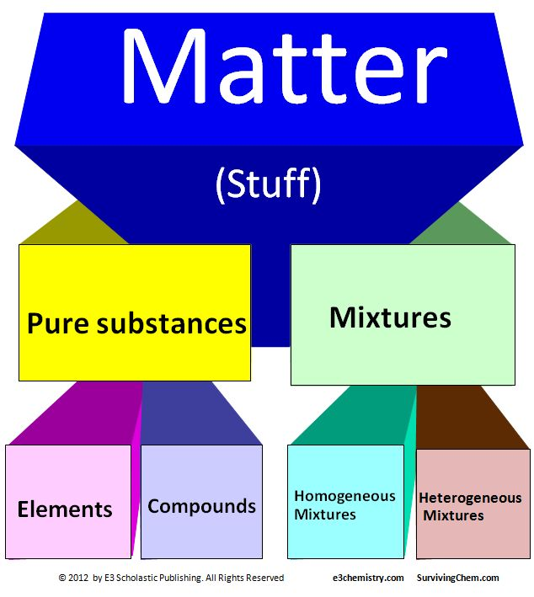
Lesson 1. Classification of Matter
© 2013 E3 Scholastic Publishing. All Rights Reserved E3hemistry.com SurvivingChem.com
Summary Diagram
Previous Concept
Next Concept
1
2
3
4
5
HOME
Lessons

Slide 13
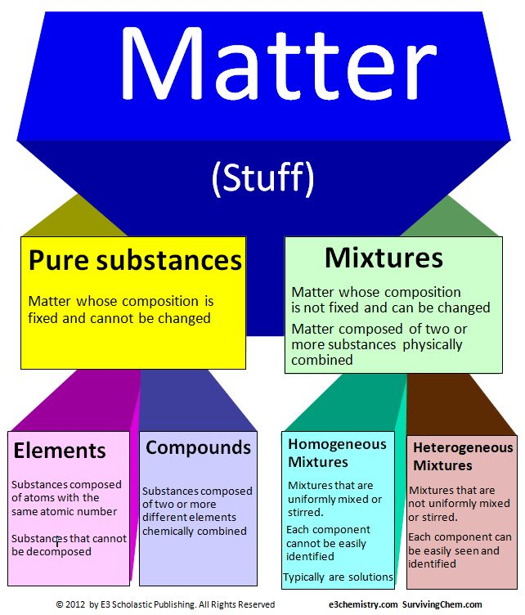
Lesson 1. Classification of Matter
© 2013 E3 Scholastic Publishing. All Rights Reserved E3hemistry.com SurvivingChem.com
Summary diagram with details
Previous Concept
Next Concept
1
2
3
4
5
HOME
Lessons

Slide 14
Lesson 1. Classification of Matter
© 2013 E3 Scholastic Publishing. All Rights Reserved E3hemistry.com SurvivingChem.com
Formula Representations of Matter
Types of Matter Example formulas
Elements K(s) Hg (l) Cl₂(g)
Compounds KClO₃(s) NH₃(l) CO(g)
Mixtures KClO₃(aq) NH₃(aq) CO(aq)
Previous Concept
Next Concept
1
2
3
4
5
HOME
Lessons

Slide 15
Lesson 1. Classification of Matter
© 2013 E3 Scholastic Publishing. All Rights Reserved E3hemistry.com SurvivingChem.com
Diagram Representations of Matter
atom X atom Y
Atoms
monatomic element X
diatomic element Y₂
Elements
compound XY
compound X₂Y
Compounds
mixture of X and XY
mixture of Y₂ and X₂Y
Mixtures
Previous Concept
Show Diagrams
Show element
Show compound
Hide element
Hide compound
Next Concept
1
2
3
4
5
HOME
Lessons

Slide 16
Lesson 1. Classification of Matter
© 2013 E3 Scholastic Publishing. All Rights Reserved E3hemistry.com SurvivingChem.com
Separation of Mixtures
● various physical methods can be used to separate substances of a mixture
● methods used depend on the physical characteristics of the substances and
mixture
Previous Concept
Next Concept
1
2
3
4
5
HOME
Lessons

Slide 17
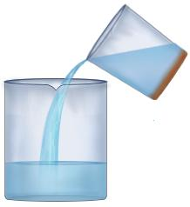
Lesson 1. Classification of Matter
© 2013 E3 Scholastic Publishing. All Rights Reserved E3hemistry.com SurvivingChem.com
Separating Heterogeneous Mixtures
Decantation
A technique used for separating mixtures that have formed liquid layers
mixture
solid layer
● the top liquid or aqueous layer is poured off
● the other components are left behind
Previous Concept
Next Concept
1
2
3
4
5
HOME
Lessons

Slide 18
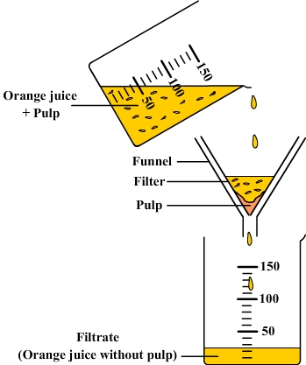
Lesson 1. Classification of Matter
© 2013 E3 Scholastic Publishing. All Rights Reserved E3hemistry.com SurvivingChem.com
Separating Heterogeneous Mixtures
Filtration
A technique for separating liquid mixtures containing undissolved (large) particles
● small particle components (liquid or aqueous) of the mixture filter through
● large particle components (solid) of the mixture stay on the filter paper
Previous Concept
Next Concept
1
2
3
4
5
HOME
Lessons

Slide 19
Lesson 1. Classification of Matter
© 2013 E3 Scholastic Publishing. All Rights Reserved E3hemistry.com SurvivingChem.com
Separating Homogeneous Mixtures
Three common physical methods
Evaporation
Distillation
Chromatography
Previous Concept
Next Concept
1
2
3
4
5
HOME
Lessons

Slide 20
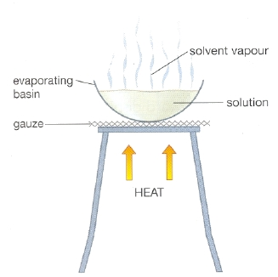
Lesson 1. Classification of Matter
© 2013 E3 Scholastic Publishing. All Rights Reserved E3hemistry.com SurvivingChem.com
Separating Homogeneous Mixtures
Evaporation
a technique used for recovering the solid component of an aqueous mixture (solution)
● gas or vapor is allowed to escape the mixture
● the solid components are left behind to re-crystallize
Previous Concept
Next Concept
1
2
3
4
5
HOME
Lessons

Slide 21
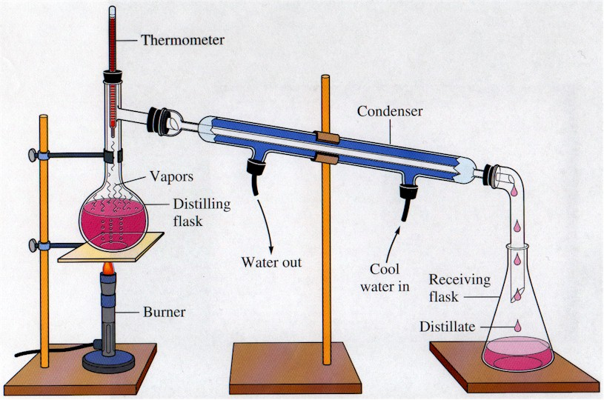
Lesson 1. Classification of Matter
Separating Homogeneous Mixtures
Distillation
a boiling technique used for separating and collecting all components of an aqueous solution
In A simple distillation apparatus
● a mixture is heated
● the liquid is evaporated, the vapor is condensed and collected
● the solid components are left behind to re-crystallize
© 2013 E3 Scholastic Publishing. All Rights Reserved E3hemistry.com SurvivingChem.com
Previous Concept
PoPuP Quiz #5
Next Concept
1
2
3
4
5
HOME
Lessons

Slide 22
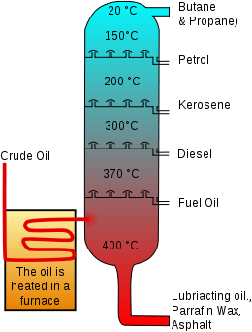
Lesson 1. Classification of Matter
Separating Homogeneous Mixtures
Distillation
In a crude oil (fractional) distillation system
● crude oil (a mixture of hydrocarbons) is heated
● fuels boil out of the mixture as their boiling point is reached
● fuels are collected in the column in order from lowest to highest boiling point
© 2013 E3 Scholastic Publishing. All Rights Reserved E3hemistry.com SurvivingChem.com
distillation column
Previous Concept
Next Concept
1
2
3
4
5
HOME
Lessons

Slide 23
Lesson 1. Classification of Matter
Separating Homogeneous Mixtures
Chromatography
a process of separating mixtures in other to purify, identify, analyze and/or quantify the
components
In Paper Chromatography
● a spot is made on a chromatography (filter) paper with a pigment or ink mixture
● the bottom tip of the paper is place in a solvent (water, alcohol..etc)
● the solvent travels up the filter paper and dissolves the mixture
● components of the mixture are carried upward by the solvent
● components separated as colored blots at different places on the paper
© 2013 E3 Scholastic Publishing. All Rights Reserved E3hemistry.com SurvivingChem.com
filter paper
blots
mixture spots
Three different mixtures
Previous Concept
Next Concept
1
2
3
4
5
HOME
Lessons

Slide 24
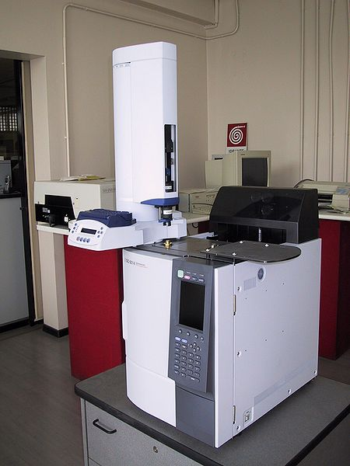
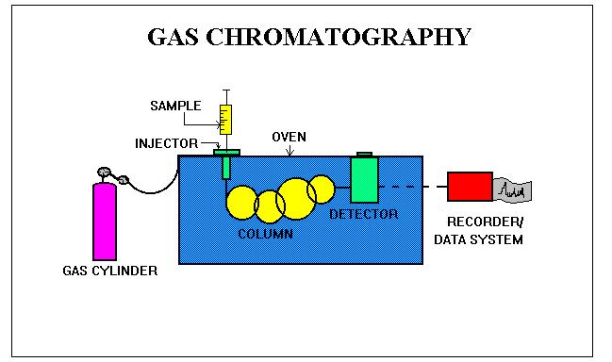
Lesson 1. Classification of Matter
Separating Homogeneous Mixtures
Chromatography
In Gas Chromatography
● a small sample of a gas mixture is injected into a GS machine
● the sample travels through series of columns
● substances of the mixture are carried through the columns at different speeds
● data machine detects and records information on the different substances
© 2013 E3 Scholastic Publishing. All Rights Reserved E3hemistry.com SurvivingChem.com
Previous Concept
Next Concept
1
2
3
4
5
HOME
Lessons

Slide 25
Lesson 2. Phases of Matter
© 2013 E3 Scholastic Publishing. All Rights Reserved E3hemistry.com SurvivingChem.com
Index of Concepts
Introduction
Phase Change Diagrams
Solid
Heating Curve
Liquid
Cooling Curve
Gas
Practice Problems
Temperature Unit Conversion
Formula and Diagram Representations of Phases
Phase Changes of Matter
Printable for Students
Phase Changes and Energy
Summary Diagram of Phase Changes and Energy
PoPuP Quiz
Phase Changes and Temperature
Temperature – kinetic Energy relationship
Thermometer
Units of Temperature and Conversions
Important Temperature Points
Previous Concept
Next Concept
1
2
3
4
5
HOME
Lessons

Slide 26
Lesson 2. Phases of Matter
© 2013 E3 Scholastic Publishing. All Rights Reserved E3hemistry.com SurvivingChem.com
Introduction
There are three major phases of matter:
Solid
Liquid
Gas
Previous Concept
Next Concept
1
2
3
4
5
HOME
Lessons

Slide 27
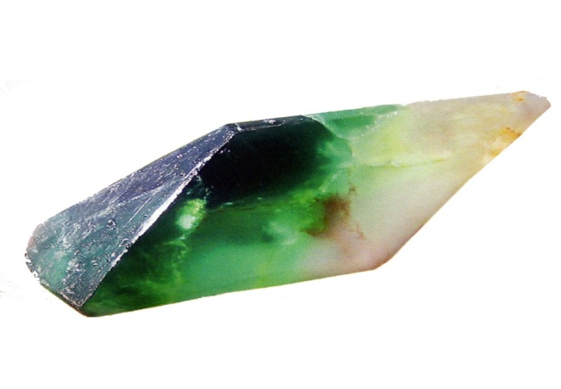
Lesson 2. Phases of Matter
© 2013 E3 Scholastic Publishing. All Rights Reserved E3hemistry.com SurvivingChem.com
Solid
a phase of matter with definite volume and definite shape
In a solid phase:
● particles are orderly arranged in a regular geometric pattern
● particles vibrate around fixed points
● particles have strong attractive forces to one another
● particles cannot be easily compressed (incompressible)
The Three Phases
Previous Concept
Next Concept
1
2
3
4
5
HOME
Lessons

Slide 28
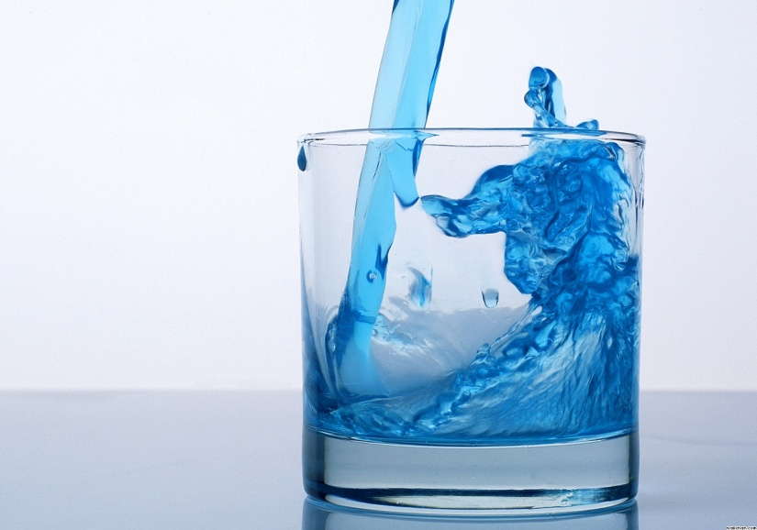
Lesson 2. Phases of Matter
© 2013 E3 Scholastic Publishing. All Rights Reserved E3hemistry.com SurvivingChem.com
Liquid
a phase of matter with definite volume but no definite shape
In a liquid phase:
● a substance takes the shape of its container
● particles flow over each other
● particles cannot be easily compressed (incompressible)
The Three Phases
Previous Concept
Next Concept
1
2
3
4
5
HOME
Lessons

Slide 29
Lesson 2. Phases of Matter
© 2013 E3 Scholastic Publishing. All Rights Reserved E3hemistry.com SurvivingChem.com
Gas
a phase of matter with no definite volume and no definite shape
In a gas phase:
● a substance takes the volume and shape of its container
● particles are less orderly arranged (most random)
● particles move fast and freely
● particles have very weak attractive forces to each other
● particles can be easily compressed (compressible)
The Three Phases
Iodine gas
I₂(g)
Previous Concept
Next Concept
1
2
3
4
5
HOME
Lessons

Slide 30
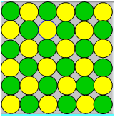
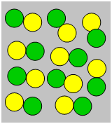
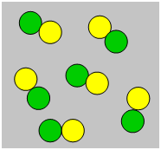
Lesson 2. Phases of Matter
© 2013 E3 Scholastic Publishing. All Rights Reserved E3hemistry.com SurvivingChem.com
Formula and Diagram Representations of Phases
Substance XY is represented in the three phases.
Solid Liquid Gas
Formulas XY(s) XY(l) XY(g)
Diagrams
Previous Concept
restore diagram
Next Concept
1
2
3
4
5
HOME
animated diagram
Lessons

Slide 31
Lesson 2. Phases of Matter
© 2013 E3 Scholastic Publishing. All Rights Reserved E3hemistry.com SurvivingChem.com
Phase Changes of Matter
Given the right conditions of temperature and/or pressure, a substance can change from one phase to another.
Melting (fusion) is a change from solid to liquid. H₂O(s) ------> H₂O(l)
Freezing is a change from liquid to solid H₂O(l) -----> H₂O(s)
Evaporation is a change from liquid to gas C₂H₅OH(l) -----> C₂H₅OH(g)
Condensation is a change from gas to liquid C₂H₅OH(g) -----> C₂HOH(l)
Deposition is a change from gas to solid CO₂(g) -----> CO₂(s)
Sublimation is a change from solid to gas CO₂(s) -----> CO₂(g
Previous Concept
PoPuP Quiz #6- 7
Next Concept
1
2
3
4
5
HOME
Lessons

Slide 32
Lesson 2. Phases of Matter
© 2013 E3 Scholastic Publishing. All Rights Reserved E3hemistry.com SurvivingChem.com
Phase Changes and Energy
A substance changes phase when it has absorbed or released enough energy to rearrange its particles.
Endothermic describes a process that absorbs heat (thermal) energy.
melting, evaporation, and sublimation are endothermic phase changes
Exothermic describes a process that releases heat (thermal) energy.
freezing, condensation, and deposition are exothermic phase changes
Previous Concept
Next Concept
1
2
3
4
5
HOME
Lessons

Slide 33
Lesson 2. Phases of Matter
© 2013 E3 Scholastic Publishing. All Rights Reserved E3hemistry.com SurvivingChem.com
Summary Diagram of Phase Changes and Energy
Previous Concept
PoPuP Quiz #8
Next Concept
1
2
3
4
5
HOME
Lessons

Slide 34
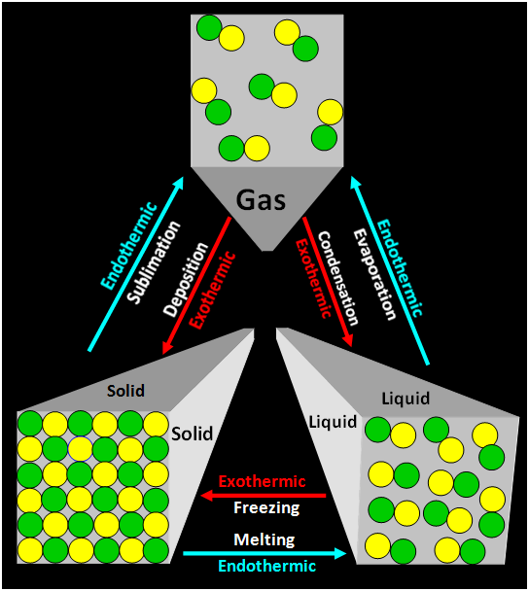
Lesson 2. Phases of Matter
© 2013 E3 Scholastic Publishing. All Rights Reserved E3hemistry.com SurvivingChem.com
Summary Diagram of Phase Changes and Energy
Alternate diagram
Previous Concept
Next Concept
1
2
3
4
5
HOME
Lessons

Slide 35
Lesson 2. Phases of Matter
© 2013 E3 Scholastic Publishing. All Rights Reserved E3hemistry.com SurvivingChem.com
Phase Changes and Temperature
Temperature
● a measure of the average kinetic energy of particles in matter
Kinetic Energy (KE)
● energy due to motions of particles in matter
● as average kinetic energy increases, so does temperature
Kinetic Energy
30ºC 35ºC
Slower moving particles Faster moving particles
Lower kinetic energy Higher kinetic Energy
Lower temperature Higher temperature
Temperature
Previous Concept
Show Diagrams
PoPuP Quiz #9
Next Concept
1
2
3
4
5
HOME
Lessons

Slide 36
Lesson 2. Phases of Matter
© 2013 E3 Scholastic Publishing. All Rights Reserved E3hemistry.com SurvivingChem.com
Phase Changes and Temperature
Thermometer
a piece of equipment used for measuring temperature
Units of Temperature and Conversions
Kelvin (K) , degree Celsius (ºC ), and degree Fahrenheit (ºF ) are the three most common units for measuring temperature
K = ºC + 273
9
°F = °C x ---- + 32
5
5
K = (°F + 459.67 ) x ---
9
Previous Concept
Practice Problem Set A
Next Concept
1
2
3
4
5
HOME
Lessons

Slide 37
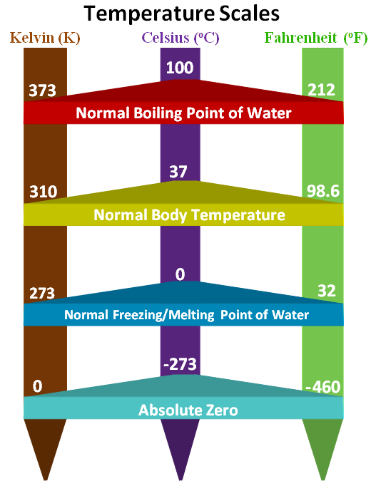
Lesson 2. Phases of Matter
© 2013 E3 Scholastic Publishing. All Rights Reserved E3hemistry.com SurvivingChem.com
Important Temperature Points
Absolute Zero
the temperature at which all molecular movements stop
Previous Concept
PoPuP Quiz #10
Next Concept
1
2
3
4
5
HOME
Lessons

Slide 38
Lesson 2. Phases of Matter
© 2013 E3 Scholastic Publishing. All Rights Reserved E3hemistry.com SurvivingChem.com
Phase Change Diagrams
Phase change diagram
A diagram showing the relationship between temperature and phase changes of a substance over time.
Heating Curve
A diagram showing a change of a substance starting with the substance as a solid.
Cooling Curve
A diagram showing a change of a substance starting with the substance as a gas.
Previous Concept
Next Concept
1
2
3
4
5
HOME
Lessons

Slide 39
Lesson 2. Phases of Matter
Phase Change Diagrams
© 2013 E3 Scholastic Publishing. All Rights Reserved E3hemistry.com SurvivingChem.com
Heating Curve
F
150 -
100 - -------------------------------------------------------------
0 - ----------------------
-5
liquid-gas
gas
Boiling Point (BP)
Temperature (ºC)
D
Boiling
E
liquid
Melting Point (MP)
solid-liquid
B
Melting
C
solid
A
0 2 4 6 8 10 12 14 16 18 20 22 24 26 28 30 32 34 36 38 40 TIME (minutes)
Previous Concept
Next Concept
1
2
3
4
5
HOME
Lessons

Slide 40
Lesson 2. Phases of Matter
During Segments AB, CD and EF
● One phase is present
● Temperature increases
● Kinetic energy increases
● Potential energy remains constant
During Segments BC and DE
● Two phases are present
● Temperature remains constant
● Kinetic energy remains constant
● Potential energy increases
© 2013 E3 Scholastic Publishing. All Rights Reserved E3hemistry.com SurvivingChem.com
Heating Curve
F
150 -
100 - -------------------------------------------------------------
0 - ----------------------
-5
Boiling Point (BP)
liquid-gas
gas
Temperature (ºC)
D
Boiling
E
liquid
Melting Point (MP)
solid-liquid
B
Melting
C
solid
A
0 2 4 6 8 10 12 14 16 18 20 22 24 26 28 30 32 34 36 38 40 TIME (minutes)
Previous Concept
Next Concept
1
2
3
4
5
HOME
Lessons

Slide 41
Lesson 2. Phases of Matter
Phase Change Diagrams
© 2013 E3 Scholastic Publishing. All Rights Reserved E3hemistry.com SurvivingChem.com
Cooling Curve
120 -
80 ------------
20 ------------------------------------------------------------------
12
A
gas
Temperature (ºC)
gas - liquid
condensation
BP
B
C
liquid
Freezing point
liquid-solid
D
freezing
E
solid
F
0 1 2 3 4 5 6 7 8 9 10 11 12 13 14 15 16 20 21 22 23 24 25
TIME (minutes)
Previous Concept
PoPuP Quiz #11
Next Concept
1
2
3
4
5
HOME
Lessons

Slide 42
Lesson 2. Phases of Matter
During segments AB, CD and EF
● One phase is present
● Temperature decreases
● Kinetic energy decreases
● Potential energy remains constant
During segments BC and DE
● Two phases are present
● Temperature remains constant
● Kinetic energy remains constant
● Potential energy remains decreases
© 2013 E3 Scholastic Publishing. All Rights Reserved E3hemistry.com SurvivingChem.com
Cooling Curve
120 -
80 ------------
20 ------------------------------------------------------------------
12
A
gas
Temperature (ºC)
gas - liquid
condensation
BP
B
C
liquid
Freezing point
liquid-solid
D
freezing
E
solid
F
0 1 2 3 4 5 6 7 8 9 10 11 12 13 14 15 16 20 21 22 23 24 25
TIME (minutes)
Previous Concept
Next Concept
1
2
3
4
5
HOME
Lessons

Slide 43
Lesson 3. Heat and Heat Calculations
© 2013 E3 Scholastic Publishing. All Rights Reserved E3hemistry.com SurvivingChem.com
Index of Concepts (This Lesson is not available in the preview)
Buy & Download the Complete Topic 1
Introduction
Practice Problems
Heat
Thermal energy
Units of heat conversion
Thermodynamics
Heat calculations
Exothermic
Printable for Students
Endothermic
Direction of heat flow
PoPuP Quiz
Units of Heat and Conversions
Heat Constants
Heat Equations
Specific heat capacity
Heat of fusion
Heat of vaporization
Previous Concept
Next Concept
1
2
3
4
5
HOME
Lessons

Slide 44
Lesson 4. Gas Characteristics and Gas Laws
© 2013 E3 Scholastic Publishing. All Rights Reserved E3hemistry.com SurvivingChem.com
Index of Concepts (This Lesson is not available in the preview)
Buy & Download the Complete Topic 1
Introduction
Boyle’s Law
Pressure
Charles’ Law
Volume
Gay-Lussac’s Law
Temperature
Combined Gas Law
STP: Standard Temperature and Pressure
Kinetic Molecular Theory of Ideal Gas
Practice Problems
Units of Pressure Conversions
Ideal gas
Real gases
Units of Volume Conversions
Deviation from Ideal Gas
Partial Pressure Calculations
Avogadro’s Law
Gas Law Calculations
Partial Pressure Laws
Printable for Students
Dalton’s Law of Partial Pressure
PoPuP Quiz
Partial Pressure when a Gas is Collected over Water
Partial Pressure from Mole Fractions
Previous Concept
Next Concept
1
2
3
4
5
HOME
Lessons

Slide 45
Lesson 5. Physical and Chemical Properties
© 2013 E3 Scholastic Publishing. All Rights Reserved E3hemistry.com SurvivingChem.com
Index of Concepts (This Lesson is not available in the preview)
Buy & Download the Complete Topic 1
Introduction
Properties
Physical Properties
Physical changes
Chemical Properties
Chemical Changes
Diagram Representations of Changes
Previous Concept
Next Concept
1
2
3
4
5
HOME
Lessons

Slide 46
Practice Problems
© 2013 E3 Scholastic Publishing. All Rights Reserved E3hemistry.com SurvivingChem.com
You can use these questions to show your students how to setup and solve math related problems, as well as problems that involve writing equations, formulas, and drawing diagrams.
Solutions to practice problems are worked out so they are easy to follow.
The next three slides list all the practice problems in this topic.
The zip file (available only in purchase product) includes a Microsoft Word document of all the practice problems. You can print and hand it out to your students so they won’t have to waste time writing down the questions.
Hundreds additional organized and engaging practice questions for this topic is available in the corresponding topic of my Workbook and Guided Study Book. Available in my stores on both TpT and Teachers Notebook.
TpT Store
Worksheet
Multiple choices
Guided Reading & Questions
Topic Bundle
Teachers Notebook
Worksheet
Multiple choices
Guided Reading & Questions
Topic Bundle
Previous Concept
Next Concept
1
2
3
4
5
HOME
Lessons

Slide 47
Practice Problems: Printable for Students
© 2013 E3 Scholastic Publishing. All Rights Reserved E3hemistry.com SurvivingChem.com
Topic 1: Matter and Energy Practice Problem Sets:
Lesson 2 Set A: Units of Temperature Conversions
1. What is 150 K in Celsius?
2. What is 80ºC in Fahrenheit?
3. What is 50ºF in Kelvin?
Lesson 3 Set B: Units of Heat Conversions (solutions not available in the preview)
1. What is 214 calories in kilocalories?
2. What is 23.4 kilojoules in joules?
3. What is 54 calories in joules?
4. What is 680 joules in kilocalories?
Lesson 3 Set C: Heat Calculations (solutions not available in the preview)
1. How much heat is released by the 10-gram sample of water to change from 25ºC to 22ºC?
2. How much heat is absorbed by the 5-gram sample of water to melt at its melting point?
3. How much heat is released by the 5-grams sample of vapor to condensed at 100ºC?
4. What is the heat of vaporization of a an unknown liquid if 3850 Joules is required to completely vaporize
a 3-gram sample at its boiling point?
Previous Concept
Next Concept
1
2
3
4
5
HOME
Lessons

Slide 48
Lesson 2. Phases of Matter
© 2013 E3 Scholastic Publishing. All Rights Reserved E3hemistry.com SurvivingChem.com
Practice Problems Set A: Units of Temperature Conversions
1. What is 150 K in Celsius?
2. What is 80ºC in Fahrenheit?
3. What is 50ºF in Kelvin?
K = ºC + 273
ºC = K - 273
ºC = 150 - 273 = -123ºC
9
°F = °C x ---- + 32
5
9
°F = 80 x ---- + 32 = 176 °F
5
5
K = (°F + 459.67 ) x ----
9
5
K = (50 + 459.67) x ---- = 283.15 K
9
Show #1
Hide #1
Show #2
Hide #2
Show #3
Hide #3
Back to Concept
Solutions & Answers
Next Problems
1
2
3
4
5
HOME
Lessons

Slide 49
PoPuP Quiz
These are questions you can bring up to your students as you cover the the different concepts. A PoPuP quiz question may be directly or indirectly related to the concept.
PoPuP quiz questions present the opportunity to make real world connections to the concept you are teaching.
You can ask students these questions as you go through the notes, or after you finish a lesson. The choice is yours.
The next three slides list all the popup quiz questions in this topic.
The zip file (available only in purchase product) includes a Microsoft Word document of all the quiz questions. You can print and hand it out to your students so they won’t have to waste time writing down the questions
Back
Go to Question List
1
2
3
4
5
HOME
Lessons

Slide 50
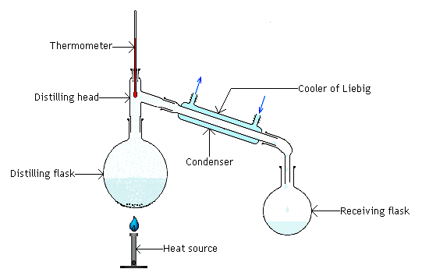
PoPuP Quiz: Printable for Students
Lesson 1: Classification of Matter questions
What are the three types of elements?
State one difference between a compound and an element.
Your teacher stopped at the water fountain before getting to your class and gulped down 53 grams of
water. Assuming your school water is pure:
How many grams of hydrogen did he take in?
How many grams of oxygen did he take in?
4. State one similarity between a mixture and compound.
5. A distillation apparatus shown below was setup to recover sea salt from a sample of seawater.
Identify the equipment (by name) in which all of the salt crystals would be found at the completion of
the distillation process.
Back
Next Question List
1
2
3
4
5
HOME
Lessons

Slide 51
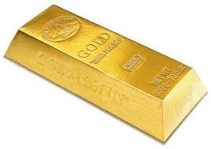
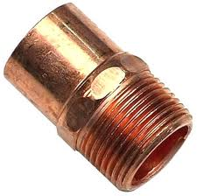
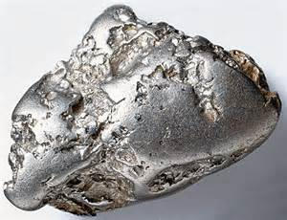
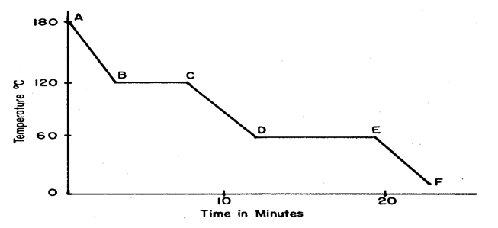
PoPuP Quiz: Printable for Students
Lesson 2: Phases of matter questions.
What is the common name for solid carbon dioxide, CO₂(s).
What is solid carbon dioxide, CO₂(s), commonly used for during natural disaster and power emergencies?
8. In terms of energy, explain why you would get seriously if you place your hand over steam of boiling water.
9. Arrange the three metals below in order from lowest kinetic energy to highest kinetic energy
10. If you were given a blank thermometer. Describe how you would create an accurate Kelvin thermometer
11 . Given the phase change diagram below:
Is the substance represented by the diagram water? Explain your answer using information from the diagram.
75ºF 25ºC 296 K
Platinum gold copper
Last Question List
Next Question List
1
2
3
4
5
HOME
Lessons

Slide 52
Lesson 1. PoPuP Quiz
1.
What are the three types of elements?
metals, nonmetals, metalloids
Back to Concept
Previous Question
Answer
Next Question
1
2
3
4
5
HOME
Lessons

Slide 53
Lesson 1. PoPuP Quiz
2.
State one difference between a compound and an element
a compound can be broken down
an element cannot be broken down
a compound is composed of two or more different atoms
an element is composed of one type of atom
Back to Concept
Previous Question
Answer
Next Question
1
2
3
4
5
HOME
Lessons

Slide 54
Lesson 1. PoPuP Quiz
3.
Your teacher stopped at the water fountain before getting to your class and gulped down 53 grams of water. Assuming your school water is pure:
How many grams of hydrogen did he take in?
How many grams of oxygen did he take in?
5.83 grams H
47.17 grams O
Back to Concept
Previous Question
Answer
Next Question
1
2
3
4
5
HOME
Lessons

Slide 55
Lesson 1. PoPuP Quiz
4.
Explain, in terms of composition, why a pepperoni pizza is a heterogeneous mixture.
Equal slices of the same pizza will not have exactly the same amounts of the ingredients.
Components of the pizza can easily be seen and identified
Back to Concept
Previous Question
Answer
Next Question
1
2
3
4
5
HOME
Lessons

Slide 56
Lesson 1. PoPuP Quiz
5.
A distillation apparatus shown below was setup to recover sea salt from a sample of seawater.
Identify the equipment (by name) in which all of the salt crystals would be found at the completion of the distillation process.
Distilling flask
Back to Concept
Previous Question
Answer
Next Question
1
2
3
4
5
HOME
Lessons

Slide 57
Lesson 2. PoPuP Quiz
6.
What is the common name for solid carbon dioxide, CO₂(s) ?
Dry ice
What is solid carbon dioxide, CO₂(s) , commonly used for during natural disaster and power emergencies?
7.
To keep food items cold and from spoiling during power outages
Back to Concept
Previous Question
Answer
Next Question
1
2
3
4
5
HOME
Lessons

Slide 58
Lesson 2. PoPuP Quiz
8.
In terms of energy, explain why you would get seriously burned if you place your hand over steam of boiling water.
Steam will release energy as it condenses on your hand. Since steam packs a lot of energy, all that energy is released on your hand.
It is the energy that is released by steam that will burn you.
Back to Concept
Previous Question
Answer
Next Question
1
2
3
4
5
HOME
Lessons

Slide 59
Lesson 2. PoPuP Quiz
9.
Arrange the three metals below in order from lowest kinetic energy to highest kinetic energy.
75ºF 25ºC 296 K
Platinum gold copper
copper platinum gold
Back to Concept
Previous Question
Answer
Next Question
1
2
3
4
5
HOME
Lessons

Slide 60
Lesson 2. PoPuP Quiz
10.
If you were given a blank thermometer as shown below,
describe how you would create an accurate Kelvin thermometer.
373 K
273 K
Establish two reference points on the thermometer using the freezing and boiling points of water (273K and 373K).
Divide the space between the two numbers evenly
--
-
-
-
-
-
-
-
-
353
333
313
293
Back to Concept
Previous Question
Answer
Next Question
1
2
3
4
5
HOME
Lessons

Slide 61
Lesson 2. Popup Quiz
11.
Given the phase change diagram below:
Is the substance represented by the diagram water? Explain your answer using information from the diagram.
No. The freezing point (60ºC) and boiling point (120ºC) are different from those of water (0ºC and 100ºC respectively)
Back to Concept
Answer
Next Question
1
2
3
4
5
HOME
Lessons

Slide 62
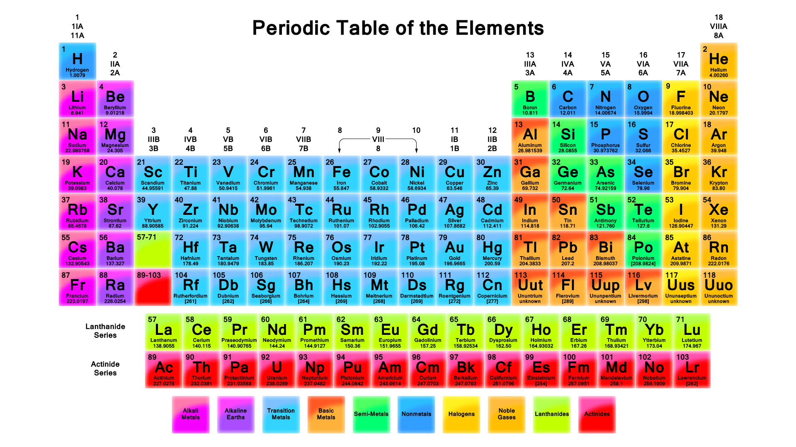
Back to Concept
Next Concept
1
2
3
4
5
HOME
Lessons

Slide 63
Important Information
Thanks for previewing or purchasing my product. Your interest in my products is greatly appreciated.
If you come across any issues that you would like to bring to my attention, please do so through the contact page of the site you are on, or email me at e3chemistry@gmail.com . I will edit the information , contact you, and you’ll be able to re-download the revised note for free.
I thank you in advance .
Effie
Back
HOME
1
2
3
4
5
HOME
Lessons

Slide 64
Lesson 3. Heat and Heat Calculations
© 2013 E3 Scholastic Publishing. All Rights Reserved E3hemistry.com SurvivingChem.com
Practice Problems Set C: Heat Calculations
How much heat is released by a 5-gram sample
of water to change from 25ºC to 22ºC?
2. How much heat is absorbed by a 5-gram sample of water to melt at its melting point?
3. How much heat is released by a 5-grams sample
of vapor to condense at 100ºC?
What is the heat of vaporization of a an unknown liquid if 3850 Joules is required to completely vaporize a 3-gram sample at its boiling point?
Heat (q) = mass x C x ∆T
Heat (q) = 5 g x 4.18 J/g.K x 3 K
Heat (q) = 62.7 J
Heat (q) = mass x Hf
Heat (q) = 5 g x 334 J/g Heat (q) = 1670 J
Heat (q) = mass x Hv
Heat (q) = 5 g x 2260 J/g
Heat (q) = 11300 J
Heat (q) = mass x Hv
Heat 3850 J
Hv = ------- = --------- = 1283.3 J/g
mass 3 g
Show #1
Hide #1
Show #2
Hide #2
Show #3
Back to Concept
Hide #3
Previous Problems
Solutions & Answers
Next Problems
1
2
3
4
5
HOME
Lessons

